Slide 1
NACDD
Policy Update
December 2
Erin Prangley, Director, Public Policy
National Association of Councils on Developmental Disabilities

Slide 2
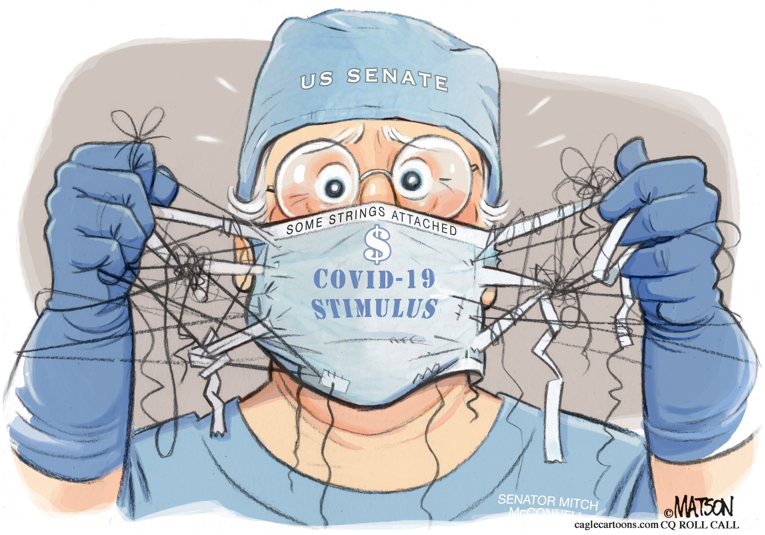
UPDATES
COVID Relief and Appropriations.
NACDD on home-and-community-based services (HCBS)
NACDD has joined the Disability and Aging Collaborative (DAC) in advocating for robust, meaningful, publicly reported home-and-community-based services (HCBS) quality measures in Medicaid.
To read the full letter, click here.
NACDD on the National Council on Disability
NACDD provided comments on a report to the by the National Council on Disability (NCD) on COVID-19 and the Impact on People with Disabilities which is expected to be released in 2021. To read the full letter, click here.
More updates at https://www.nacdd.org/policy/

Slide 3

VACCINE RESOURCES
CCD Vaccine Allocation Priorities (NACDD) at
http://c-c-d.org/fichiers/CCD-Vaccine-Allocation-Principles-October-2020.pdf
AUCD FAQ: COVID-19 Vaccine Distribution Considerations for the Disability Community at https://www.aucd.org/template/news.cfm?news_id=15111&parent=16&parent_title=Home&url=/template/index.cfm
CCD Letter to COVID Transition Team http://www.c-c-d.org/fichiers/CCD-Letter-to-COVID19-taskforce-final-11-20-20.pdf
Vaccine Allocation. Center for Public Representation https://medicaid.publicrep.org/feature/covid-19-vaccine-allocation/

Slide 4
NACDD Public Policy Committee Meeting
Thursday, December 3, 2pm Eastern/11am Pacific
Join Zoom Meeting
https://us02web.zoom.us/j/82156490017?pwd=RXdDckIwUkxuMGo3dkovOW1LWllVZz09
One tap mobile +13017158592,,82156490017#,,1#,465609# US
Appropriations and COVID Relief | 117th Public Policy Priorities
Task Forces Updates
State Budget Emergency
Emergency Medicaid Waivers
Medicaid in the Territories Task Force

