Slide 1
Thriving As A Youth Advocate
Presented By: Matthew Shapiro

Slide 2


Leadership Training Programs that Contribute to Becoming
Self-Determined

Slide 3
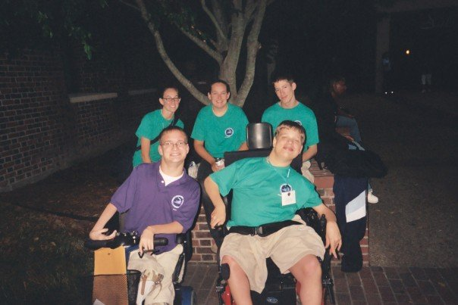
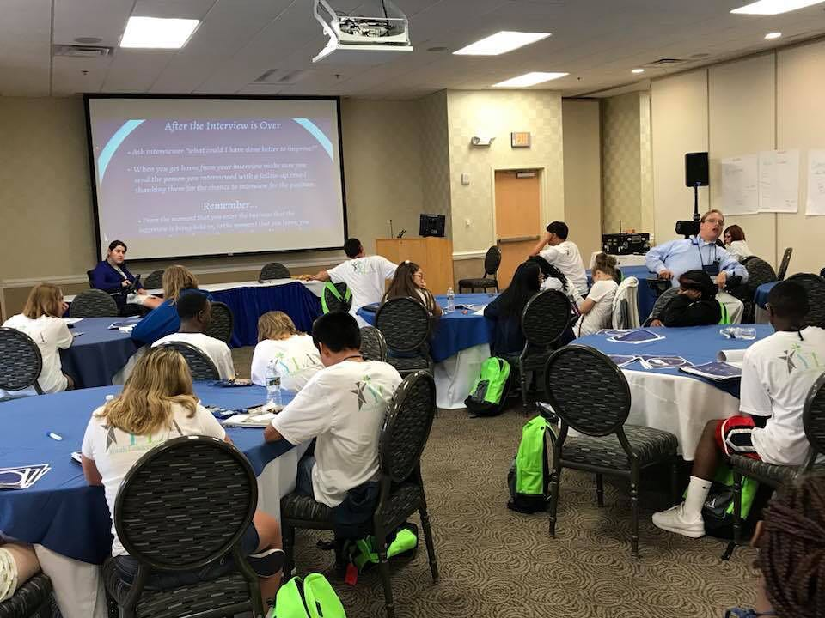
My YLF/YLA Experience- The Start of a Life Altering Journey

Slide 4
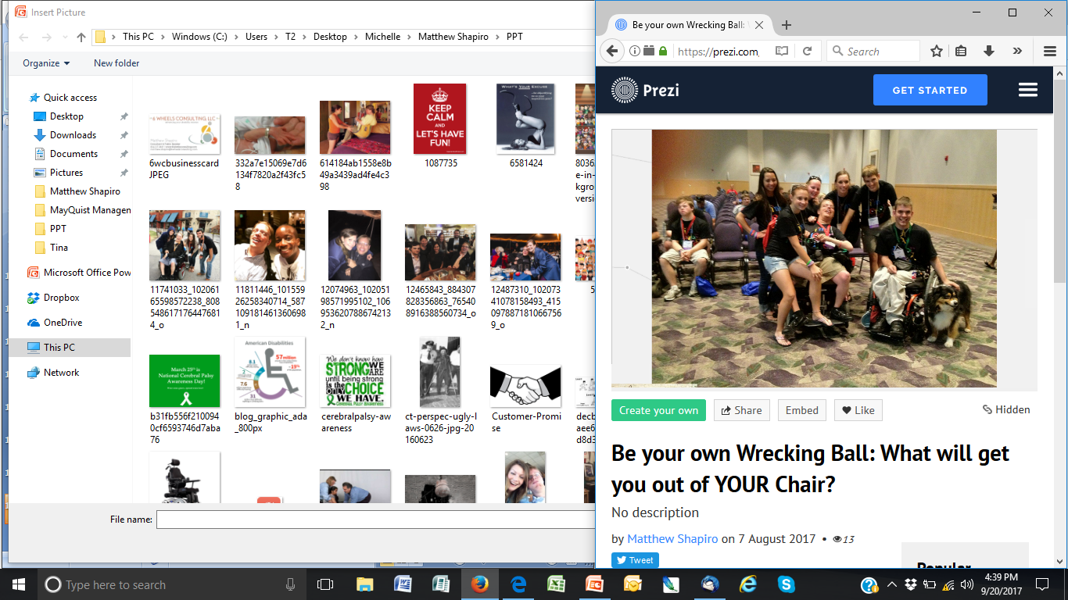
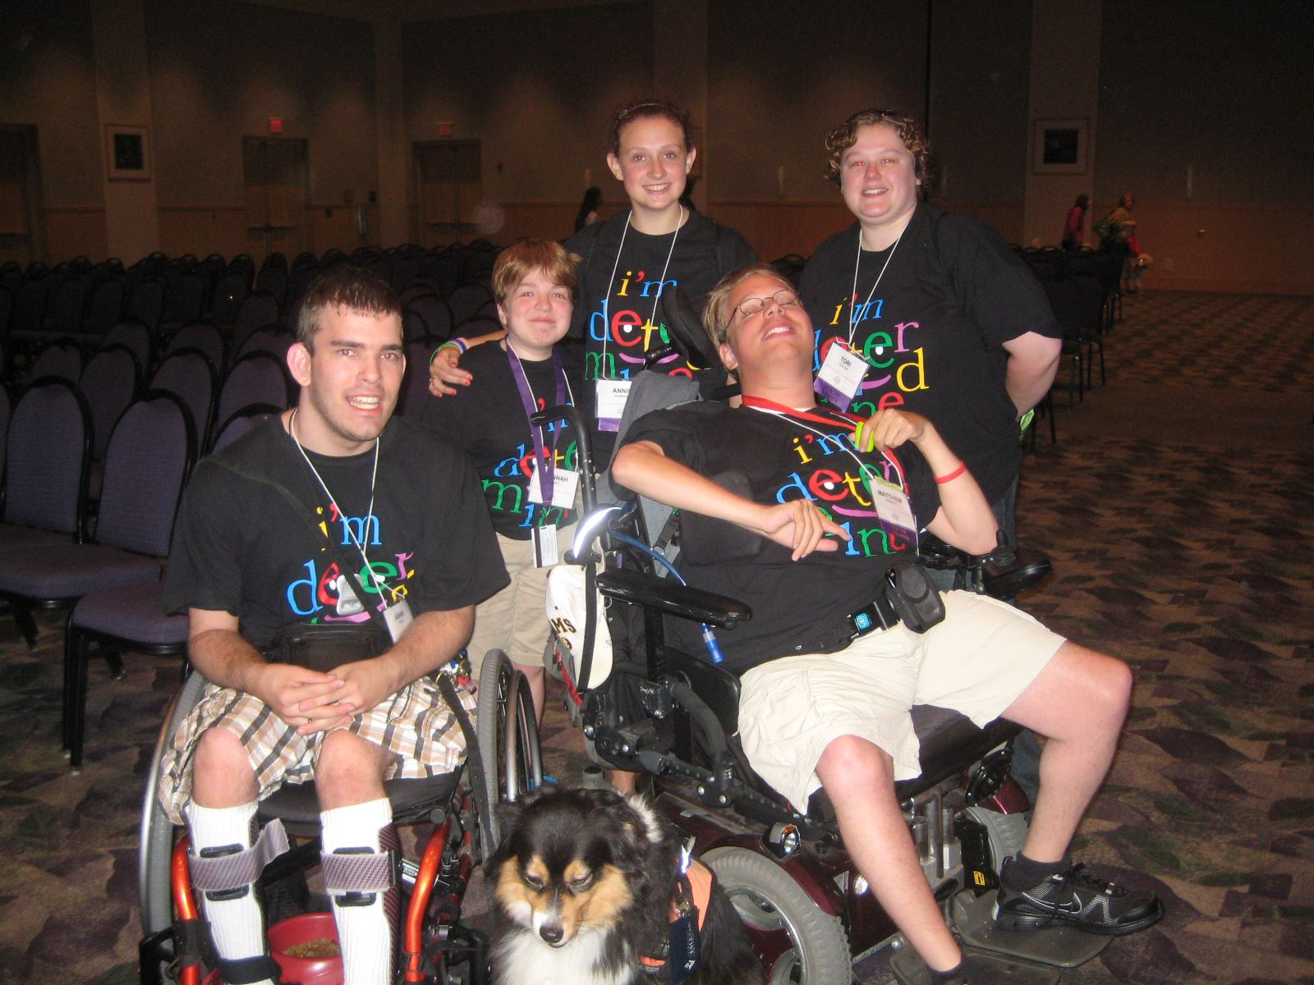
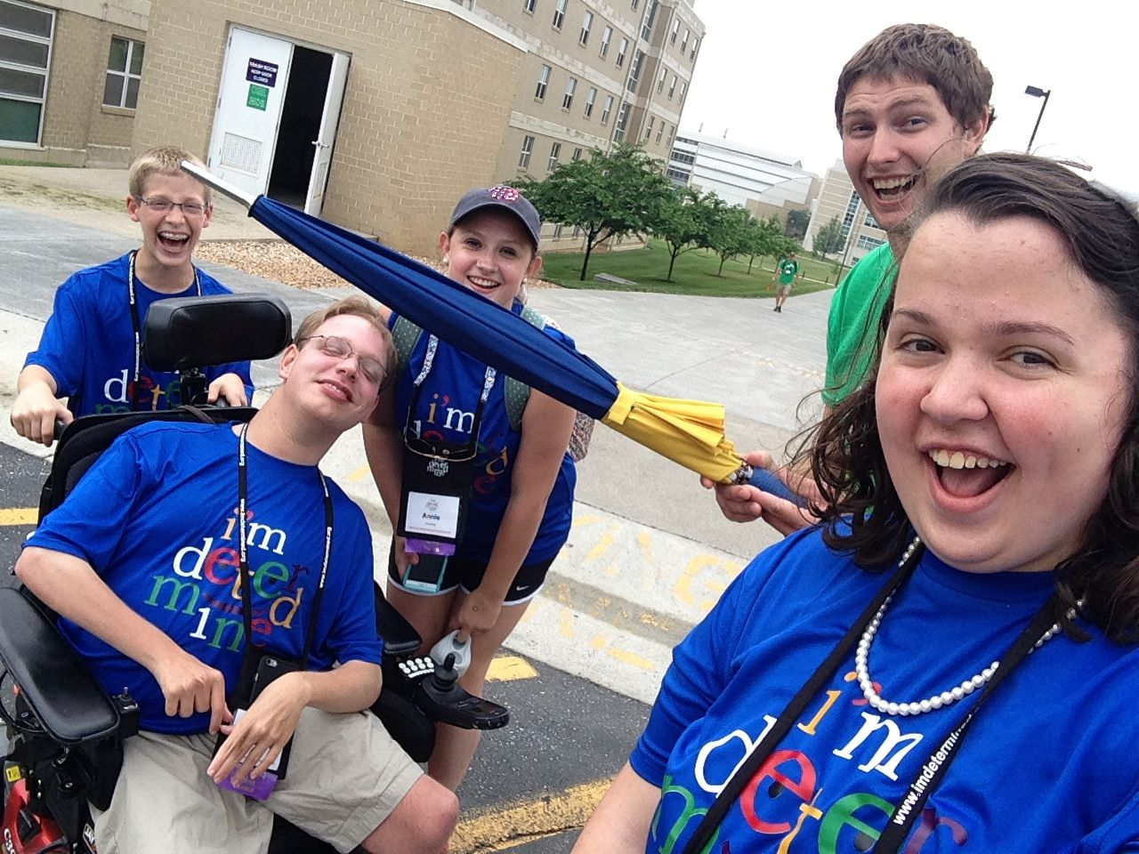
My I’m Determined Experience- GREAT Friends

Slide 5



WE OFFER:
CONSULTING
SPEAKING
LOBBYING
Starting 6 Wheels Consulting, LLC

Slide 6


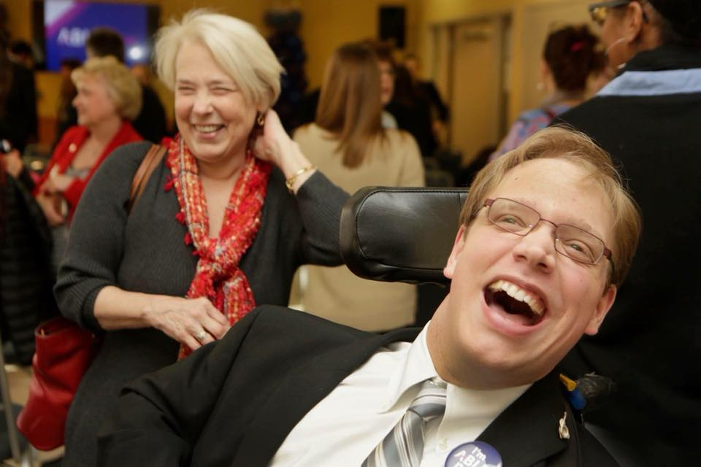




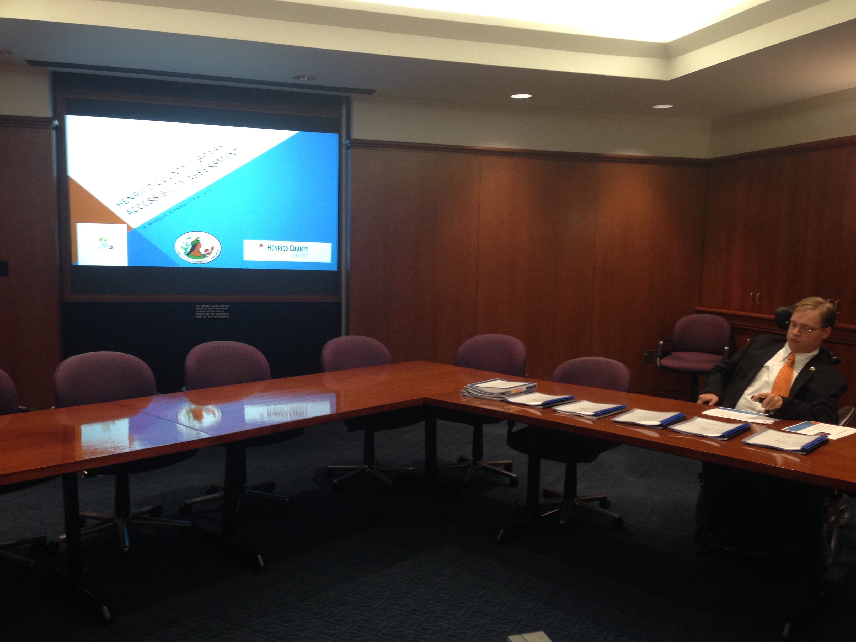
Consulting Successes

Slide 7

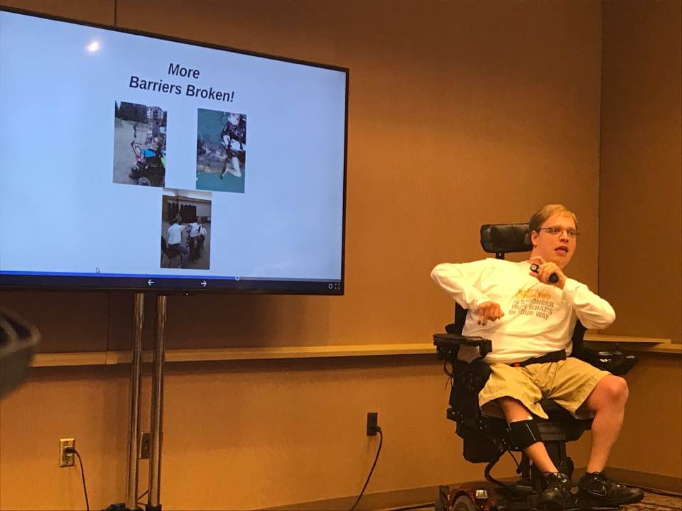
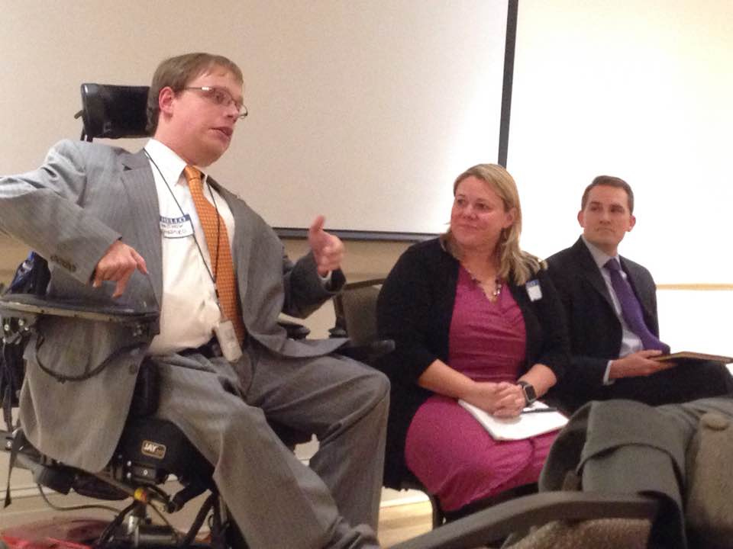

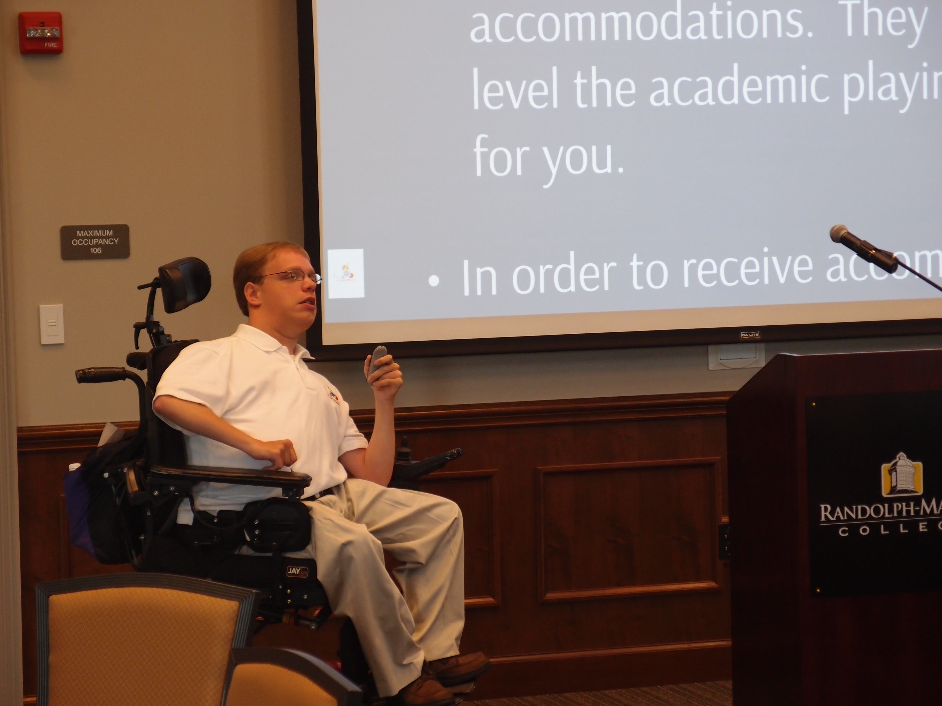


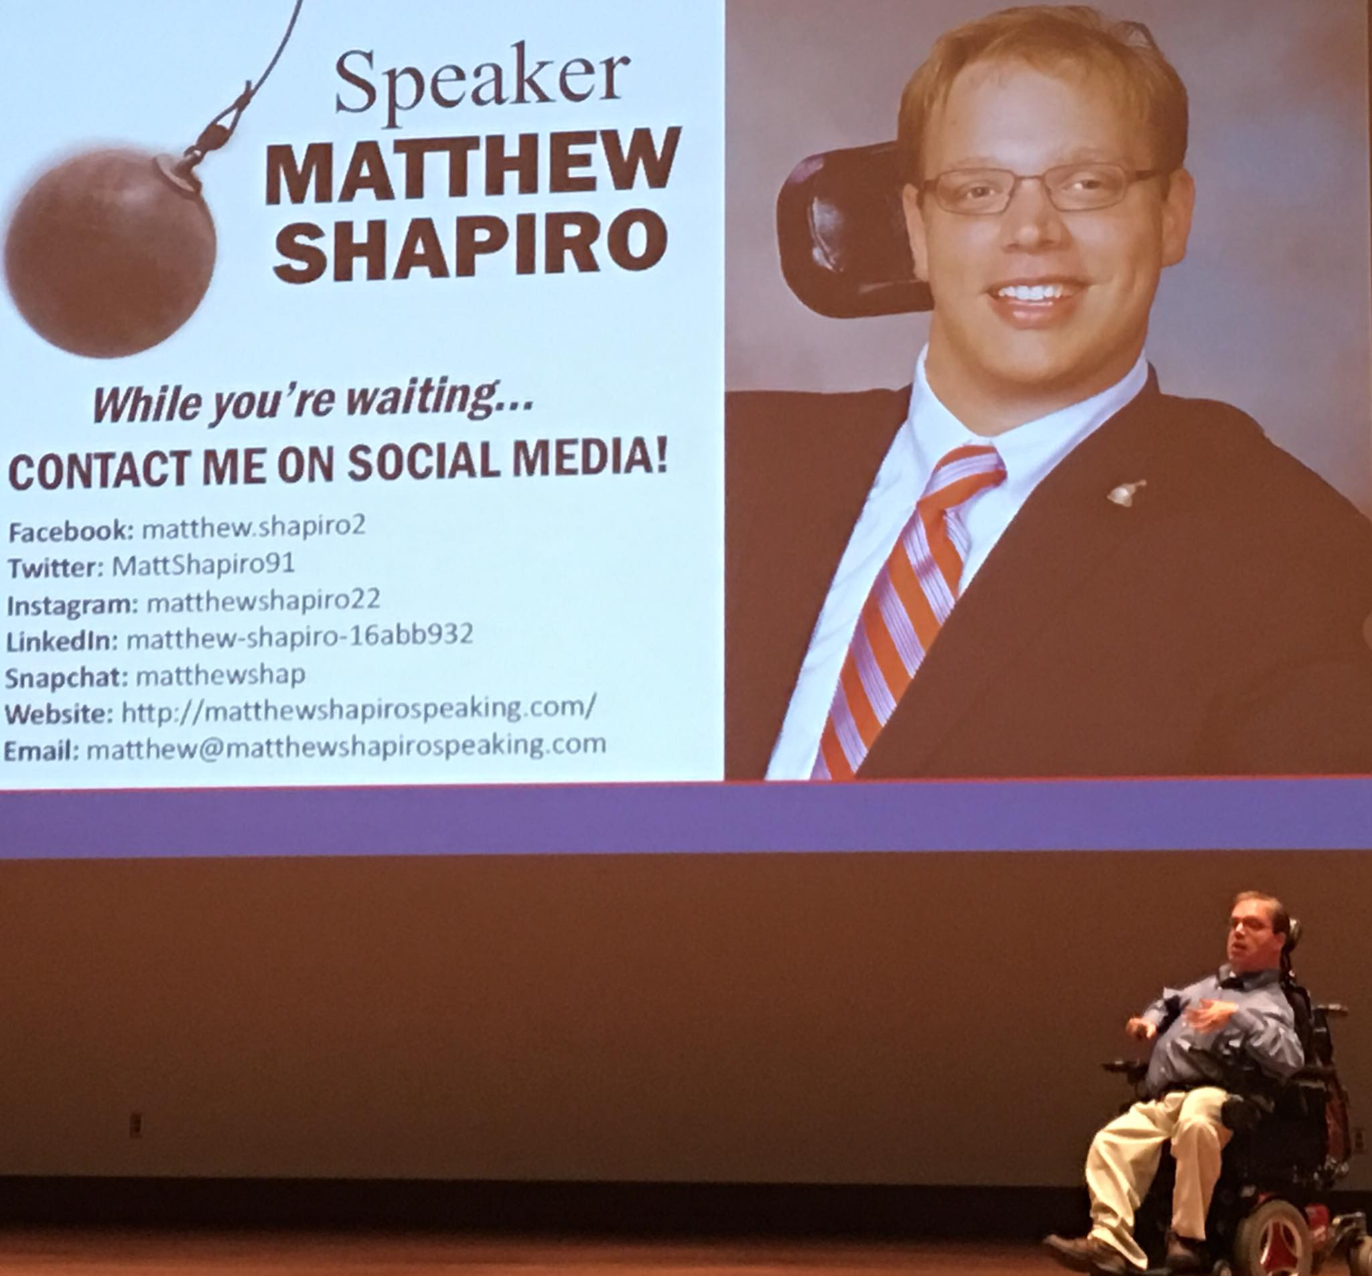

Impactful Public Speaking

Slide 8

Lobbying Successes

Slide 9



STAY IN TOUCH
Matthew Shapiro
6 Wheels Consulting, LLC
804-317-0819
matthew.shapiro@6wheelsconsulting.com
6wheelsconsulting.com
Follow 6 Wheels:
Facebook – 6 Wheels Consulting, LLC
Twitter - @6WConsulting
Instagram - @6wheelsconsultingllc
YouTube - 6 Wheels Consulting
LinkedIn – 6 Wheels Consulting
Find the The 6 Wheels Consulting Disability Podcast at:
Apple Podcasts
Spotify
SoundCloud
PodBean
Our Website
And More!

Slide 10
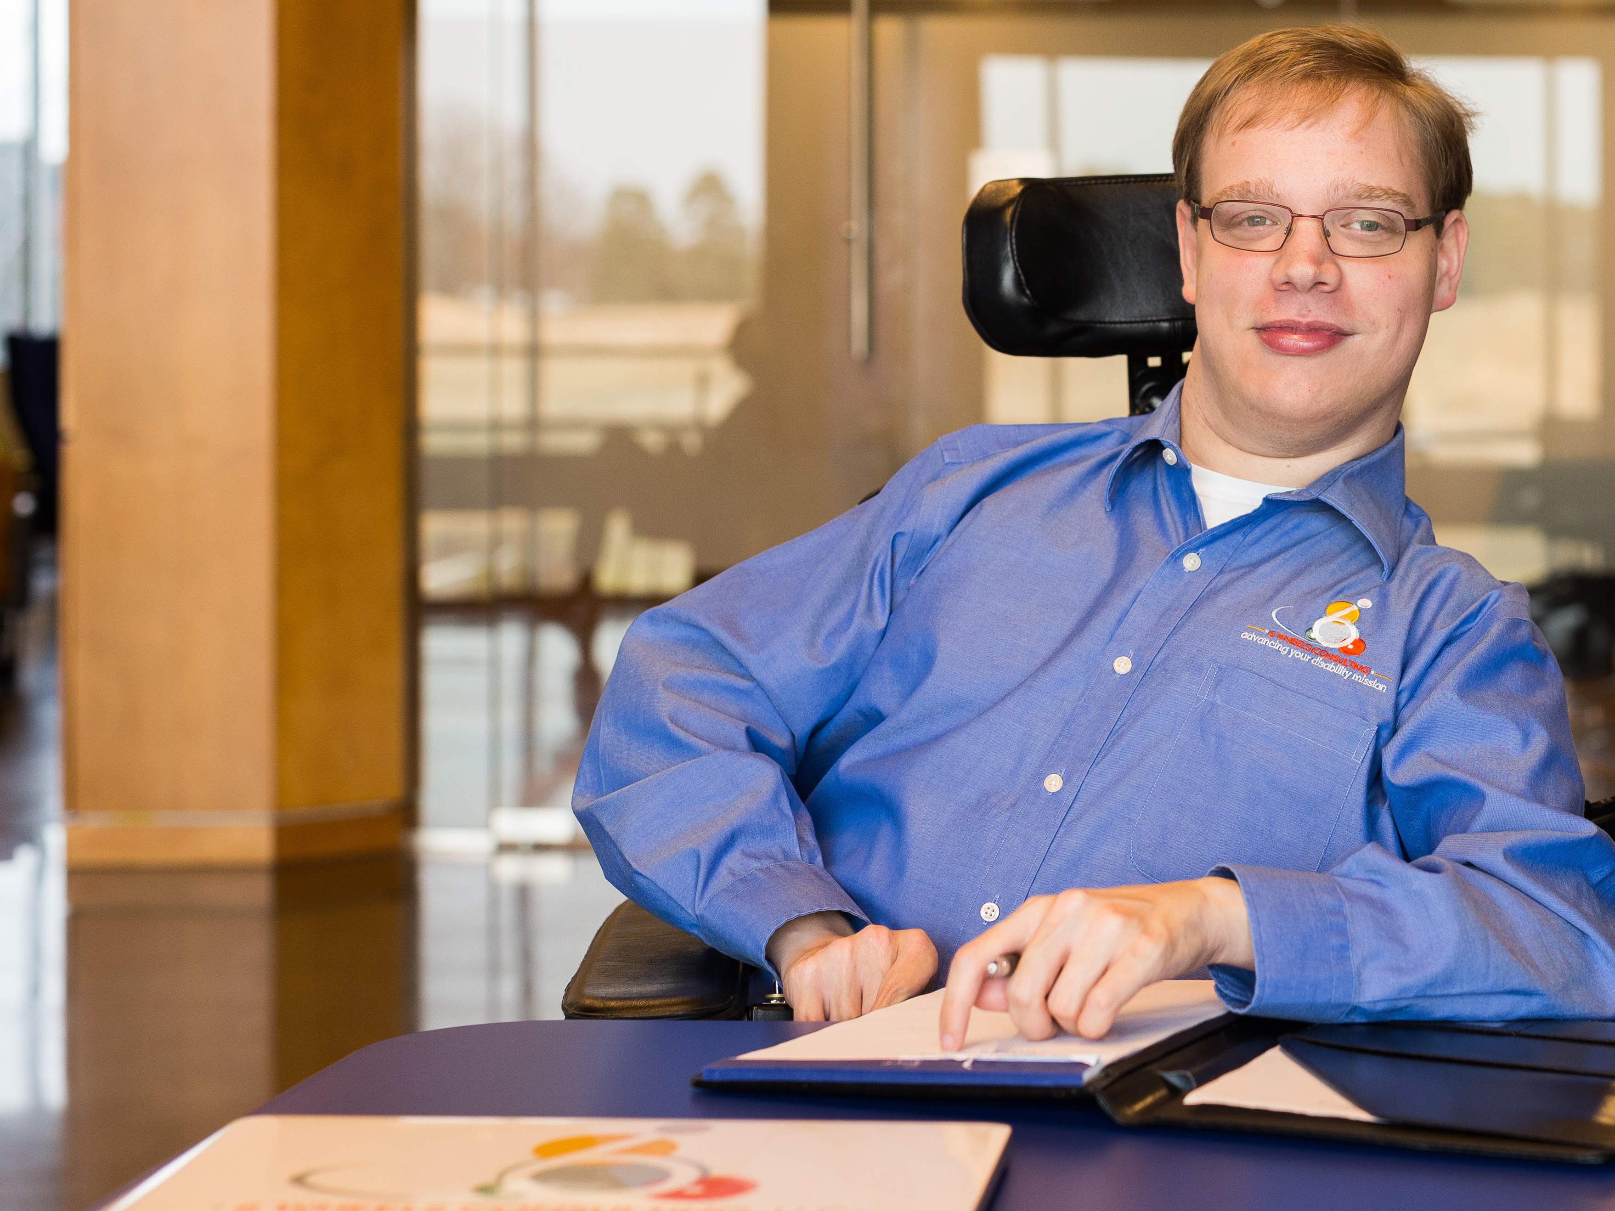
Thank You!
Notes:
About Me
27 Years Old
Graduated from VCU in the fall of 2013 with a double major in Interdisciplinary Studies with a concentration in disability advocacy and Sociology with a minor in Psychology.
Hobbies include: Sports, Politics, being with friends and family, and working with individuals and youth with disabilities.
I started 6 Wheels Consulting, LLC in December of 2014.

