Slide 1
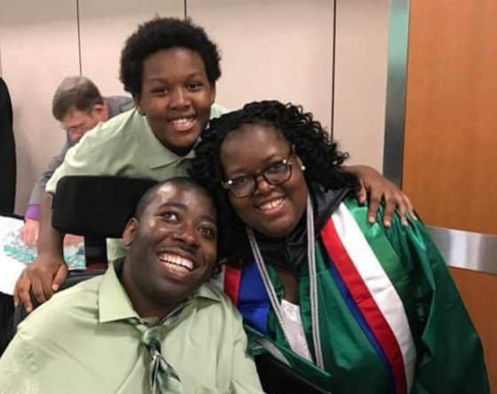
Emmanuel Jenkins
The Delaware Development Disabilities Council
Administrative specials/Community Engagement Officer
Founder and CEO of We Stand 4 Something interesting

Slide 2
The advocacy journey began
Advocated to the Board of Education
partners in policymaking class of 2014

Slide 3
What Do I Have Going on Now
Boards and committees
Let's Talk about It Video Series
Nonprofit organization
Motivational speaker
podcast

Slide 4
One of my favorite quotes
“Life is like a car it will take you anywhere you want to go but you must get in the driver's seat"
Emmanuel Jenkins

Slide 5
Emmanuel Jenkins
Administrative Specialist//Community Engagement Officer
email Emmanuel.Jenkins@delaware.gov
telephone number 302-739-7192

