Slide 1
NACDD Policy Update November 4
Erin Prangley, Director, Public Policy National Association of Councils on Developmental Disabilities

Slide 2
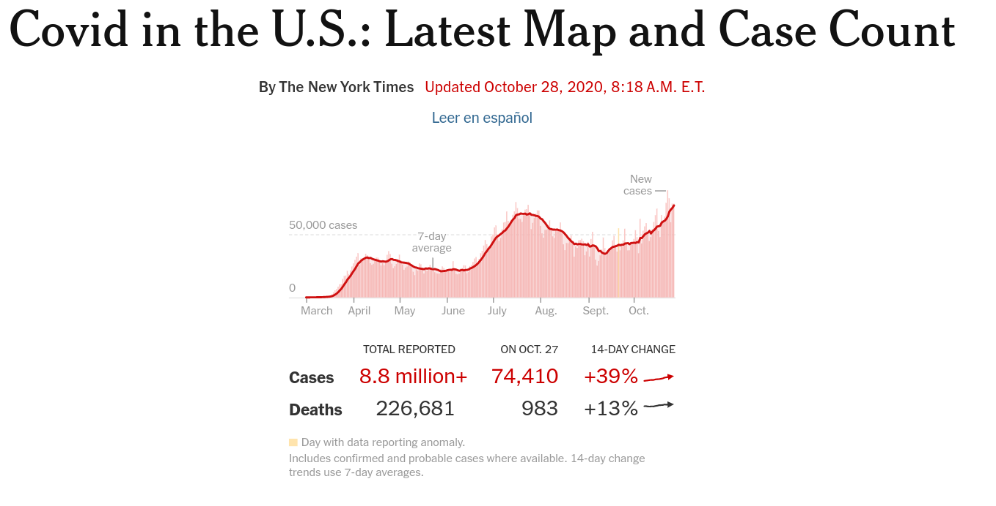

Slide 3
Legislative Update
Senate confirmed Amy Coney Barrett as Supreme Court Justice.
Senate adjourned until Monday, November 9.
No COVID Relief
New sticking point: White House push back against spending for comprehensive testing and tracing.
Still no movement on other points: weakening ADA and other civil rights (liability shields), no relief for HCBS or Medicaid, not enough relief to state/local).

Slide 4
NACDD Staff
Update draft with coalition partners
Present to Policy Committee
Policy Committee
Review draft
Recommend final draft to Board for approval
Board of Directors
Approve final draft
Recommend changes to coalition
How does NACDD decide their policy priorities?

Slide 5
Read
Read NACDD Priorities
Read current policy priorities at https://bit.ly/3ecXBhi
Email eprangley@nacdd.or to get latest draft for 117th Congress
Attend
Attend Policy Meeting
Attend meeting on Thursday, Nov. 5, 2pm Eastern
Link https://bit.ly/3kDG2sX | Meeting ID: 821 5649 0017 | Password: 465609
Join
Join Policy Committee or Board of Directors
Nominations for Policy Committee for 117th are being collected now. Send to eprangley@nacdd.org.
Check with Robin Troutman about Board of Directors.

