Slide 1
Voting
NACDD
October 15, 2020

Slide 2
VOTE 2020
Notes:
Covering the role of advocacy organizations and how appropriations works.

Slide 4
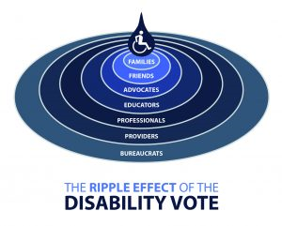
The Ripple Effect of the Disability Vote
Over 35 million eligible voters are people with disabilities
Over 62 million eligible voters are either PWD or family members with PWD in their household
Millions more are connected to disability

Slide 5
COVID-19 Challenges
Fewer in-person registration drives
Need to vote from home
Need for safety at polling locations
Staffing for polling locations
Needs for Accessibility
https://www.cdc.gov/coronavirus/2019-ncov/community/election-polling-locations.html

Slide 6
What to do
Get registered or confirm your registration
Plan how best to vote this year
Learn about candidates
VOTE

Slide 7
Planning
Will you vote by mail?
Request ballot
Get help filling out
Know deadlines
Will you vote in person?
Find location
Plan for getting there
Consider early voting if possible

Slide 8
Planning Tools
Know Your Options
Plain Language and easy read guides tool kit
Learn about Voting by Mail
Learn about early voting
Learn about assessible voting
Video: Overcoming Voting Barriers
Notes:
https://autisticadvocacy.org/policy/toolkits/voting/
https://www.aucd.org/template/news.cfm?news_id=14731&parent=295&parent_title=AUCD%20Publications&url=/template/page.cfm?id%3D295
https://www.wikihow.com/Vote-Early
https://www.ndrn.org/voting/resources/

Slide 9
Learn about Candidates
Find sample ballot
Learn about candidates
What issues are important to you?

Slide 10
Elections 2020
All 435 seats in the United States House of Representatives
35 of the 100 seats in the United States Senate will be contested.
State and local races
President

Slide 11
Learn about Candidates Tools
Find sample ballot
Election board website
Local advocates
Learn about candidates
Media
Issue organizations
Video: Being an Educated Voter

Slide 12
VOTE
Meet deadlines
Overcome barriers
Help others

Slide 13
Contact Me??
Liz Weintraub
Senior Advocacy Specialist
AUCD
Lweintraub@aucd.org

