Slide 1
SC COVID-19 Vaccine Advisory Committee
NASEM report
October 14, 2020

Slide 2
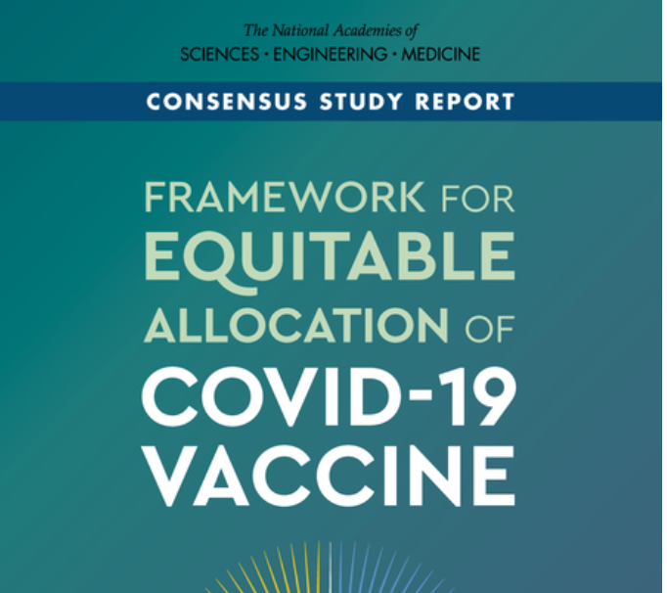
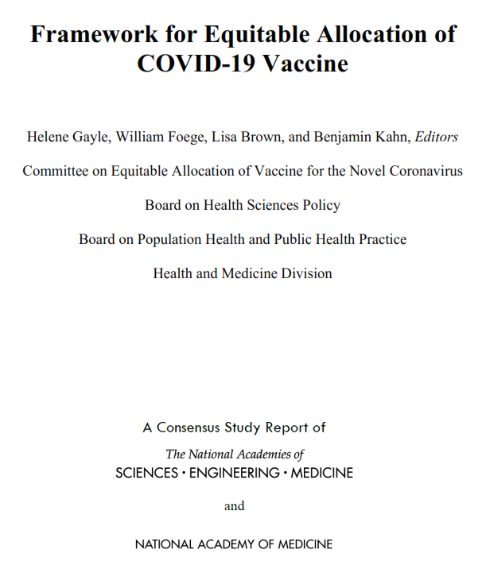
Note: PDF of the full text of this document, as published in October 2020, may be downloaded at:
https://www.nap.edu/catalog/25917/framework-for-equitable-allocation-of-covid-19-vaccine

Slide 3
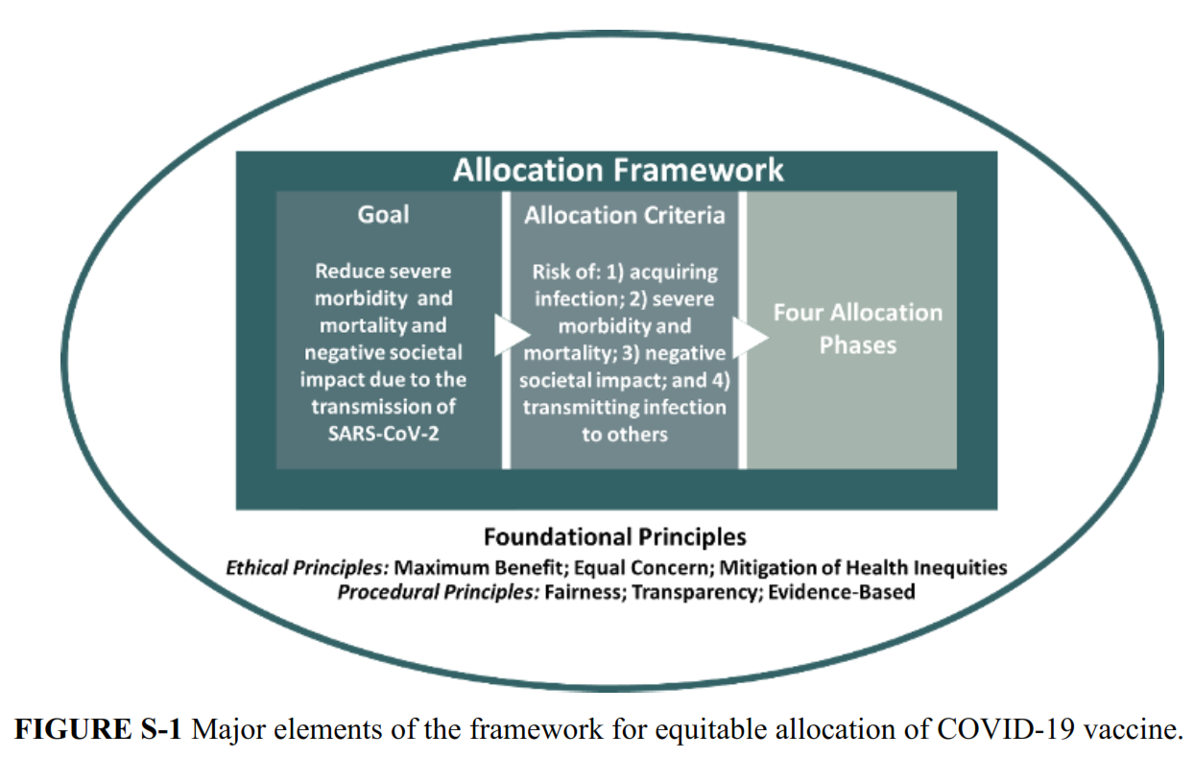

Slide 5
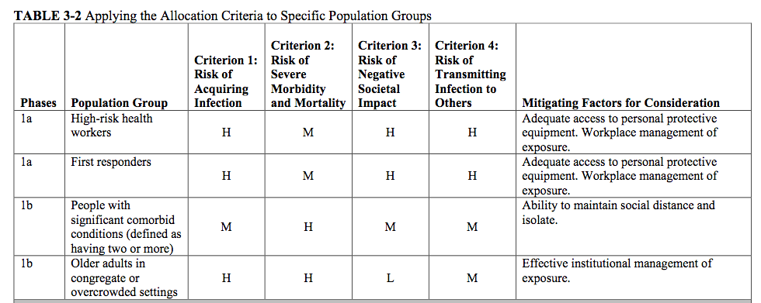

Slide 6
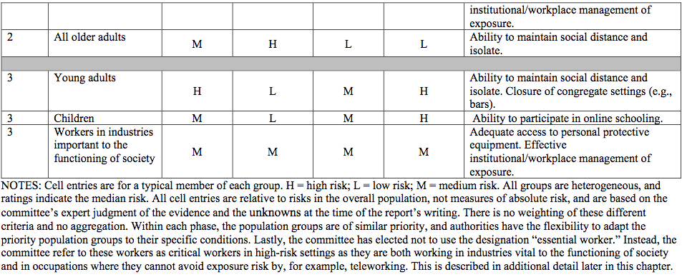

Slide 7
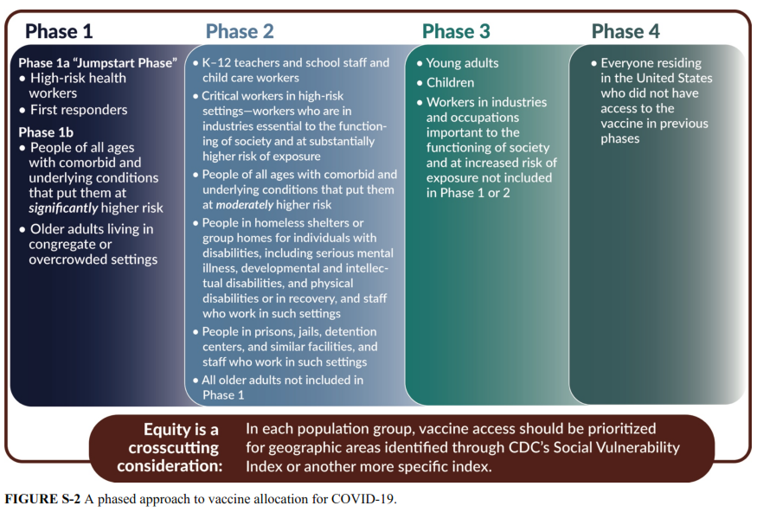

Slide 9
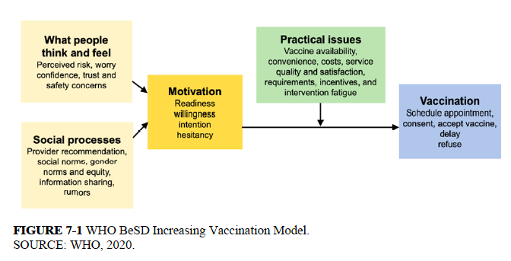

Slide 10
Questions?

