Slide 1
NACDD Policy Update September 23
Erin Prangley, NACDD, Director, Public Policy
eprangley@nacdd.org

Slide 2
“We the people” lost a larger-than-life champion for equality on the Supreme Court this weekend. For 27 years, Justice Ruth Bader Ginsburg helped move the Supreme Court into a new century of jurisprudence with thoughtful and contemporary decisions and dissents.
While she will be remembered primarily for her work on gender equity, many of her decisions and dissents were particularly focused on expanding individual rights and equality to other groups. Most significant for the disability rights movement was her majority opinion in the 1999 decision Olmstead v. LC.
Read NACDD full statement at https://bit.ly/2HiPTWi

Slide 3
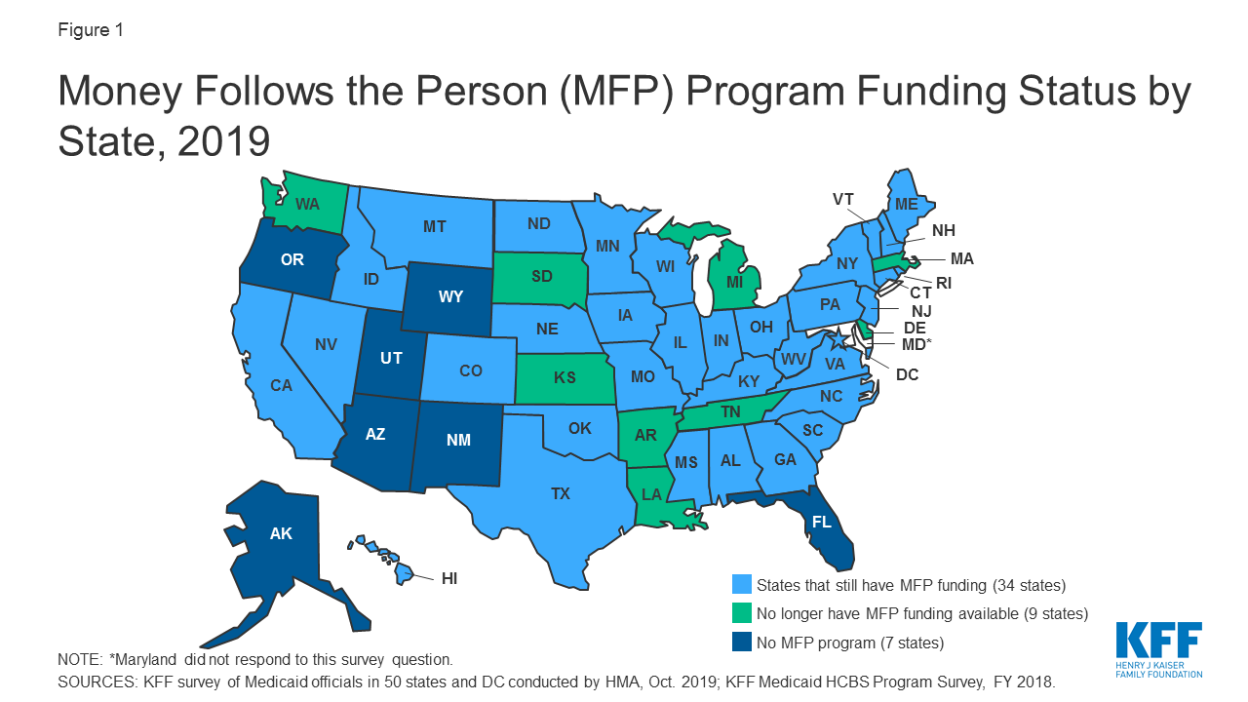
New MFP Federal Funding to Support Transitioning Individuals from Nursing Homes to the Community
Up to $165 million in supplemental funding to current 33 MFP states (up to $5M per state)
Press statement acknowledges Coronavirus "exposes America’s over-reliance on institutional long-term care facilities.” CMS will contact states and apps and approve on rolling basis through June 30, 2021.
CMS shared new data that shows the need for this supplemental funding opportunity to accelerate states’ MFP activities. Last year, only 4,173 Medicaid beneficiaries were transitioned under the MFP program – a 46 percent decrease from 2018.
List of activities added states could use this funding opportunity to support HCBS planning and capacity building activities in direct response to the COVID-19 public health emergency, such as to plan and implement the use of telehealth for nursing facility transition activities that would normally be conducted in-person or to redesign service delivery models to reduce the risk of COVID-19 infection among MFP participants.
See Press Release https://www.cms.gov/newsroom/press-releases/cms-announces-new-federal-funding-33-states-support-transitioning-individuals-nursing-homes​

Slide 4
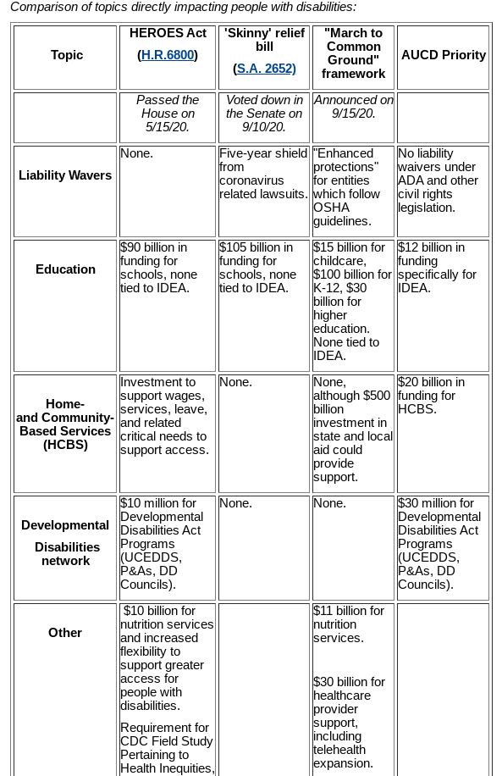
Legislative Update
COVID bill still stalled. AUCD released a new "side by side" that includes March to Common Ground proposal.
Continuing Resolution with funding for FY21 passes House.
The House passed 359-57 a short-term CR through December 11 (H.R. 8337 (116)). Read section by section here https://bit.ly/2Eqykm7.
DD Councils level-funded but we need to keep pressure on.
Other NACDD Priorities included in bill: Medicaid Extenders, MFP/Spousal Impovrishment, Nutrition Services, Census Bureau Funding.
House passes Pregnant Workers Fairness Act (H.R. 2694) passes House.
NACDD/CCD supported legislation Provides a clear pregnancy accommodation standard to help prevent pregnancy-related complications before they arise and allow pregnant workers to remain in the workforce. Read more here: https://edlabor.house.gov/imo/media/doc/PWF%20Act%20-%20Fact%20Sheet.pdf
From AUCD Disability Policy News at https://www.aucd.org/template/news.cfm?news_id=15018&parent=164&parent_title=Disability%20Policy%20News&url=/template/page.cfm?id%3D164

Slide 5
Administrative Update
CMS meets with NACDD Medicaid Waivers Taskforce
NACDD presented to CRS leadership recommendations on use of Medicaid waivers to support for people with IDD during the pandemic and more permanently to address rebalancing. CMS asked the taskforce to help them identify the best innovations and incentivize states to use the Medicaid flexibilities and path towards moving towards rebalancing.
Coalition Activities
NACDD joins Statement on Reducing Police Responses to People with Disabilities
NACDD called for policing reforms, including eliminating the role of police in responding to situations that are better addressed by disability service systems or other social or human services staff. Police responses in those situations have too often resulted in people with disabilities being needlessly incarcerated or even killed. For disabled people of color, and particularly Black disabled people,these outcomes are even more likely. See Statement at http://c-c-d.org/fichiers/Policing-statement-9-14-20.pdf

Slide 6
Save the Date!​
COVID-19 Impact on State Budgets​
October 1, 2:00pm-3:00pm Eastern​
Presented by NACDD State Budget Emergency Task Force
Register in advance at: https://bit.ly/302b59v
After registering, you will receive a confirmation email containing information about joining the meeting.

Slide 7
For more information contact Erin Prangley at eprangley@nacdd.org

