Slide 1
Flu Vaccination Programmatic Activities, 2020- 2021
CAPT Sapna Bamrah Morris, MD, MBA
Influenza Response Team
Vaccine Planning Unit
DHDD partners call
September 10, 2020

Slide 2
Background

Slide 3
Summary of 2019-2020 influenza season
Deaths
24,000-62,000
Hospitalizations
410,000-740,000
Illnesses
39,000,000-56,000,000
Medical visits
18,000,000-26,000,000
https://www.cdc.gov/flu/about/burden/preliminary-in-season-estimates.htm

Slide 4
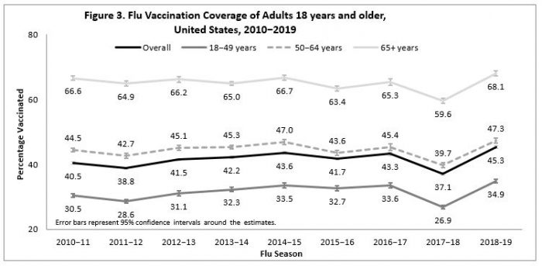
Adult flu vaccination coverage
https://www.cdc.gov/flu/fluvaxview/coverage-1819estimates.htm

Slide 5
Flu Vaccination Planning for 2020- 21

Slide 6
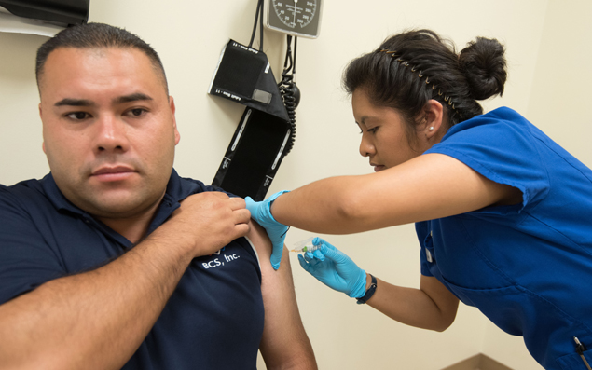
Increasing seasonal influenza vaccine coverage to decrease healthcare utilization, 2020-21
Expect SARS-CoV-2 to continue to circulate in the fall
Increasing flu vaccination coverage will reduce stress on the healthcare system
  Decrease doctor visits and hospitalizations
  Reduce influenza diagnostic testing
Focus on adults at higher risk from COVID-19
  Staff and residents of long-term care facilities
  Adults with underlying illnesses
  African-Americans and Hispanics
  Adults who are part of critical infrastructure

Slide 7
Influenza vaccination planning for 2020-2021 season
Influenza Vaccine Doses Distributed By Season, 2008-09 to 2019-20, and Projected, 2020-21
Maximize available vaccine supply
  Expect >190M doses for U.S. market
Operational considerations
  Outreach to those at higher risk
  Planning for need to physical distance
  Extending influenza vaccination season (September through December or later)
Enhance communication
  Align with COVID-19 messaging
  Messaging for high-risk individuals

Slide 8
Resources and Supplemental Flu Doses to Increase Flu Vaccination Rates

Slide 9
CDC Supplemental operational funding
$140 million in supplemental funding distributed among 64 jurisdictions
Intended to support activities designed to increase flu vaccination coverage
  Plan activities with partners that serve priority populations
  Build or enhance adult vaccination programs
  Promote reminder/recall activities
  Improve provider allocation and ordering
  Organize or fund mass vaccination clinics
  Implement vaccine strike teams
Establishing or expanding key partnerships to reach vulnerable populations for flu vaccination will ultimately help build the foundation for COVID-19 vaccination

Slide 10
IIS activities: COVID/flu supplemental funds
21 immunization programs are funding IIS-related enhancements:
  Enhance IIS to receive data from IZ Gateway
  Enhance IIS to conduct centralized reminder/recall
  Enhance IIS to recruit, enroll, onboard and train providers
  Enhance IIS for vaccine ordering and inventory management
  Enhance IIS for online patient consent
  Enhance IIS for data collection, analysis and reporting
  Enhance IIS bidirectional data exchange
  Improve IIS system performance and database management
Each of these efforts to strengthen IISs will also help operationalize the complexities of COVID-19 vaccine implementation (particularly with tracking who has had which vaccine and when)

Slide 11
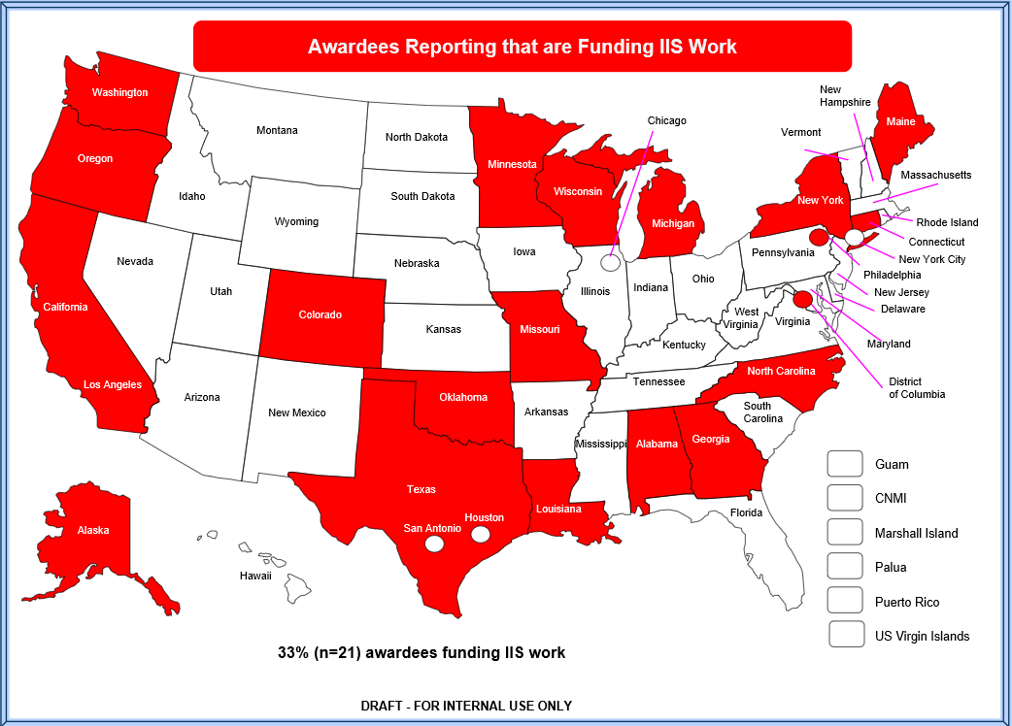
Immunization Programs Reporting They are Using Flu Supplemental Funding for IIS Improvements
33% (n= 21)

Slide 12

Alaska: Flu vaccination outreach clinics and centralized IIS reminder/recall
1. Run flu vaccine coverage rate reports quarterly, present data to stakeholder group*, and identify HCP in need of additional support and education.
2. Target regions where healthcare providers need education.
3. Identify opportunities to conduct influenza vaccine outreach clinics and conduct centralized reminder/recall through IIS.
Stake holder group: Alaska Native Tribal Health Consortium, CDC, Arctic Investigations Program, the Section of Public Health Nursing, Women’s Children’s and Family Health Program, FQHC, and Municipality of Anchorage
Notes:
1. The Epidemiology Specialist (hired through the funding) will run immunization coverage rate reports from VacTrAK quarterly, present this data to the stakeholder group*, and identify healthcare providers in need of additional support and education.
2. The stakeholder group will use this data when creating additional campaign materials and for targeting regions where healthcare providers need education.
3. The stakeholder group will work with local coalitions, public health nursing, and school nurses to identify opportunities to conduct influenza vaccine clinics.

Slide 13
Federal doses requested in CDC’s spring pre-book
 | Adult Doses | Pediatric Doses
AstraZeneca | 670 | 810,440
GSK | 302,710 | 8,926,100
Sanofi | 78,190 | 6,331,900
Seqirus USA, Inc | 117,480 | 406,510
Total Doses | 499,050 | 16,474,950
Doses in this table were pre-booked (reserved) by awardees during Jan-Feb 2020 for use in children and adults. Of note, the pediatric doses shown here do not reflect ~2M additional doses added by CDC in May 2020 to account for an anticipated increase in VFC eligible children requiring flu vaccination during the 2020-21 season.

Slide 14
Additional adult flu vaccine doses purchased this summer
Manufacturer | Doses
AstraZeneca | 1,300,000
GSK | 2,000,000
Sanofi | 2,677,560
Seqirus | 3,377,500
Total | 9,355,060
Doses in this table have been purchased by CDC using pandemic response funds to enhance seasonal flu vaccination in adults during the 2020-21 season. Awardees submitted supplemental pre-book requests for these doses at the end of June.

Slide 15


Joint letter from NACHC and AIM
1st time these organizations officially partnered
Leadership in both organizations wrote a letter to all 64 immunization awardees encouraging collaboration

Slide 16
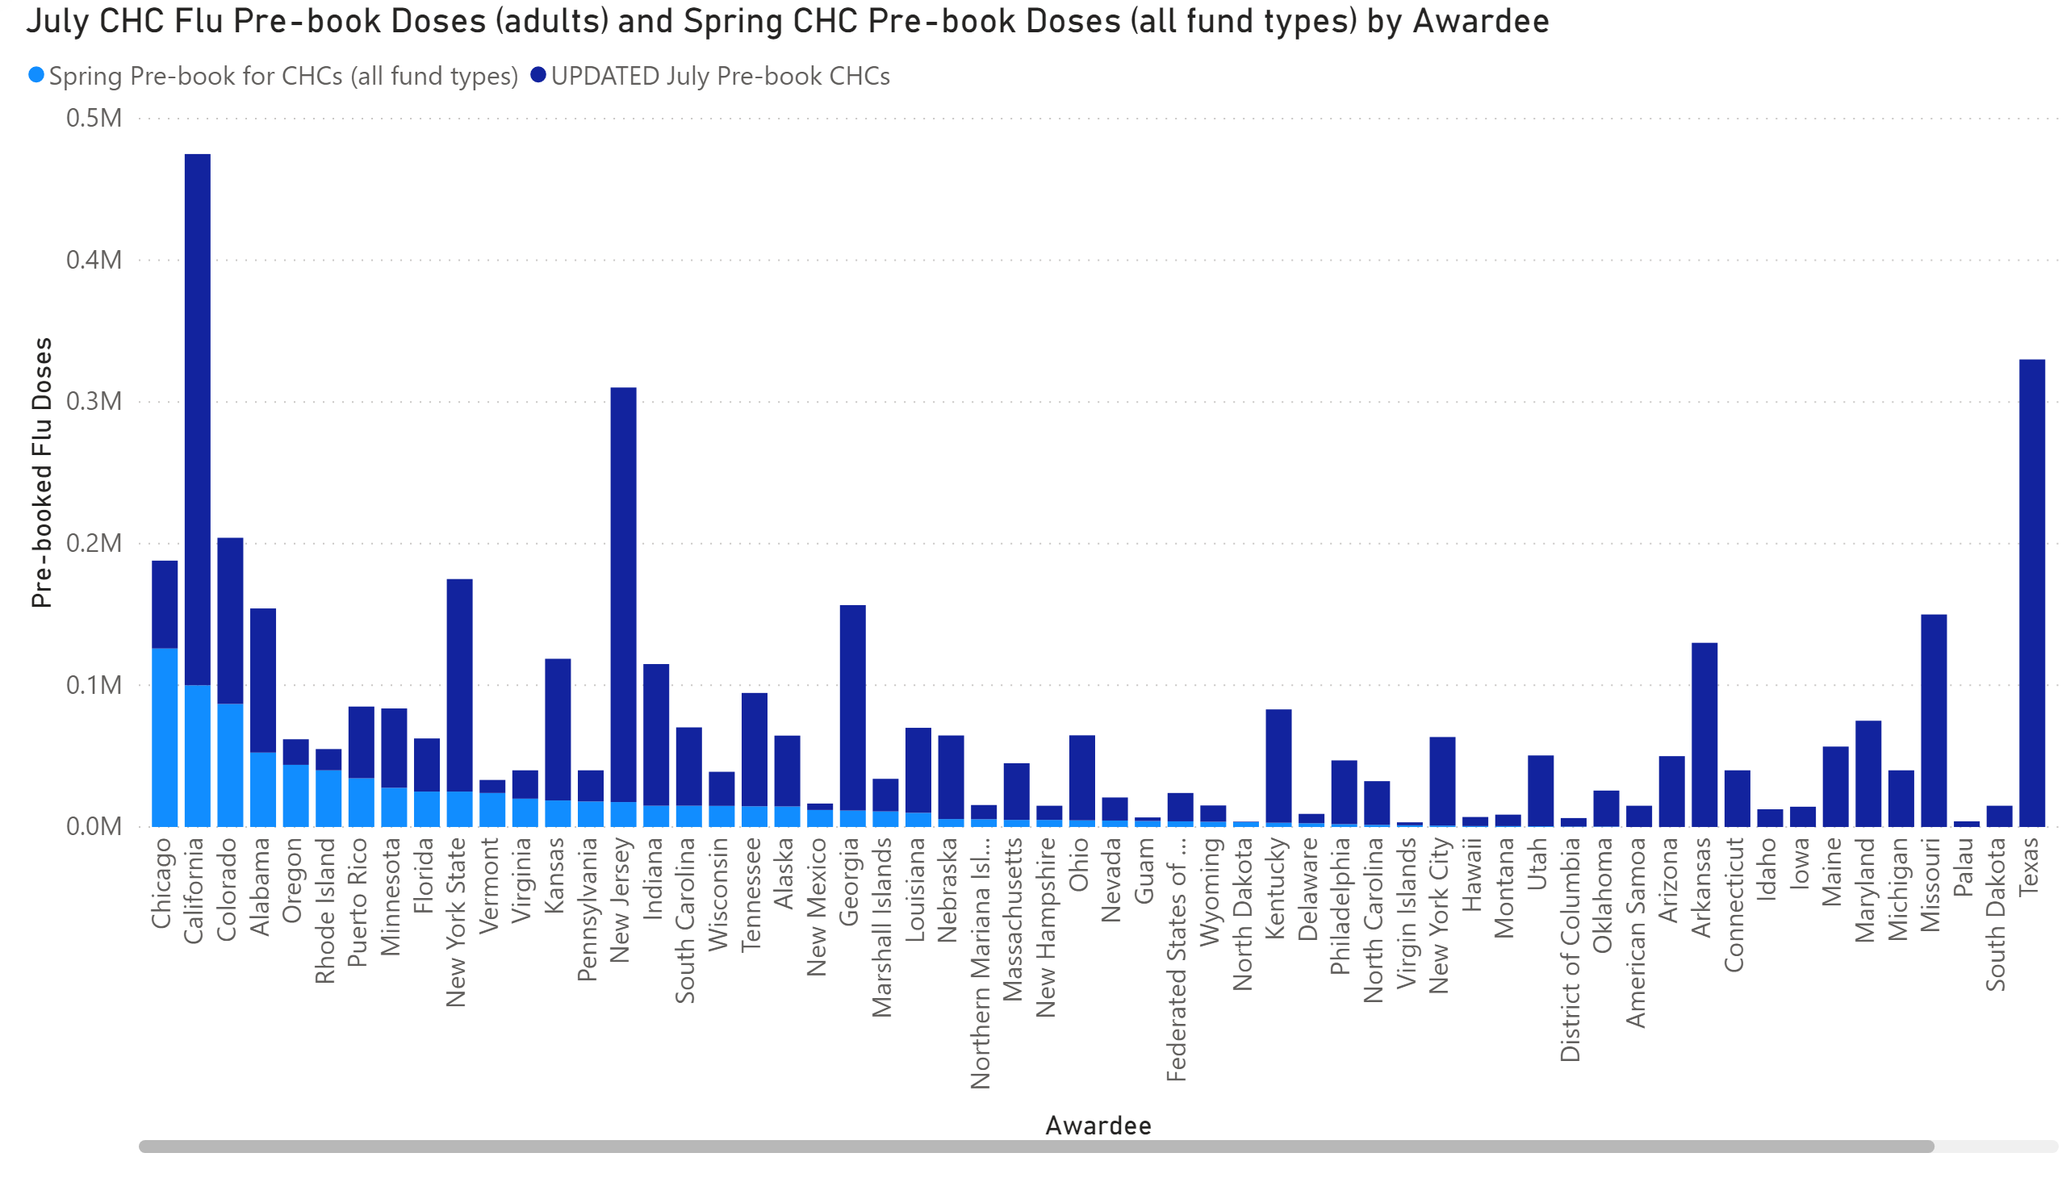
Impact of the July pre-book opportunity, and the additional adult flu vaccine, on vaccine pre-booked for Community Health Centers (CHCs)
Awardees
Note: Awardees will receive, and flu vaccine use will be tracked as, a single allocation of vaccine, regardless of the CHC designation.

Slide 17

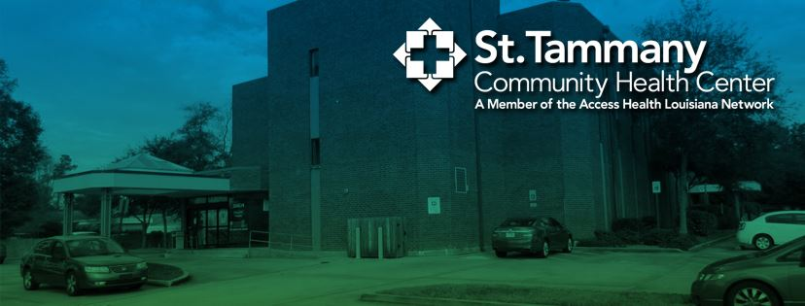
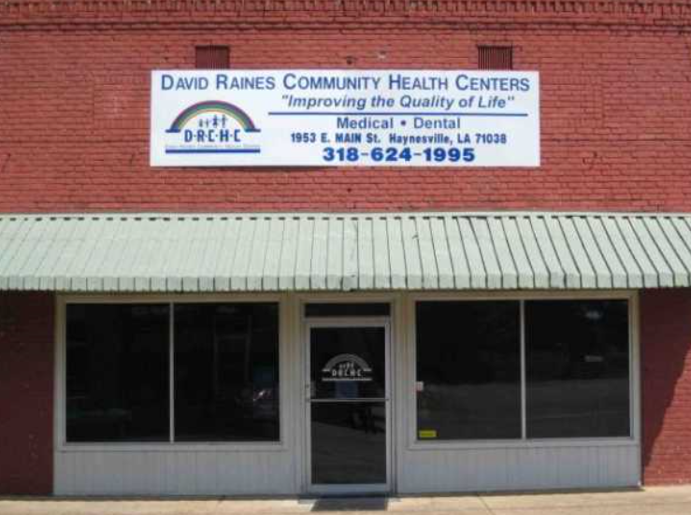

Louisiana: Example of partnering with CHCs
Louisiana Dept of Health has established partnerships with 39 FQHCs (that operate >285 clinics) to implement flu vaccination campaigns
These sites completed a first-ever pre-book for CDC-provided adult flu vaccine in June 2020
Begin enhanced adult flu campaign in fall 2020

Slide 18
Vaccination Guidance during the Pandemic

Slide 19
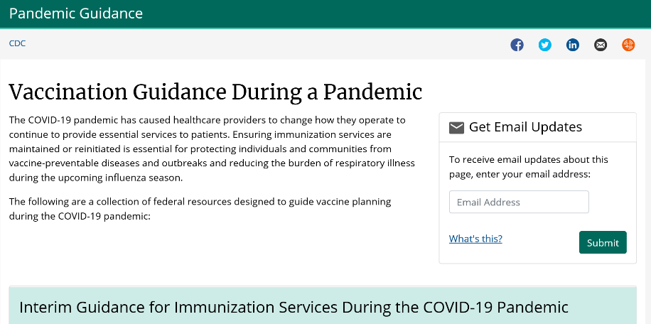
Vaccination guidance is continuously being reviewed and updated
Visit https://www.cdc.gov/vaccines/pandemic-guidance/index.html for the most recent guidance.
Sign up to be notified when information on the web page changes.
Notes:
Any changes in guidance will be updated on this website. Please sign up to be notified by email when information changes.
We will be posting further guidance for temporary and off-site clinic sites for immunization in the next week

Slide 20
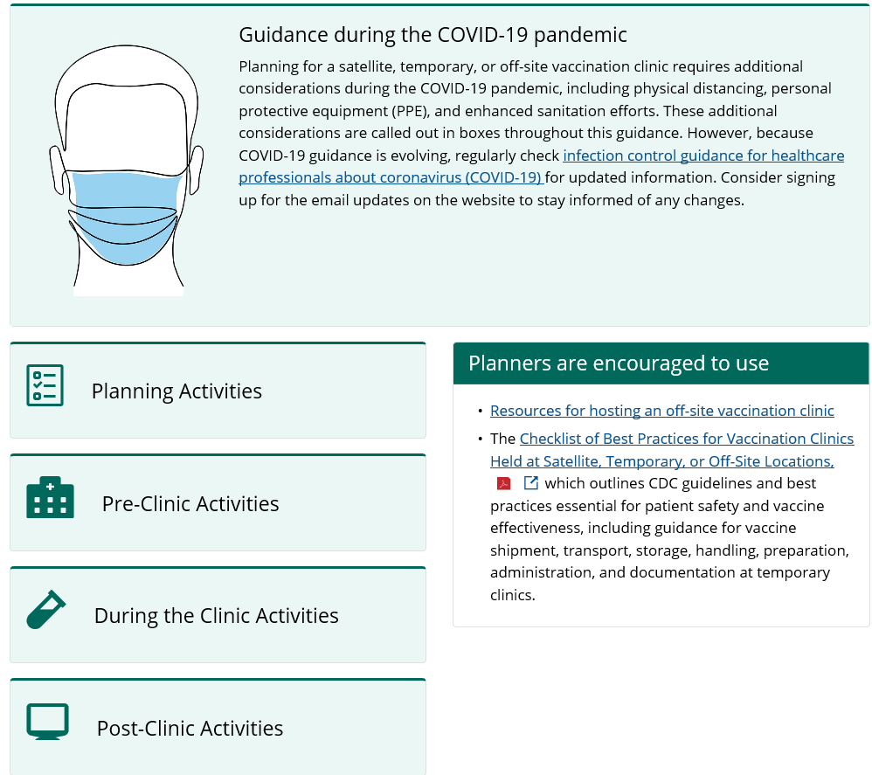
Guidance for vaccination clinics held in satellite, temporary, or off-site locations
https://www.cdc.gov/vaccines/hcp/admin/mass-clinic-activities/index.html

Slide 21
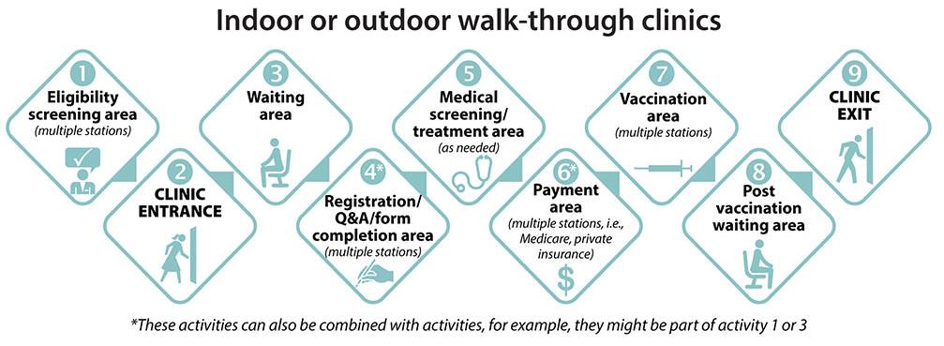
Flowchart for vaccination clinic layout for walk-through clinics
https://www.cdc.gov/vaccines/hcp/admin/mass-clinic-activities/pre-clinic-activities.html

Slide 22
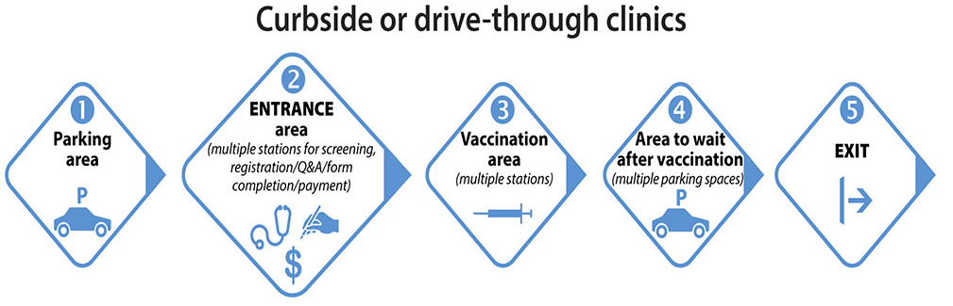
Flowchart for vaccination clinic layout of curbside clinics
https://www.cdc.gov/vaccines/hcp/admin/mass-clinic-activities/pre-clinic-activities.html

Slide 23
Conclusions

Slide 24
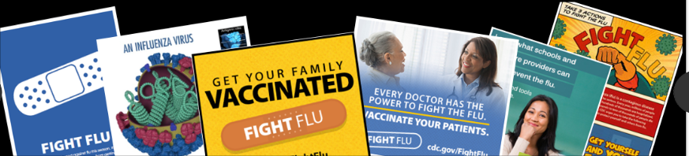
Conclusions
Flu vaccination will be more important this season than ever
The $140M supplemental funding and the additional 9.3M adult flu doses will be used to achieve increased flu vaccination coverage in underserved adults
State and local health departments are establishing new and strengthening existing partnerships with CHCs in their jurisdictions
We will need to continue to promote flu vaccination throughout flu season to ensure successfully delivery of all available doses

Slide 25
Thank you

