Slide 1
CDC Flu Vaccine Campaign Update: 2020-2021 Communications Activities Summary Research Findings Messaging & Creative Concept for Digital Campaign
Erin Burns
Flu Vaccine Campaign Lead
September 9, 2020

Slide 2
Communications Goal & Special Target Audiences
GOAL: Increase flu vaccine uptake, especially in people at higher risk from flu and COVID-19, as well as serious outcomes from flu & COVID-19.
SPECIAL TARGET AUDIENCES: Older Americans, People of any age with underlying health conditions (for example lung disease, heart disease, neurologic disorders, weakened immune systems, diabetes), African Americans and Hispanics, Essential Workers
Comprehensive plans for traditional media, digital and social media and partner outreach.
Two new campaigns for the public, plus ongoing public and clinician education activities by CDC.

Slide 3
Timeline
Mid-September
soft-launch of digital campaign aimed at high risk persons (9/14-9/25)
9/24 Radio media tour
October 1
NFID press conference launching the vaccination season (October 1), and social and digital media.
October 6
Ad Council Phase 1 launch (dedicated campaign website, digital & social assets, possibly radio)
October 24
Ad Council Phase 2 launch (TV and other materials)
December 6-12: National Influenza Vaccination Week
Campaign activities continue through March 2021

Slide 4
CDC Flu Overarching Messaging for 2020-2021
Take 3 Communications platform
Get a flu vaccine
During the 2020-2021 cold and flu season, getting a flu vaccine is more important than ever to protect yourself, your loved ones, your community, and the global community from flu.
Take everyday preventive actions.
To include preventive actions to prevent COVID-19.
Take antiviral drugs if prescribed.
Important point is message integration with COVID-19 guidance

Slide 5
CDC Consumer Testing, Background
We tested draft messages and materials in July 2020 to determine overall appeal, reported impact on intended behavior, and motivation to accept flu vaccine in anticipation of the 2020-2021 flu season
We fielded two online surveys with adults using an existing survey panel
General population adults, including older adults and adults with chronic health conditions (n=502)
African American adults, including older adults and adults with chronic health conditions (n=500)

Slide 6
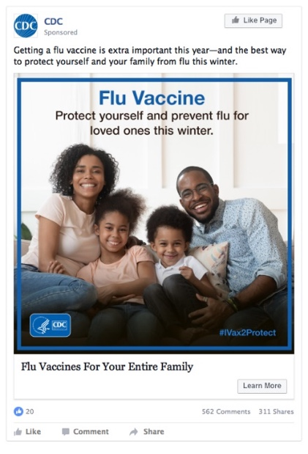
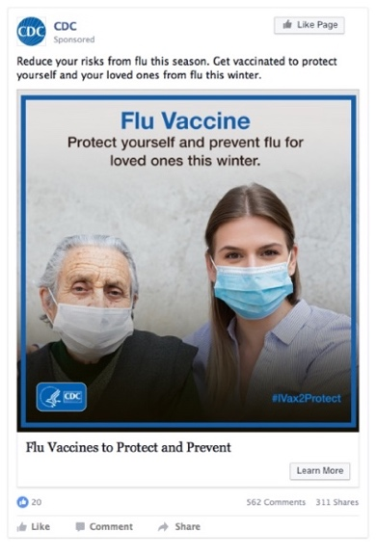
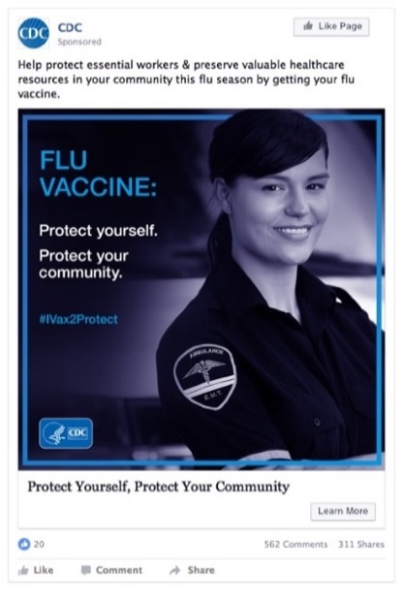
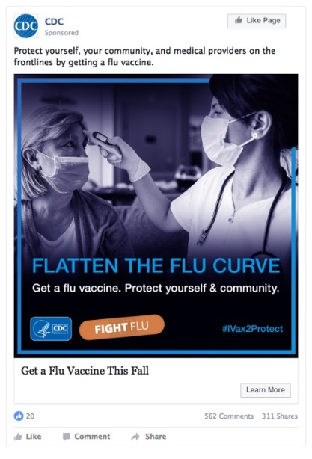
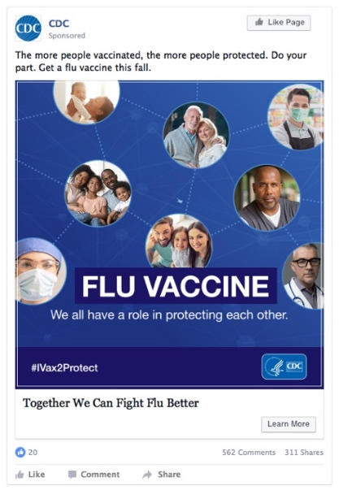
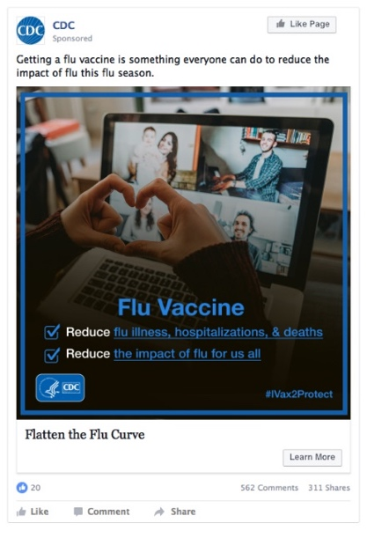
Creative Concepts Tested
Protect yourself and loved ones
Protect yourself and those around you
Protect the broader community
A: Family
B: Grandmother/
granddaughter
C: EMT
D: Healthcare worker
E: Community
F: Virtual meetup
#1 among general population and African Americans, including those who do not plan to get vaccinated.
#3 among general population
Preferred by general population who do not plan to get a vaccine.
#3 among African Americans who do not plan to get vaccinated.
#2 General pop and among African Americans, including African Americans who do not plan to get a vaccine.
A, E & E motivated a majority of adults who indicated they do not know if they will get a flu vaccine this fall to talk with their doctor about a flu vaccine and ask for the flu vaccine.

Slide 7
Message Testing—Top 5 Motivating Messages Overall
How much would each of these statements motivate you to get a flu vaccine? Very/Somewhat Motivating
General Population (n=502)
Getting a flu vaccine is the best way to protect yourself and your loved ones from flu this winter. | 75%
The more people vaccinated, the more people protected. Do your part. Get a flu vaccine this fall. | 75%
Getting a flu vaccine is something everyone can do to reduce the impact of flu this flu season. | 75%
Reduce your risks from flu this season. Get vaccinated to protect yourself and your loved ones from flu this winter. | 74%
Protect yourself, your community, and medical providers on the frontlines by getting a flu vaccine. | 74%
African Americans (n=500)
Protect yourself, your community, and medical providers on the frontlines by getting a flu vaccine. | 68%
Getting a flu vaccine is the best way to protect yourself and your loved ones from flu this winter. | 67%
The more people vaccinated, the more people protected. Do your part. Get a flu vaccine this fall. | 67%
Reduce your risks from flu this season. Get vaccinated to protect yourself and your loved ones from flu this winter. | 67%
A flu vaccine also helps protect the frontline healthcare workers. | 67%

Slide 8
Message Testing—Top 5 Motivating Messages (Ppl unsure about getting a flu vaccine this season—Note small sample size)
How much would each of these statements motivate you to get a flu vaccine? Very/Somewhat Motivating
General Population (n=42)
Protect yourself, your community, and medical providers on the frontlines by getting a flu vaccine. | 71%
Reduce your risks from flu this season. Get vaccinated to protect yourself and your loved ones from flu this winter. | 70%
Getting a flu vaccine can help save doctors' and nurses' time and critical supplies like facemasks, hospital beds and ventilators. | 69%
The more people vaccinated, the more people protected. Do your part. Get a flu vaccine this fall. | 66%
A flu vaccine also helps protect the frontline healthcare workers. | 65%
Help protect essential workers & preserve valuable healthcare resources in your community this flu season by getting your flu vaccine. | 65%
African Americans (n=52)
Getting a flu vaccine is the best way to protect yourself and your loved ones from flu this winter. | 67%
The more people vaccinated, the more people protected. Do your part. Get a flu vaccine this fall. | 67%
Reduce your risks from flu this season. Get vaccinated to protect yourself and your loved ones from flu this winter. | 65%
A flu vaccine also helps protect the frontline healthcare workers. | 64%
Flu usually causes a lot of illness in the fall and winter. Getting a flu vaccine will prevent flu illnesses, hospitalizations and deaths. This is an easy way to help 'flatten the curve' of respiratory illnesses caused by flu this fall and winter. | 63%

Slide 9
Message Testing—Top 5 Motivating Messages (Not planning to get a flu vaccine this season)
How much would each of these statements motivate you to get a flu vaccine? Very/Somewhat Motivating
General Population (n=136)
Flu usually causes a lot of illness in the fall and winter. Getting a flu vaccine will prevent flu illnesses, hospitalizations and deaths. This is an easy way to help 'flatten the curve' of respiratory illnesses caused by flu this fall and winter. | 50%
Help protect essential workers & preserve valuable healthcare resources in your community this flu season by getting your flu vaccine. | 49%
A flu vaccine also helps protect the frontline healthcare workers. | 49%
Getting a flu vaccine is something everyone can do to reduce the impact of flu this flu season. | 48%
Protect yourself, your community, and medical providers on the frontlines by getting a flu vaccine. | 47%
African Americans (n=191)
A flu vaccine also helps protect the frontline healthcare workers. | 45%
Reduce your risks from flu this season. Get vaccinated to protect yourself and your loved ones from flu this winter. | 45%
Protect yourself, your community, and medical providers on the frontlines by getting a flu vaccine. | 45%
Getting a flu vaccine is the best way to protect yourself and your loved ones from flu this winter. | 43%
Help protect essential workers & preserve valuable healthcare resources in your community this flu season by getting your flu vaccine. | 42%
The more people vaccinated, the more people protected. Do your part. Get a flu vaccine this fall. | 42%

Slide 10
Core Messaging
This season, flu vaccine is more important than ever.
Flu vaccine protects you, your loved ones, and your community from flu.
The more people vaccinated, the more people protected.
This season, flu vaccine is more important than ever.
Flu vaccine can flatten the curve of flu illnesses, save medical resources, and protect essential workers from flu.
The more people vaccinated, the more people protected.

Slide 11
Creative Direction
+

Slide 12
Draft Digital Campaign Materials Embargoed for release 9/14/2020

Slide 13
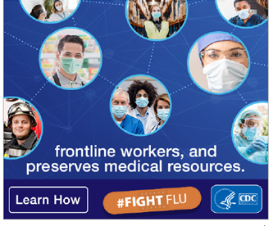
Draft Digital Campaign Materials Embargoed for release 9/14/2020

Slide 14
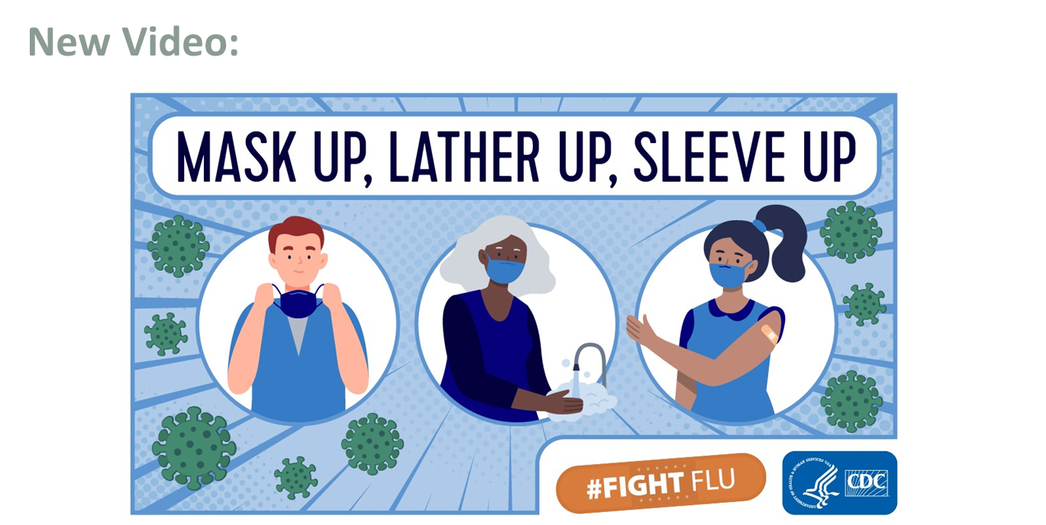

Slide 16
Communications Activities
Porter Novelli – Digital campaign
General population, people with high risk conditions, essential workers
Guided by consumer testing
CDC, AMA, Ad Council Collaboration – Full campaign
African American & Hispanic Audiences
Doing their own research & testing
CDC in-house product development
Clinician outreach
Supplemental materials

Slide 17
Acknowledgements & Thank you
Allison Fisher, HCSO Research Team Lead
Porter Novelli Flu Vaccine Campaign Team
My Awesome CDC team
More information: eub5@cdc.gov

