Slide 1
NACDD Policy Updates

Slide 2
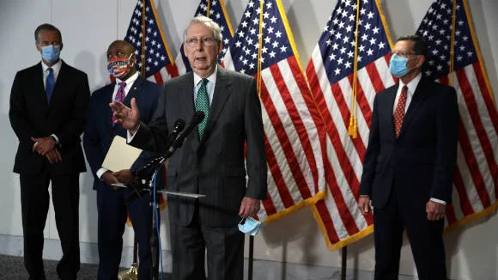
Senate “Skinny Bill on COVID Relief”
Senate Republicans on Tuesday unveiled a coronavirus relief plan.
It faces an uphill battle as Democrats immediately vowed to block what they called “a political ploy to help endangered Republicans win their elections instead of an earnest attempt to meet the needs of American families and businesses”.
Senate Majority Leader Mitch McConnell (R-KY) said “an initial vote on the measure could happen Thursday, and according to The Hill, appears confident he will be able to get 51 votes for the measure. McConnell will still be short of the 60 votes required to advance in the Senate.”

Slide 3
Senate “Skinny Bill on COVID Relief”
The estimated $300-billion proposal, dubbed the Delivering Immediate Relief to America’s Families, Schools and Small Businesses Act, includes:
Liability relief for businesses, schools, hospitals, and other nonprofit institutions
Codifies the executive order on unemployment insurance by giving states the option to continue providing $300 per week in extra, federally-funded benefits to those who qualified under CARES through December 27
Creates a second round of the Paycheck Protection Program with reforms, including a requirement that new applications show a revenue loss and that loan documents are to be maintained consistent with IRS requirements
Extends the deadline to September 30, 2021 for already appropriated Coronavirus Relief Funds, although no new money or flexibilities are provided

Slide 4
Senate “Skinny Bill on COVID Relief”
Additional appropriations:
Provides $105 billion in an Education Stabilization Fund for schools;
Provides $16 billion for testing, contact tracing, and surveillance in states;
Provides $31 billion for vaccine, therapeutic and diagnostic development, distribution, and stockpiles;
Provides $20 billion for additional farm assistance;
Provides $500 million to direct federal assistance for fisheries;
Provides $5 billion for the Child Care and Development

Slide 5
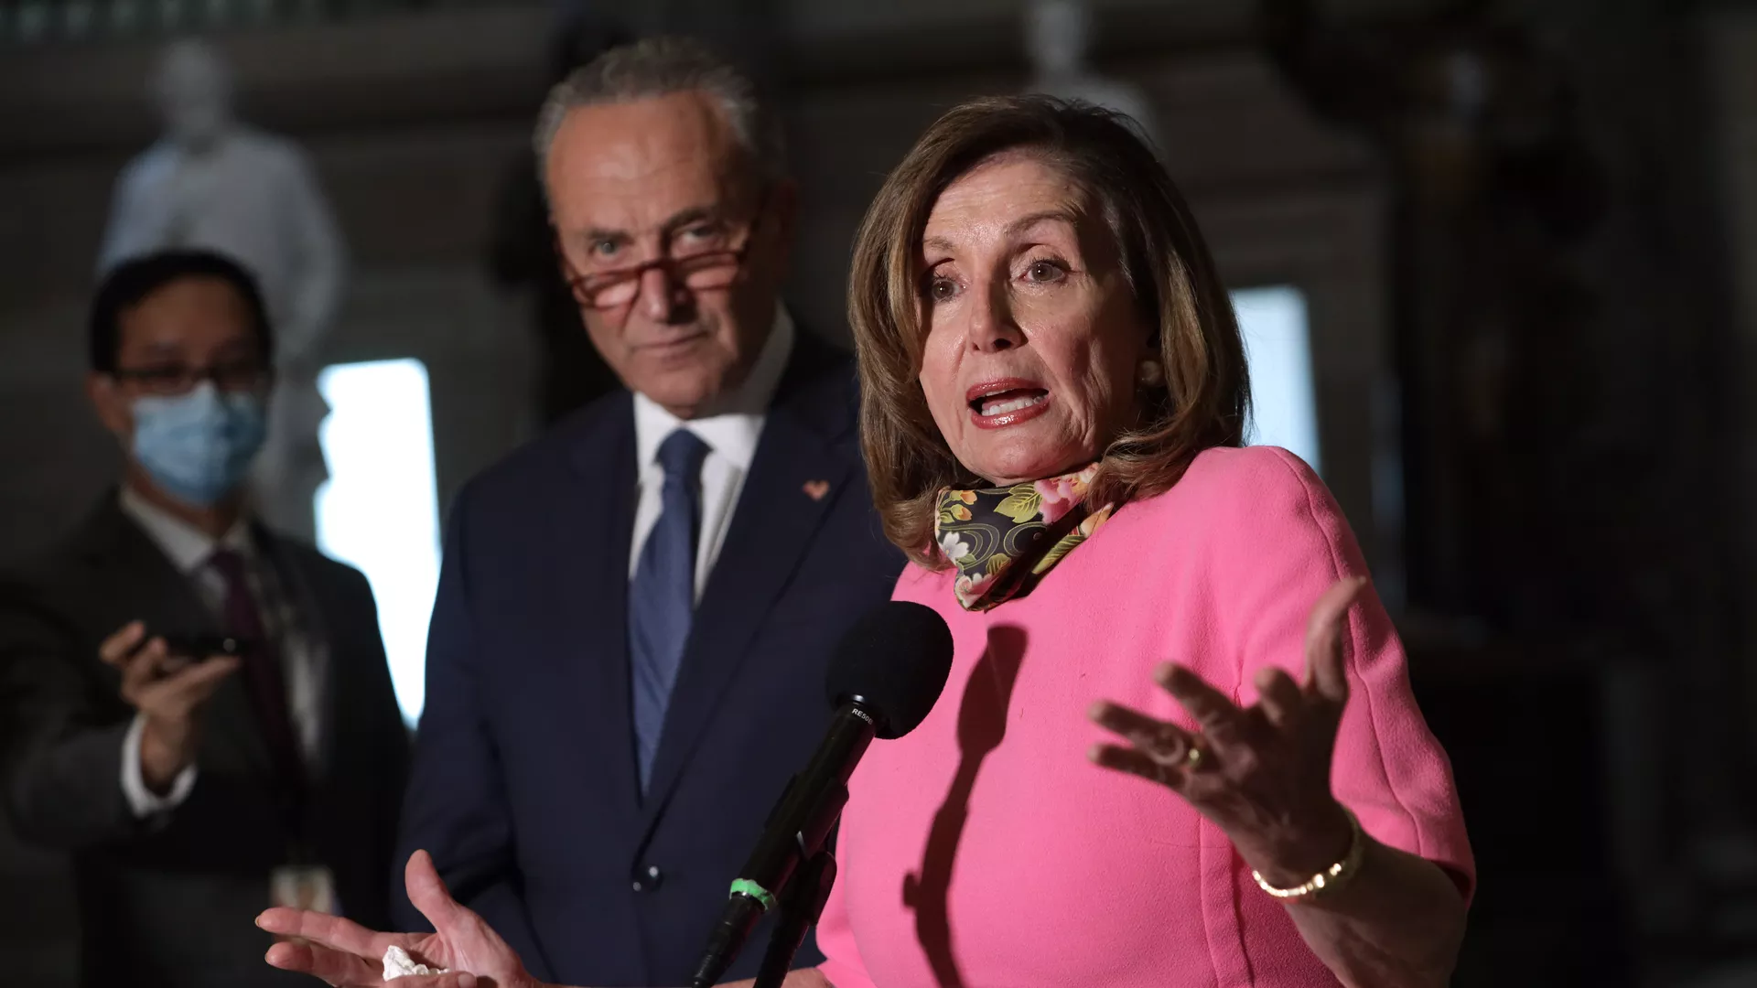
Senate “Skinny Bill on COVID Relief”
Senate Democrats say “this bill does not go nearly far enough as it doesn’t include help for small businesses, no stimulus checks for individuals, no funding for schools to help kids stay safe and learn, and no relief to the many states preparing to make huge budget cuts which will lead to layoffs of state employees”.
Senate Minority Leader Chuck Schumer said that “Democrats will use the same strategy that has worked twice already – say no to this bill and put on the pressure to bring forward more funding and more support to address real needs”.

Slide 6
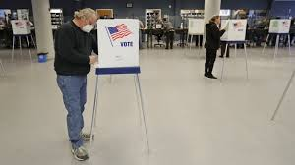
Appropriations Update
According to rumors, the Senate Appropriations Committee is not likely to post or mark-up any of their twelve Fiscal Year (FY) 2021 spending bills before October and could possibly wait until after the election.
The tables and report language could be released by subcommittees as a Chairman's Mark in either late September or early October, so that there is a marker for future omnibus negotiations.
Two Different Scenarios for Continuing Resolutions:
Through December – Republicans are suggesting
Through January – Democrats are suggesting (clearly in hopes of a change in Administration and possibly the Senate in the Nov. election)

