Slide 1
NACDD Policy Update August 26
Erin Prangley, NACDD, Director, Public Policy
eprangley@nacdd.org

Slide 2
Legislative Update
COVID Relief
Senate "skinny bill." The bill is sections of the HEALS Act including: unemployment insurance, education funding, PPP funding, and some funding for the US Postal services. The most problematic is inclusion of the liability shield bill that strips the ADA and other civil rights laws from enforcement and provides immunity to nursing homes and other medical providers even if they are negligent. See Center for Public Representation Summary at https://medicaid.publicrep.org/wp-content/uploads/Skinny-Senate-Proposal-and-Disability-Priorities.pdf and "side-by-side" comparison of all bills at https://medicaid.publicrep.org/wp-content/uploads/HEALS-v-Skinny-Proposal-v-HEROES.pdf
Next steps: CPR also has a good advocacy alert which you could share with your council members and self-advocates so long as you remind them that they are allowed to take action as individuals, but not on behalf of the council. Go to https://medicaid.publicrep.org/feature/covid-19-advocacy/#contact
Appropriations
FY21 Housing and Urban Development bill passes House (H.R. 7617). Provides significant increase in funding for housing programs that serve low-income people and communities, including people with disabilities. Includes an additional $4.6 billion for HUD programs above FY20 enacted levels. Read more at "Millions Awarded In Rental Assistance For People With Disabilities," Disability Scoop. (8/11/20) at https://www.disabilityscoop.com/2020/08/11/millions-awarded-in-rental-assistance-for-people-with-disabilities/28716/

Slide 3
Administration Updates
Public charge rule and COVID-19 public health emergency
Previously, NACDD signed on to an amicus brief challenging the public charge rule which put in place a new test for people who are applying for visas or green cards. Because the test looks at people’s health, including whether they have a disability, and whether they have used or might one day use public benefits, including Medicaid-funded home and community-based services on which many people with disabilities rely, several courts have already found that the rule illegally discriminates against people with disabilities. In August, federal courts issued multiple important decisions in the litigation challenging the Trump Administration’s public charge immigration rule and related policies. One court blocked the rule nationwide, but a few weeks after that another court said the rule applies in all states except New York, Connecticut, and Vermont. Attorneys at Center for Public Representation recommend:
Individuals who expect to apply for a visa or lawful permanent resident status should consult an immigration lawyer. To find help in your area, visit immigrationadvocates.org/nonprofit/legaldirectory.
For more information on these injunctions, see CPR's website at https://medicaid.publicrep.org/feature/public-charge/#lawsuit
Lawsuit Challenges Unlawful DeVos Rule Jeopardizing Low Income Students with Disabilities
The Council of Parent Attorneys and Advocates (COPAA) filed a lawsuit against Secretary Betsy DeVos and the U.S. Department of Education (ED) for attempting to siphon emergency federal COVID-19 funding away from K - 12 public schools and the students they serve.

Slide 4
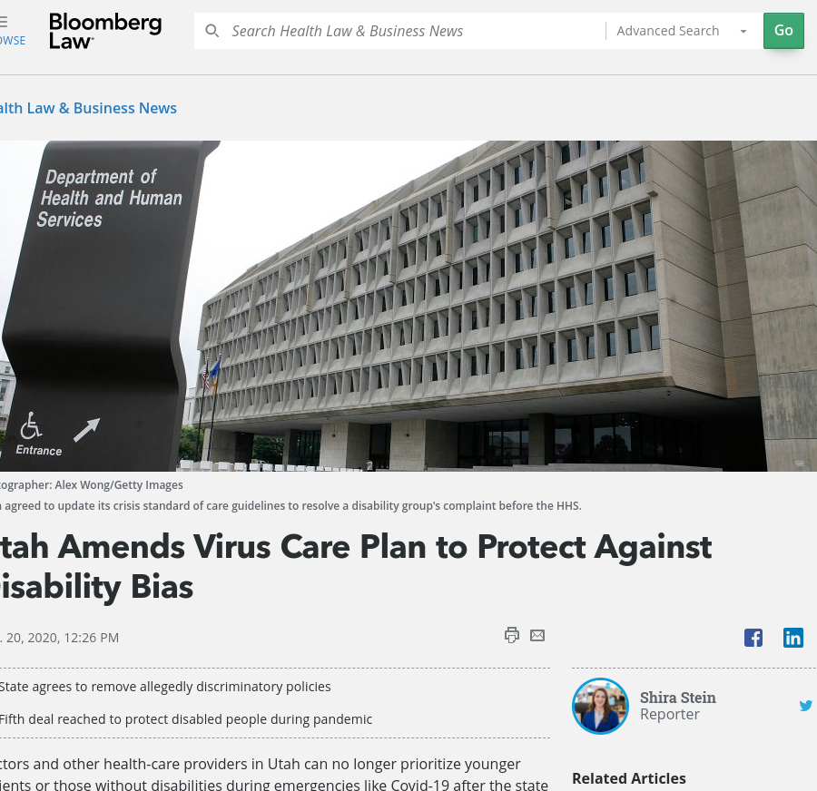
State Spotlight: Congratulations, Utah!
HHS' Office of Civil Rights announced a resolution with Utah which for the first time prohibits steering people with disabilities or conditioning their care on having a Do Not Resuscitate (DNR) order in place. See https://www.hhs.gov/about/news/2020/08/20/ocr-resolves-complaint-with-utah-after-revised-crisis-standards-of-care-to-protect-against-age-disability-discrimination.html and https://www.centerforpublicrep.org/wp-content/uploads/Utah-press-release_8-20-20.pdf
Next Steps: Share this information with your DD Agency and/or Public Health Agency to make sure your state health protocols align with this new resolution. (Note: This is only binding in Utah, but sends a strong signal to other states.)
Notes:
nother resolultion of a complaint filed by national and state disability organizations. In addition to the areas covered by previous resolutions (like prohibiting exclusions or deprioritization based on disability diagnosis or resource intensity, requiring modifications to assessment tools, prohibiting long-term survivability considerations, and prohibiting reallocation of personal ventilators), this

Slide 5
Emergency Management: When Covid and Hurricanes collide.
Legislative Action: Real Emergency Access for Aging and Disability Inclusion (REAADI) Act would require experts in lived experience in disability and aging to be part of the federal disaster planning, response, recovery, and mitigation. See S-1755 and HR-3208; https://reaadi.com/.
Disaster Relief Medicaid Act (DRMA) would require the federal government to cover 100% of the Medicaid costs for "Relief-Eligible" evacuees to other states. See S-1754 and HR-3215; https://reaadi.com/
Next steps: 1) Share information with your council about these NACDD priority bills.
2) Educate your council and self-advocates on ways they can get involved by taking action at https://reaadi.com/take-action-now/.
Response Efforts:
The Partnership for Inclusive Disaster Strategies
is hosting daily COVID-19 Disability Rights Calls. M, T, W, F at 6pm Eastern; Th 7pm Eastern. See https://disasterstrategies.org/
CALL-IN INFO:
Join Zoom Meeting
https://zoom.us/j/2114337114
** Password: 336330 **
Meeting ID: 211 433 7114
One tap mobile
+1.312.626.6799,, 211 433 7114# US (Chicago)
+1.646.876.9923,, 211 433 7114# US (New York)
Next steps: 1) Reach out to other DD Councils to support them.
2) Gather information on how people with disabilities are being impacted when there are multiple strains on emergency services.
3) Read the Partnership's latest report "Failures in COVID-19 Response Harm People with Disabilities and Older Adults," at https://bit.ly/3hwInnT
Notes:
REAADI It funds a National Commission on Disability Rights and Disasters (made up of at least 51% people with disabilities or aging population) to hold systems accountable for their response efforts; support accessible communication, protection of civil rights, accessible transportation and evacuation, and accessible health and medical care at the forefront of discussions; and requires DOJ to review all disaster relief spending to ensure funds are being spent in accordance of the Americans with Disabilities Act.

Slide 6
For more information contact Erin Prangley at eprangley@nacdd.org

