Slide 1
NACDD Policy Update August 5
Erin Prangley, NACDD, Director, Public Policy
eprangley@nacdd.org

Slide 2
Legislative Update
COVID Relief
Negotiations between White House and Democrats. White House chief of staff Mark Meadows said Tuesday's session was "probably the most productive meeting we've had to date." Treasury Secretary Steven Mnuchin said the two sides set a goal of reaching an agreement by the end of the week to permit a vote next week.
The Senate is scheduled to recess on Friday (August 7), but the break will almost certainly be delayed if an agreement cannot be reached. The House was scheduled to start its August break on Friday (July 31) and Members were sent home but told to be prepared to return with 24-hours’ notice once a deal is reached.
Appropriations
On Friday the House passed, on a 217 to 197 vote, a package of fiscal year 2021 appropriations bills. The package consists of six bills that fund federal departments including Defense, Commerce, Justice, Energy, Treasury Labor, Health and Human Services, Education, Transportation, and Housing and Urban Development from October 1, 2020 to September 30, 2021.
The minibus spending package, included the Labor-HHS-Education spending bill as Division F.
$80,000,000 for State Councils on Developmental Disabilities, which is $2,000,000 above the fiscal year 2020 enacted level and $24,000,000 above the fiscal year 2021 budget request.

Slide 3
Administration Updates
White House Issues Executive Order on Telehealth
The White House acknowledged that the utilization of telehealth services during the COVID-19 pandemic will make telehealth “a permanent feature of healthcare delivery system” going forward.
The executive order: 1) Directs the Department of Health and Human Services (HHS) to create rural health payment models; 2) Directs the Department of Agriculture and the Federal Communications Commission to develop a strategy to improve communications infrastructure in rural communities; 3) Directs HHS to report to the White House within 30 days on a plan to improve rural care, reduce maternal mortality, and mental health in rural communities; 4) Directs HHS to begin the regulatory process to allow the Department to continue telehealth payment beyond the expiration of the public health declaration. (Note: This is a recommendation from the Waiver Unwinding Working Group.)
The full text of the executive order can be found HERE.
Federal judge rules it is unconstitutional to deny Puerto Ricans access to SSI, SNAP, Medicare Part D
In a 70-page ruling, U.S. District Judge William G. Young “called it a discriminatory policy to deny Puerto Ricans Supplemental Security Income, which provides extra income for the elderly, blind, or disabled; Supplemental Nutrition Assistance Program, formerly known as food stamps; and Medicare Part D Low-Income Subsidy, which helps cover the cost of a prescription drug plan.
“The federal safety net is flimsier and more porous in Puerto Rico than in the rest of the nation,” he wrote. “To be blunt, the federal government discriminates against Americans who live in Puerto Rico.”
Click to read more: https://apnews.com/bce8ae96cb6a466f966a2a3a229cf9f0

Slide 4
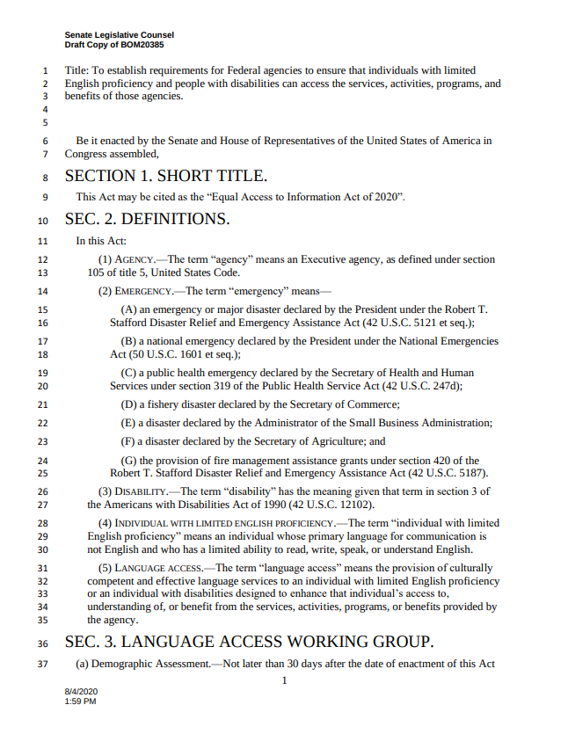
Coalition Work
Endorsed: Equal Access to Information Act (Sen. Menendez (NJ)): Would require: 1) All federal agencies to survey people with disabilities, people with limited English, within 30 days (and annually for the next 3 years); 2) Working group to draft a report on how the agencies communicate with people with disabilities and limited English proficiency during emergencies; 3) Stakeholder input requirements.
Other actions (sign on letters, social media, etc.)
Census: Letter to Leadership to extend the statutory reporting deadlines for the 2020 Census. (Census Project)
Adult Dependents: Thank you to Chair Grassley for Adult Dependent Rebates included in HEALS. (NACDD lead)
Telehealth: CCD statement of principles for telehealth expansion. (CCD)
Durable Medical Equipment: Letter to CMS asking for a delay in Medicare Competitive Bidding Program (CBP) for , Prosthetics, Orthotics, and Supplies (DMEPOS) for one year or throughout the public health emergency (whichever is longer)(ITEM Coalition)

Slide 5
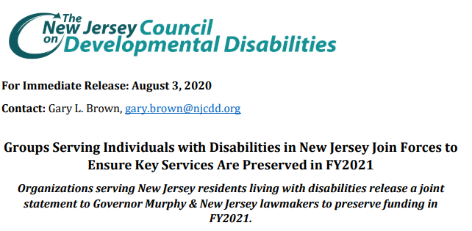
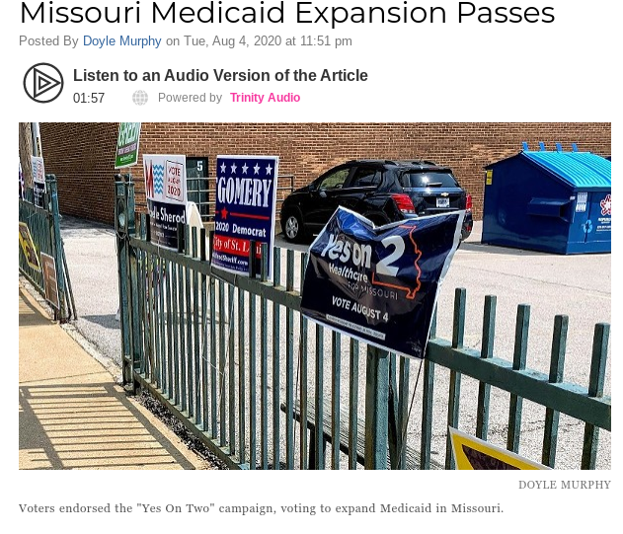
State Spotlights

Slide 6
Next Steps: Grassroots/Grasstops Advocacy
Contact your Congressional Delegation:
Call the Capitol Switchboard at (202) 224-3121 (voice) or (202) 224-3091 (tty) and ask to be connected to your member.
Script: "Hello, this is [Name]. I'm a resident of [Town, State]. I am calling to ask [Senator's or Representative's Name] to insist that legislation for the COVID-19 response include 1) an increased FMAP, 2) funding for Medicaid home and community-based services, 3) at least $540B funding for states, and at least $30M for the state developmental disabilities councils and other DD Act programs."
Self-Advocates
DD Council Execs
DD Council Members Local Legislators
Non-profits/providers Council grantees
Media
1. Power map influencers in your state.
2. Ask them to forward the letter from Sen. Warren or the DD Network letter to their members of Congress.
3. Keep track of the congressional staff responses and let NACDD know so they can follow up.
4. Contact Erin Prangley for background information and letters to send.

Slide 7
For more information contact Erin Prangley at eprangley@nacdd.org

