Slide 1
NACDD Policy Update July 22
Erin Prangley, NACDD, Director, Public Policy
eprangley@nacdd.org

Slide 2
Agenda
Legislative Update: HEALS v. HEROES
Next Steps for DD Council Advocacy
Public Policy Committee Task Forces resources and next steps:
State Budget Emergency Toolkit
Emergency Waivers Recommendations
Story collections

Slide 3
Legislative Update
This is a comparison of the Heroes Act (H.R. 6800) COVID-19 relief package, passed by the House on May 15, 2020, and the Health, Economic Assistance, Liability Protection, and Schools (HEALS) Act announced on July 27, 2020.
See more disability specific information here: https://medicaid.publicrep.org/wp-content/uploads/HEALS-v-HEROES.pdf and general information here https://progressivecaucusactionfund.org/s/Comparison-of-the-Heroes-Act-and-HEALS-Act.pdf.
Issue | HEALS | HEROES
Total Funding | $1T | $3.5T
DD Act Programs | $10M for P&A; $2M for other ACL programs which might include DD Act programs. | $10M for DD Act Programs
Adult Dependent | Includes adult dependents. | Includes adult dependents.
HCBS Funding | None. | FMAP bump to 14% plus additional 10% HCBS program for 1 year.
State Stabilization Funds | No general relief funds for state and local governments. | $540 billion in grants to states, tribes, and territories; $375 billion to local
Corporate immunity from lawsuits "related to" COVID-19. | Expansive corporate immunity sheilding from lawsuits (states and federal) except for "intentional misconduct and gross negligence" through 2024. | No corporate immunity provision
Notes:
State funds "flexiblity": Changes to use of existing CARES Act funds for state and local governments ○ Prohibits use for pensions, post-employment benefits, rainy day funds, and personal use of government officers ○ Allows use to cover revenue shortfalls ○ Extends eligible use through 90 days after the end of a government’s 2021 fiscal year ● No additional funding for highways, transits agencies, CDBG, or tribal government
Immunity: Replaces state tort law with an exclusive federal cause of action for lawsuits related to COVID-19 exposure ○ Bars lawsuits for negligence but includes an exception for intentional misconduct and gross negligence ○ Raises the standard of proof plaintiffs must meet to “clear and convincing evidence” ● Shields corporations from lawsuits if they “make reasonable efforts” to comply with mandatory government safety standards ○ Where multiple government standards apply (e.g. differing state and local guidance), corporations would be shielded from lawsuits as long as they make reasonable efforts to comply with any one applicable standard ● Immunizes employers from both lawsuits and public enforcement of employment law where alleged violations are related to COVID-19 response, including lawsuits to enforce the Fair Labor Standards Act (FLSA), Americans with Disabilities Act (ADA), Title VII of the Civil Rights Act, and other non-discrimination laws ● Bars COVID-19 related medical liability lawsuits against health care providers, except for “gross negligence and willful misconduct” ● Corporate immunity provisions would last through 2024

Slide 4
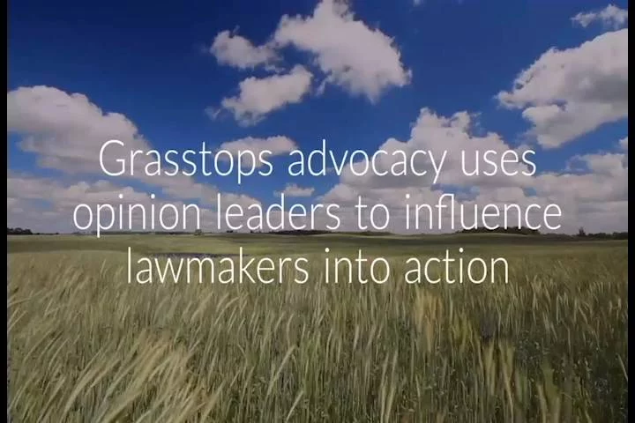
Next Steps: Grassroots/Grasstops Advocacy
Contact your Congressional Delegation:
Call the Capitol Switchboard at (202) 224-3121 (voice) or (202) 224-3091 (tty) and ask to be connected to your member.
Script: "Hello, this is [Name]. I'm a resident of [Town, State]. I am calling to ask [Senator's or Representative's Name] to insist that legislation for the COVID-19 response include 1) an increased FMAP, 2) funding for Medicaid home and community-based services, 3) at least $540B funding for states, and at least $30M for the state developmental disabilities councils and other DD Act programs."
Self-Advocates
DD Council Execs
DD Council Members Local Legislators
Non-profits/providers Council grantees
Media
1. Power map influencers in your state.
2. Ask them to forward the letter from Sen. Warren or the DD Network letter to their members of Congress.
3. Keep track of the congressional staff responses and let NACDD know so they can follow up.
4. Contact Erin Prangley for background information and letters to send.

Slide 5
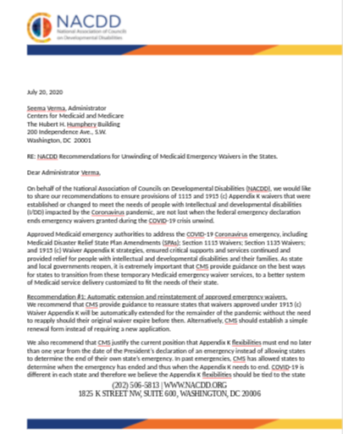
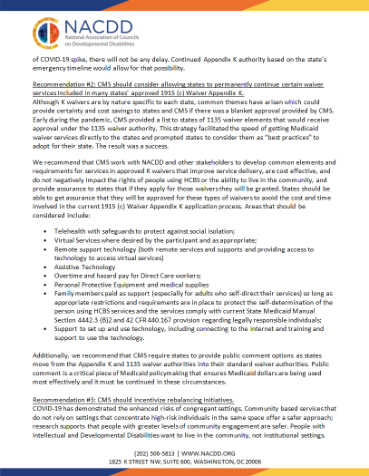
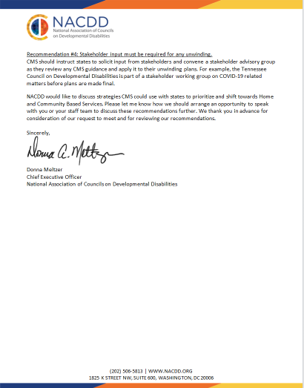
PPC Resource: Emergency Medicaid Waivers
Recommendation #1: Automatic extension and reinstatement of approved emergency waivers.
Recommendation #2: Allow states to permanently continue certain waiver services included in many states’ approved 1915 (c) Waiver Appendix K.·
Telehealth with safeguards to protect against social isolation;
Virtual Services where desired by the participant and as appropriate;
Remote support technology (both remote services and supports and providing access to technology to access virtual services)
Assistive Technology
Overtime and hazard pay for Direct Care workers;
Personal Protective Equipment and medical supplies
Family members paid as support
Support to set up and use technology, including connecting to the internet and training and support to use the technology.
Recommendation #3: CMS should incentivize rebalancing initiatives.
Recommendation #4: Stakeholder input

Slide 6
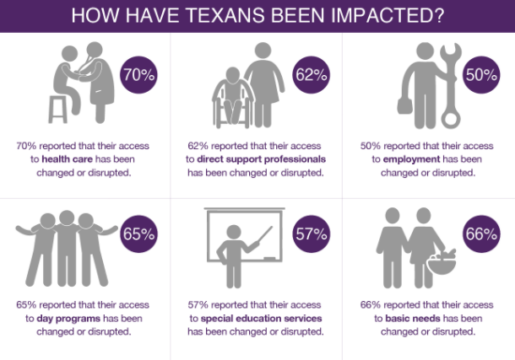
Next Steps: State Support for Waivers
Grassroots
1. Story collection. (See shared resources drive for examples from Wisconsin, Texas, and other states.)
2. Package and report to state and federal legislators. See TX Covid Stories at https://tcdd.texas.gov/resources/covid-19-information/texas-covid-stories/ and WI Survival Coalition press release and press packet on survey of COVID impacts on people with disabilities at
http://www.survivalcoalitionwi.org/wp-content/uploads/2020/04/SurvivalCoalition_PressRelease_COVID2_042120_FINAL.pdf
Grasstops
1. Powermap grasstop influencers.
2. Contact them to see if they agree with NACDD recommendations and would be willing to contact CMS with their own letter to amplify these recommendations.

Slide 7
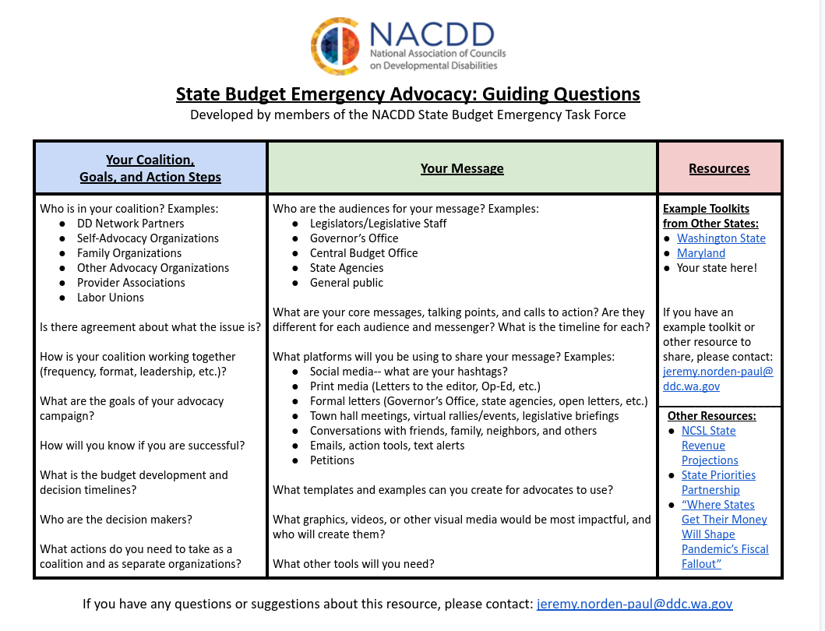
PPC Resource: State Emergency Budget Toolkit

Slide 8
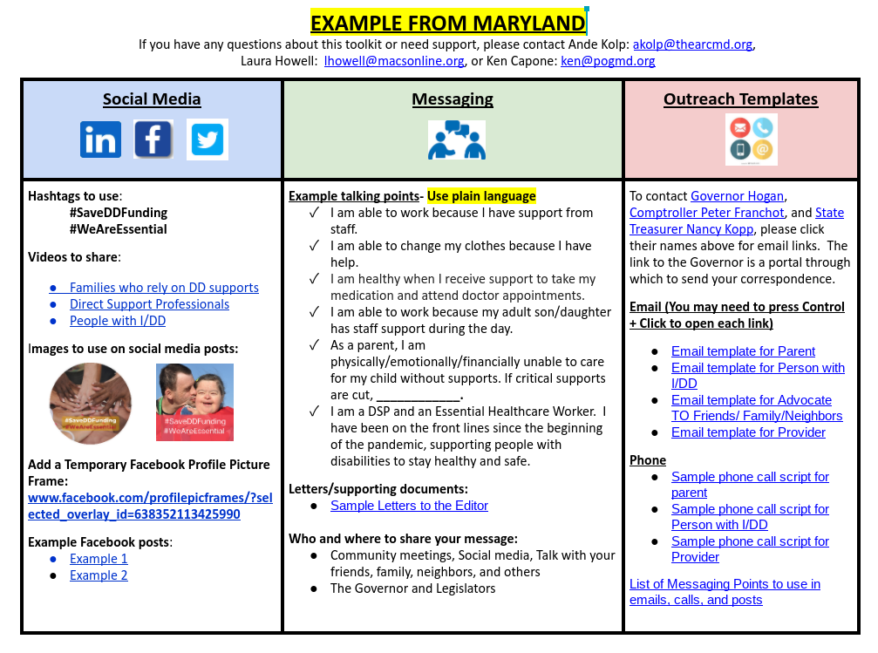
Next Step: Customize the Toolkit!

Slide 9
For more information contact Erin Prangley at eprangley@nacdd.org

