Slide 1
NACDD Policy Update July 22
Erin Prangley, NACDD, Director, Public Policy
eprangley@nacdd.org

Slide 2
Agenda
Legislative Update: COVID 4
Administrative Update: Emergency Waiver Task Force Report
State Spotlight: State Budget Emergency Toolkit
State Spotlight: Texas COVID-19 Advoacy through Stories
New Resources: CDC, NASDDDS, RespectAbility
NACDD Champions Award Announcement
Senate ADA 30th Panel Presentation

Slide 3
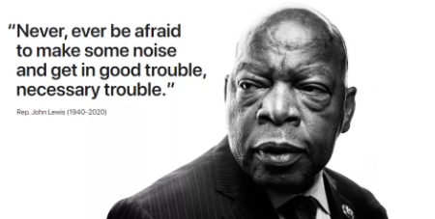
John Lewis (February 21, 1940 – July 17, 2020)
NCIL 20th Anniversary of ADA event in front of Congress. Here's the link: https://www.youtube.com/watch?v=EwpN09LlgqM)

Slide 4
Legislative Update
"COVID 4" Status: Senate bill delayed until later this week or next because White House and Republican Caucus disagreement on Trump pushing payroll tax cut. House press conference also shows divisions in ranks over spending. (Tea party v. everyone else). Senate Dems are concerned that delay/discord will run up agains the expiring enhanced unimployment benefits and eviction moritiroum set to expire at the end of next week. No word on DD Act funding, dependent adult payments or HCBS. Meanwhile, House passed HEROES weeks ago. $3.5T aligned with disabiity priorities. Problem is pressure of the clock to yield. Changes hour by hour, day by day.​​

Slide 5
Legislative Update
Senate Bill (Based on rumor/no details)
Total funds: $ 1T 1.5B for "safe reopening" schools with strings. No additional state stability dollars, but more flexiblity on how the previously appropriated funds can be spent. Another round of stiumulus payments, but likely capped at 40k individual or 80k household Tax incentives for hiring and retaining workers. Another round of PPP towards hardest hit businesses. | Health funding vacine and testing reources, Unemployment insurance extension but significantly less than 600 (maybe 200-300 range) Maybe childcare money. No word on disability priorities yet. AUCD Action Alert: https://www.aucd.org/template/news.cfm?news_id=14610&parent=16&parent_title=Home&url=/template/index.cfm?

Slide 6
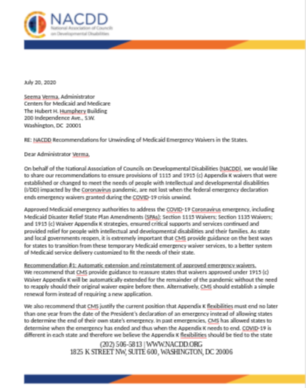
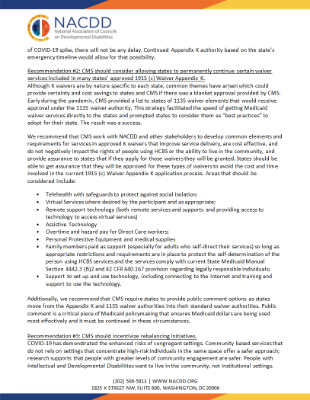
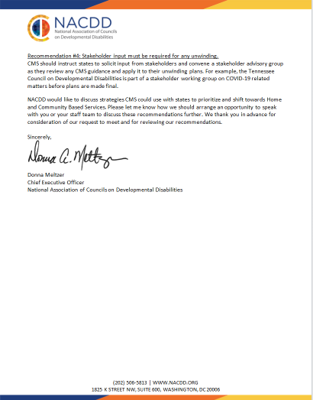
Administrative Update: Emergency Medicaid Waivers
Recommendation #1: Automatic extension and reinstatement of approved emergency waivers.
Recommendation #2: Allow states to permanently continue certain waiver services included in many states’ approved 1915 (c) Waiver Appendix K.·
Telehealth with safeguards to protect against social isolation;
Virtual Services where desired by the participant and as appropriate;
Remote support technology (both remote services and supports and providing access to technology to access virtual services)
Assistive Technology
Overtime and hazard pay for Direct Care workers;
Personal Protective Equipment and medical supplies
Family members paid as support
Support to set up and use technology, including connecting to the internet and training and support to use the technology.
Recommendation #3: CMS should incentivize rebalancing initiatives.
Recommendation #4: Stakeholder input

Slide 7
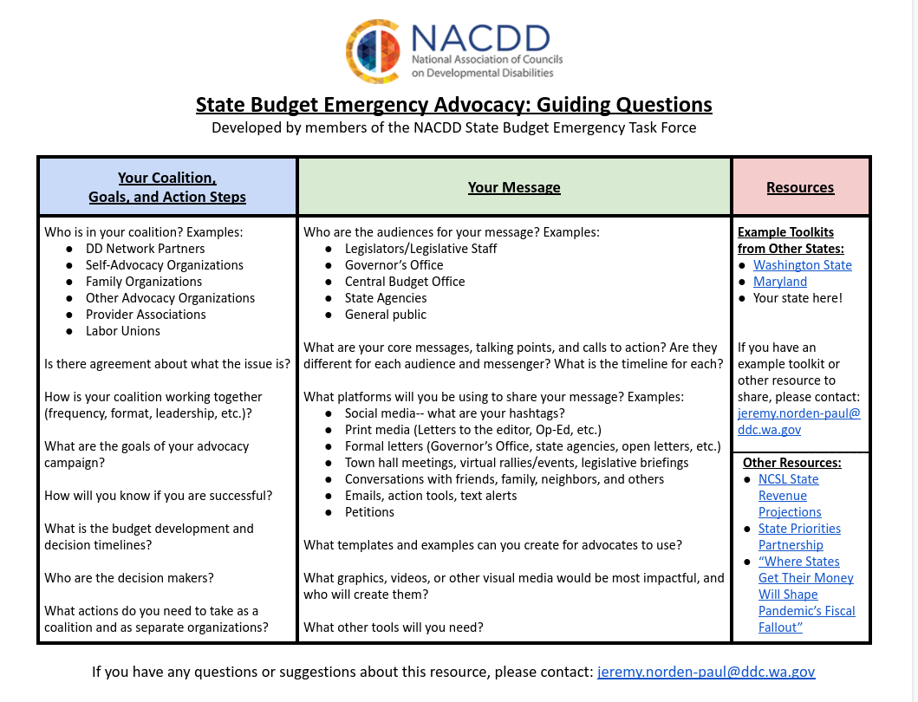
State Spotlight: State Emergency Budget Toolkit

Slide 8
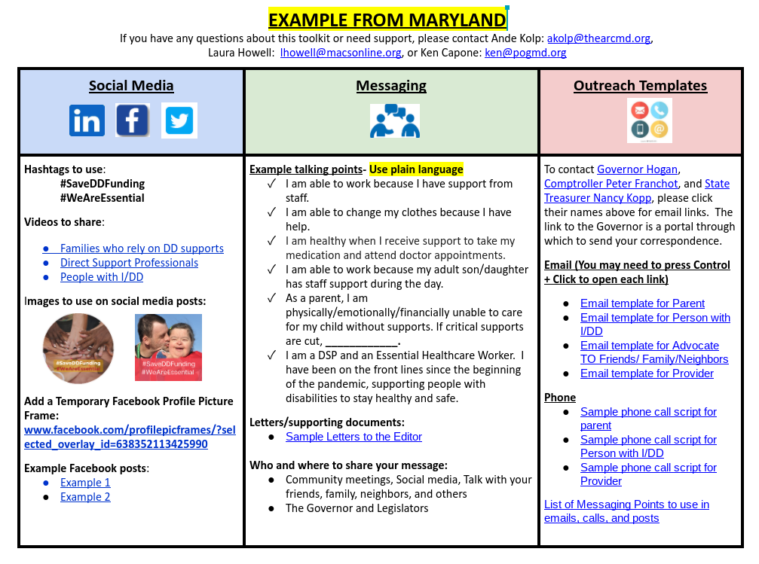
State Spotlight: State Emergency Budget Toolkit

Slide 9
State Spotlight: Texas Advocacy through Stories

Slide 10
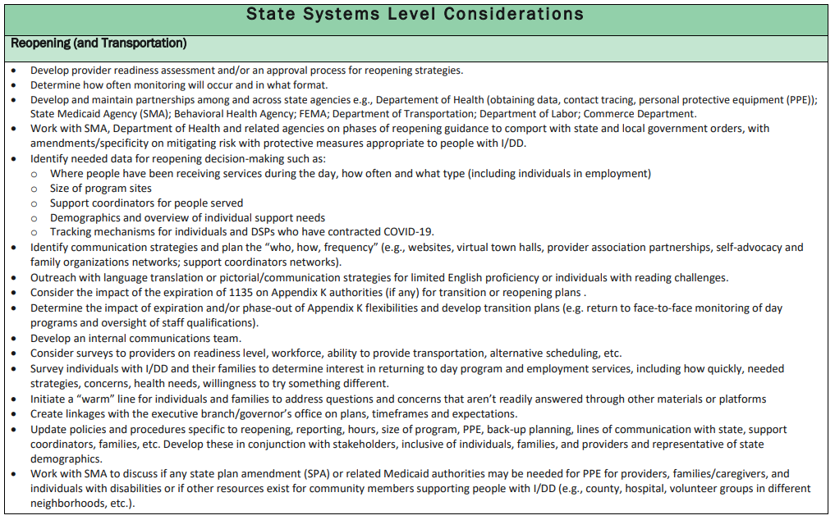
New Resources
https://www.nasddds.org/news/re-opening-information-for-employment-and-day-service-providers

Slide 11
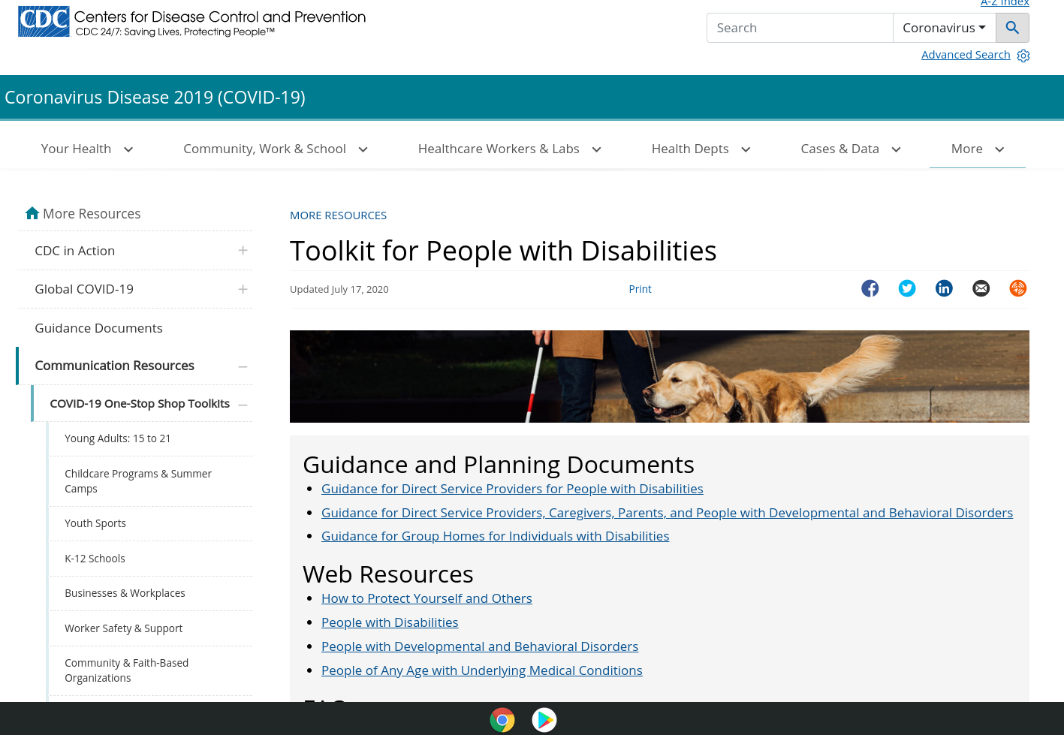
New Resource: CDC Toolkit
Guidance and Planning Documents
Web Resources
FAQs
Posters
Fact Sheets
Social Media
https://www.cdc.gov/coronavirus/2019-ncov/communication/toolkits/people-with-disabilities.html

Slide 12
New Resource: RespectAbililty Education Reopening Resources
Do you know of toolkits/resources that could help students with disabilities and families as they continue online learning? RespectAbility is collecting resources (local, state and national) to unveil this Monday at their national conference.See https://www.respectability.org/resources/education-resources-disability-issues/ Please send resources to eprangley@nacdd.org to be included on this page.

Slide 13
Save the Date! NACDD Announces its 2020 Champions of Equal Opportunity Awardees plus event and panel.
NACDD Annual Conference Kick Off and Awards |Thursday August 6, 2020 | 2pm ET via Zoom
Honoring
Heidi Lieb-Williams (AK), Betty Williams Champions of Equal Opportunity Award Jessica Barrett (NE), April Dunn Start Your Journey Award.
Featuring a panel discussion on how the ADA 30th Anniversary has changed opportunities for people with disabilities and how having DD Councils for 50 years has given opportunities for people with disabilities to really make a difference in their state of territory.
Panelists
Aaron Kaufman, former NACDD Board member and former Maryland DD Council chair
Max Barrows, 2019 Champion of Equal Opportunity awardee Kate Brady, Deputy Director of the Georgia DD Council Emmanuel Jenkins, Administrative Specialist of the Delaware DD Council Renee Manfredi, 2018 Self-Advocates Leadership Circle inductee, and Hawaii DD Council Member.

Slide 14
Senate ADA Celebration
30th Anniversary of the Americans with Disabilities Act (ADA) Senate Celebration Part 2
“Continuing the Fight: Ensuring the ADA Works for Everyone” July 24, 2020 1-2pm EST
The panel will center on the next 30 years and beyond of the ADA and shine a spotlight on how intersectional identities—including race, gender, and sexuality—affect access to the rights affirmed by the ADA. Members of Congress have been invited to give remarks. Panelists include:
Jeiri Flores, Advocacy Discipline Coordinator, University of Rochester LEND
Conchita Hernandez Legorreta, Maryland Statewide Blind and Low Vision Specialist
Catherine Lhamon, Moderator, Chair, U.S. Commission on Civil Rights
CART and American Sign Language will be provided. No need to register. Just go to this link when the event starts:
https://senate.webex.com/senate/onstage/g.php?MTID=e6fa730d6ff72aabd92e62c9e712393ac

Slide 15
For more information contact Erin Prangley at eprangley@nacdd.org

