Slide 1
NACDD
Policy Update
July 1
Erin Prangley, NACDD, Director, Public Policy
eprangley@nacdd.org

Slide 2
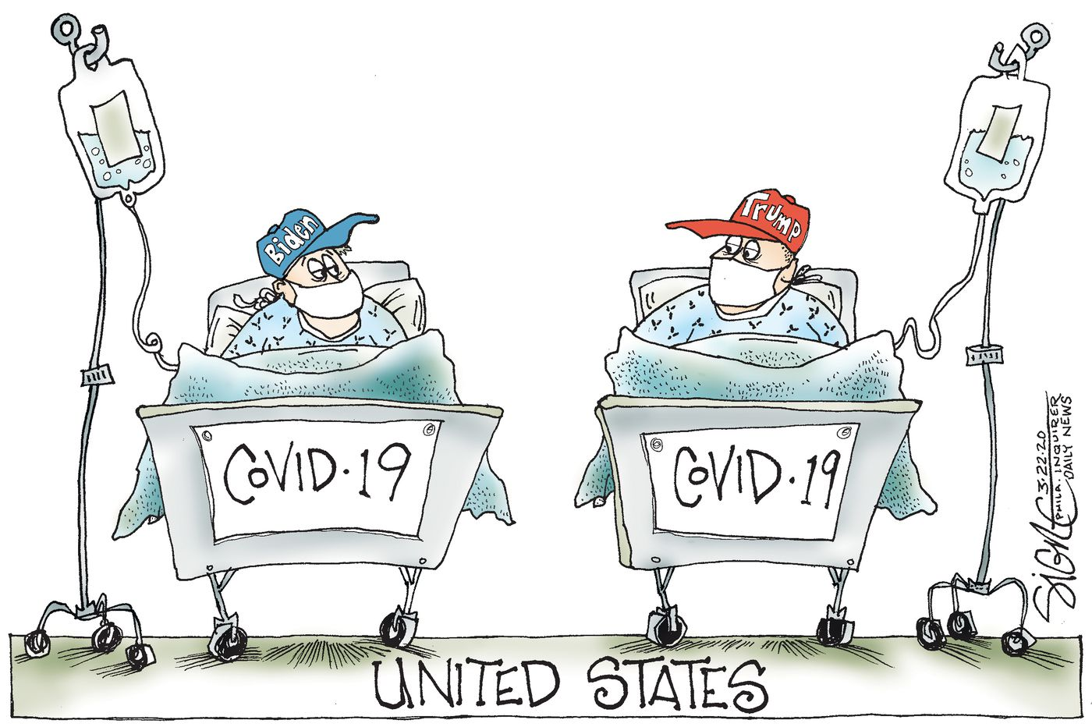
Legislative Update: Senate
Senate passed extention to Paycheck Protection Program loans, which can be turned into grants, until Aug. 8. SBA has approved $520.6 billion via nearly 4.9 million loans. But, $130M is left unspent unless Congress can agree to an extension. House and President must act.
Senate Democrats struck a very partisan tone this week.
  Several senators brougth COVID related bills to the floor requesting unanimous consent that they would not get. Two of them were of particular interest to NACDD: Coronavirus Child Care and Education Relief Act (would provide $430 billion to education including $12 billion for IDEA; and clarifies congressional intent is for funds to go to public schools, not vouchers) and the Nursing Home COVID-19 Protection and Prevention Act ($20 billion to help states, nursing homes and other congregate settings implement strategies to reduce the spread of COVID-19).
  Democrats on the Aging Subcommittee released a report "COVID-19 IN NURSING HOMES How the Trump Administration Failed Residents and Workers" https://www.aging.senate.gov/imo/media/doc/COVID-19%20in%20Nursing%20Homes%20Final%20Report.pdf Despite the partisan tone, there is a lot of good data and arguments in there.
Senate will take up next COVID Package during the last week of July.
ADA Celebration Senate activities will include virtual panels during the week of 7/20.
House
Last week held a hearing on "Examining the Nursing Home COVID-19 crisis (video recording and testimony here). While most of the testimony was focused on nursing home regulations, there also was some mention of the need to expand HCBS as an alternative to nursing homes (mentioned specifically in the testimony of AARP and the ombudsmen). CCD submitted a statement for the hearing, focusing on the need for HCBS funding for alternatives to nursing homes and other institutions and that the problems being highlighted in the hearing are not just nursing home issues but are congregate care issues. See http://www.c-c-d.org/fichiers/CCD-LTSS-Statement-for-House-Ways-and-Means-Nursing-Home-Hearing-6-25-20.pdf
House took up National Defense Authorization Act. There is a concern that an Ability One amendendment could weaken competitive and integrated employment.
Notes:
FY2021 Appropriations:
Mark-ups in Senate: Likely next week and early June and continue after July 4th recess.
House: Will not proceed until the next COVID-19 relief bill has passed
Covid-19 Response Bills: On Friday, Senate Democrats introduced a COVID-19 response bill that aims to provide affordable coverage to Americans during the pandemic. It includes language that would require coverage of all COVID-19-related treatment, subsidized COBRA and a special enrollment period for healthcare.gov.
Another bipartisan group of Senators introduced the "Paycheck Protection Extension Act", which would extend the deadline to apply to the Paycheck Protection Program (PPP) and the period that borrowers are allowed to use funds, as well as allow funds to be used to purchase PPE. The bill text can be found here, and a summary is here.
When the Senate returns in June, they will have a busy agenda waiting for them. Finance Committee Chairman Chuck Grassley (R-IA) was quoted saying that he expects negotiations on the next coronavirus response to begin in the third or fourth week of June, and wrap up before August recess. (via Roll Call)
House Democrats are expressing more urgency on moving a COVID-19 relief package, and that the PPP fix that could come as soon as next week is not the only urgent need. We are hearing that House Democrats are pushing for negotiations with the pressure points of June 30 for state budgets and July 31 for the need to extend unemployment insurance.

Slide 3
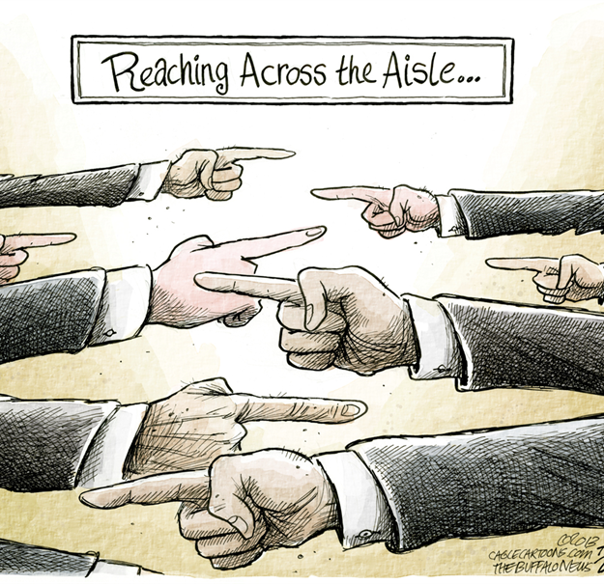
Legislative Update: House
Last week held a hearing on "Examining the Nursing Home COVID-19 crisis (video recording and testimony at https://waysandmeans.house.gov/legislation/hearings/examining-covid-19-nursing-home-crisis). While most of the testimony was focused on nursing home regulations, there also was some mention of the need to expand HCBS as an alternative to nursing homes (mentioned specifically in the testimony of AARP and the ombudsmen). CCD submitted a statement for the hearing, focusing on the need for HCBS funding for alternatives to nursing homes and other institutions and that the problems being highlighted in the hearing are not just nursing home issues but are congregate care issues. See http://www.c-c-d.org/fichiers/CCD-LTSS-Statement-for-House-Ways-and-Means-Nursing-Home-Hearing-6-25-20.pdf
House took up National Defense Authorization Act. There is a concern that an Ability One amendendment could weaken competitive and integrated employment.
House
Last week held a hearing on "Examining the Nursing Home COVID-19 crisis (video recording and testimony here). While most of the testimony was focused on nursing home regulations, there also was some mention of the need to expand HCBS as an alternative to nursing homes (mentioned specifically in the testimony of AARP and the ombudsmen). CCD submitted a statement for the hearing, focusing on the need for HCBS funding for alternatives to nursing homes and other institutions and that the problems being highlighted in the hearing are not just nursing home issues but are congregate care issues. See http://www.c-c-d.org/fichiers/CCD-LTSS-Statement-for-House-Ways-and-Means-Nursing-Home-Hearing-6-25-20.pdf
House took up National Defense Authorization Act. There is a concern that an Ability One amendendment could weaken competitive and integrated employment.
Notes:
FY2021 Appropriations:
Mark-ups in Senate: Likely next week and early June and continue after July 4th recess.
House: Will not proceed until the next COVID-19 relief bill has passed
Covid-19 Response Bills: On Friday, Senate Democrats introduced a COVID-19 response bill that aims to provide affordable coverage to Americans during the pandemic. It includes language that would require coverage of all COVID-19-related treatment, subsidized COBRA and a special enrollment period for healthcare.gov.
Another bipartisan group of Senators introduced the "Paycheck Protection Extension Act", which would extend the deadline to apply to the Paycheck Protection Program (PPP) and the period that borrowers are allowed to use funds, as well as allow funds to be used to purchase PPE. The bill text can be found here, and a summary is here.
When the Senate returns in June, they will have a busy agenda waiting for them. Finance Committee Chairman Chuck Grassley (R-IA) was quoted saying that he expects negotiations on the next coronavirus response to begin in the third or fourth week of June, and wrap up before August recess. (via Roll Call)
House Democrats are expressing more urgency on moving a COVID-19 relief package, and that the PPP fix that could come as soon as next week is not the only urgent need. We are hearing that House Democrats are pushing for negotiations with the pressure points of June 30 for state budgets and July 31 for the need to extend unemployment insurance.

Slide 4
New Amicus Brief: NY v. Dept. of Education
Issue: Whether the U.S. Department of Education (“ED”) and Secretary of Education Betsy DeVos published a final rule that upends ED’s 45-year-old regulations implementing Title IX, stripping longstanding protections for sexual harassment victims and imposing expansive new procedural requirements on K-12 and postsecondary educational institutions in handling students’ sexual harassment complaints, harms students with disablities.
Argument: Students with disablities are dispropotionately affected by sexual assault and sexual harassment in schools. These regulations make it harder for students to report the assault and harassment and harder to receive a fair process because of lack of accommodations.
Other signers: Lawyers’ Committee for Civil Rights Under Law, the American Humanist Association, Education Law Center- PA, Lambda Legal Defense and Education Fund, Inc., National Center for Parent Leadership, Advocacy and Community Empowerment, National Association of Councils on Developmental Disabilities and the National Center for Special Education in Charter Schools.
For more information about the case, go to https://www.insidehighered.com/quicktakes/2020/06/05/attorneys-general-sue-devos-education-department-over-title-ix-rule. For backgound on how this new regulation is harmful to students with disabiities see https://nacdd.org/wp-content/uploads/2019/01/Final-CCD-Title-IX-comments-1.30.19.pdf
Notes:
The commission has four primary tasks for immediate and long-term windows, including:
identify best practices for facilities to enable rapid and effective virus identification and mitigate transmission;
recommend best practices for infection control and facility resiliency;
identify best practices for improved care delivery and responsiveness for nursing home residences before, during and after an emergency;
leverage new data sources to improve infection control policies and enable coordination across government and local agencies to mitigate coronavirus and future emergencies.
The commission met for the first time on Tuesday, and Burket said one priority for him is to try to blend the requirement to follow science-driven guidance on the virus with a desire for the public to find a new normal.

Slide 5
Next Steps
Join the State Budget Emergency Task Force!
Contact: Jeremy Paul-Norden at jeremy.norden-paul@ddc.wa.gov
Join "Unwinding" Emergency Waivers Task Force!
Contact: Tamara Jackson tamara.jackson@wisconsin.gov
Attend the NACDD Public Policy Committee Meeting!
Tomorrow, July 2, 2020, 2:00 PM Eastern Time
Zoom Meeting
https://us02web.zoom.us/j/82156490017?pwd=RXdDckIwUkxuMGo3dkovOW1LWllVZz09
Meeting ID: 821 5649 0017 | Password: 465609
Dial by your location
+1 301 715 8592 US (Germantown)
+1 929 205 6099 US (New York)

Slide 6
For more information contact
Erin Prangley at eprangley@nacdd.org

