Slide 1
Using The State of the States in Intellectual and Developmental Disabilities Data in State Plan Development
Administration for Community Living
Webinar for DD Councils
August 6, 2019 (rev. 6.17.2020)
Amie Lulinski, PhD, FAAIDD
Emily Shea Tanis, PhD, FAAIDD (PI)
Joy Wu, PhD

Slide 2
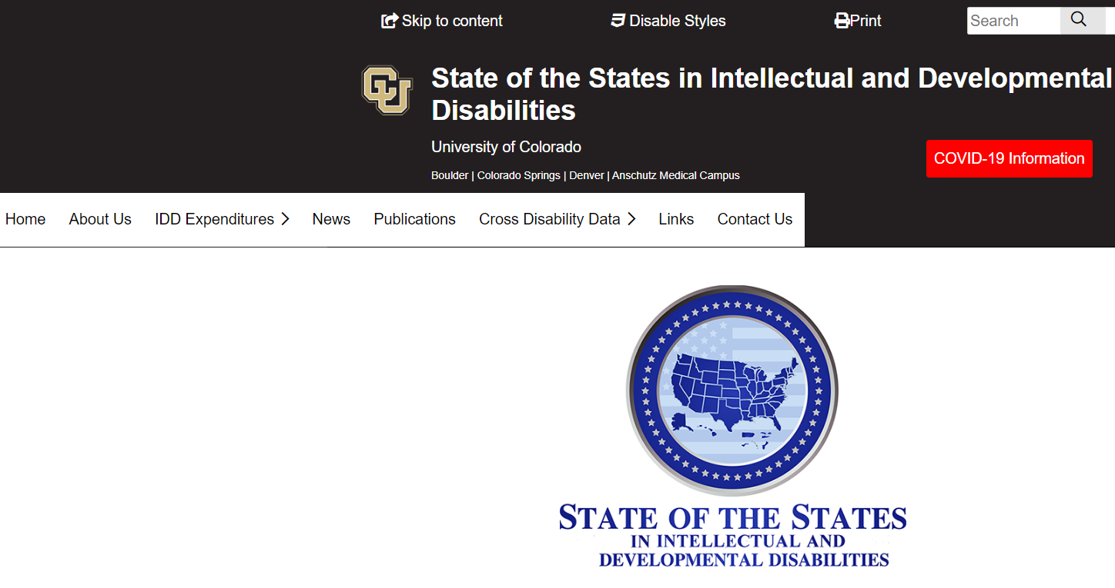
State profile www.stateofthestates.org
Notes:
Another way to obtain SOS data is via the website www.stateofthestates.org
Each state profile contains the following information specific to that state:
Total public IDD spending for services
Public IDD spending by revenue source
Fiscal effort for IDD services
Federal IDD Medicaid spending by revenue source
Federal-state Medicaid as a percentage of total and IDD spending in fiscal year (this one is FY 2015)
# of HCBS waiver participants
Inflation adjusted waiver cost per participant
Average number of daily residents by setting size
Chart of number of persons served by setting
# of people in public and private 16+ institutions
Individual and family support spending and participants
Proportion of spending by setting
% of supported employment participants in employment programs
Estimated number of individuals by living arrangement
Estimated number of individuals with IDD living with family caregivers by caregiver age group and
Number of IDD caregiving families receiving formal supports from IDD agency

Slide 3
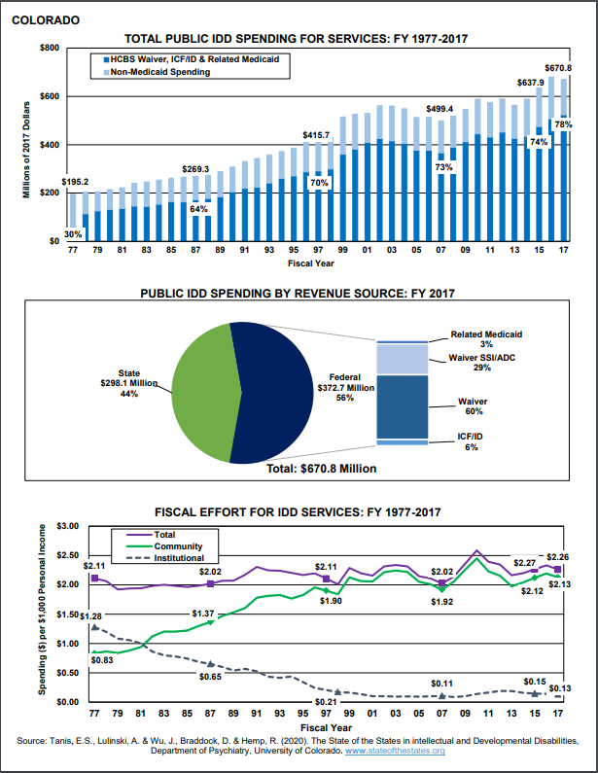
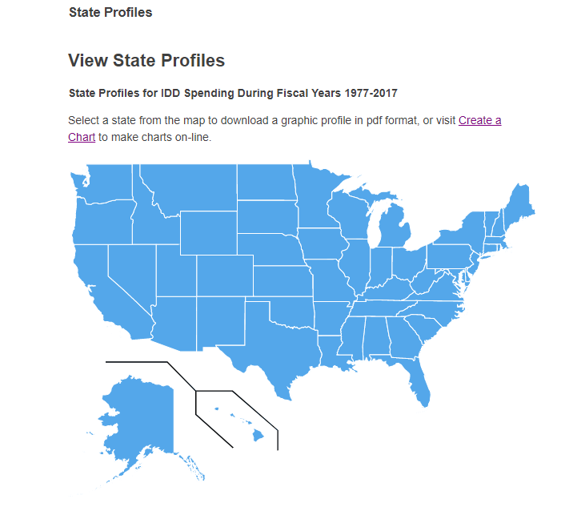
State profile continued

Slide 4
Overall Spending – State Profile (p. 1)
Source: Tanis, Lulinski, Wu, Braddock, & Hemp (in preparation). Department of Psychiatry, University of Colorado

Slide 5
Overall Spending Trends (p. 2)

Slide 6
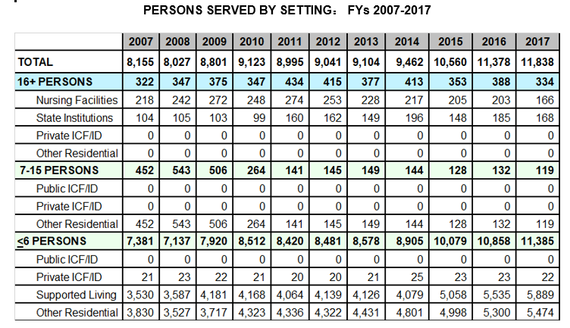
Residential Settings – State Profile (p. 4)
Source: Tanis, Lulinski, Wu, Braddock, & Hemp (in preparation). Department of Psychiatry, University of Colorado

Slide 7
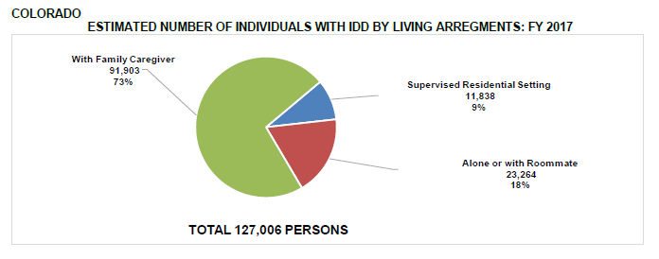
Housing – State Profile (p. 6)

Slide 8
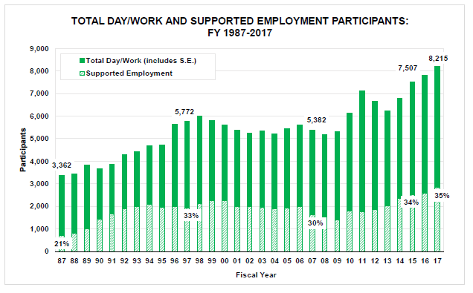
Employment – State Profile (p. 5)
Source: Tanis, Lulinski, Wu, Braddock, & Hemp (in preparation). Department of Psychiatry, University of Colorado

Slide 9
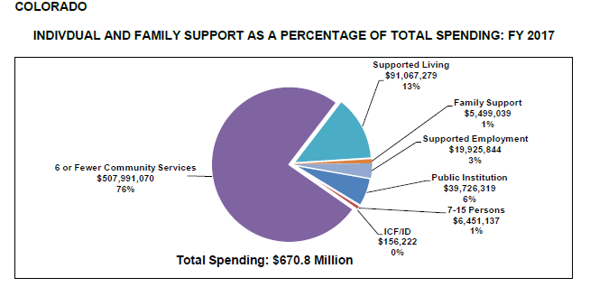
Employment, Individual and Family Support (p. 5)
Notes:
Top of page 4 - state profile

Slide 10
Family Support and Adequacy – State Profile (p. 6)– families

Slide 11
Housing - State Profile (p. 6)

Slide 12
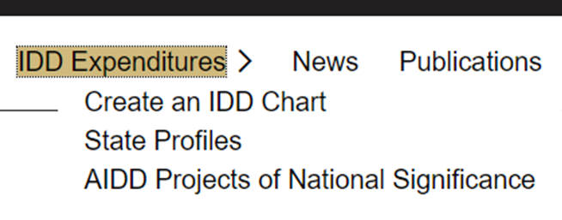
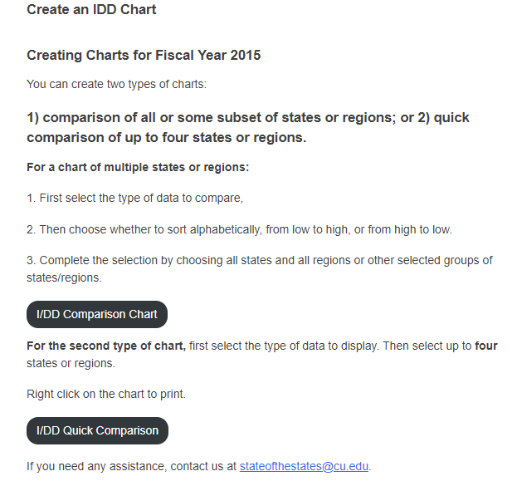
Create-a-chart
www.StateoftheStates.org
Notes:
To create a chart, go to the home page www.stateofthestates.org, click on “create a chart” under Intellectual/Developmental Disabilities in the right column highlighted here by a red arrow and circled in red.
The next page will bring you to two options:
Compare all or some subset of states or regions
Compare up to four states or regions
Here I’ve chosen the first option, so click the button that says “Create Chart”
It will take you to an informational page not illustrated here that provides instructions. Click the button that says “Begin Creating a Chart”

Slide 13
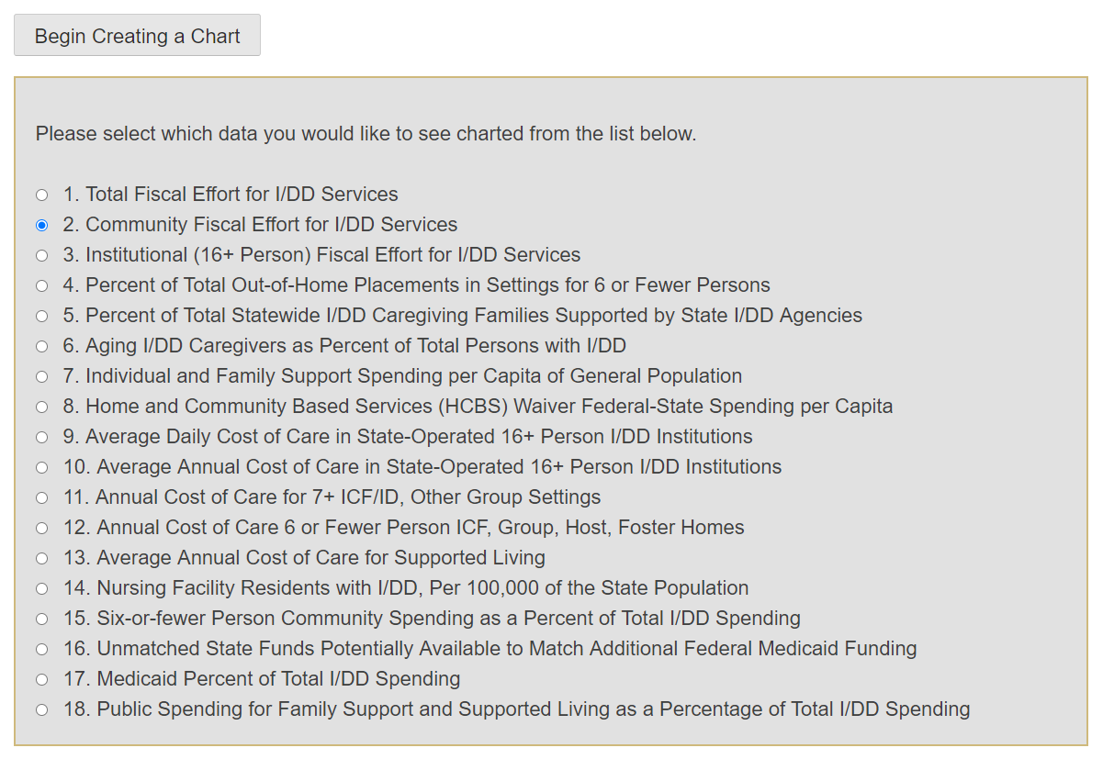
Create-a-Chart continued
Choose a variable

Slide 14
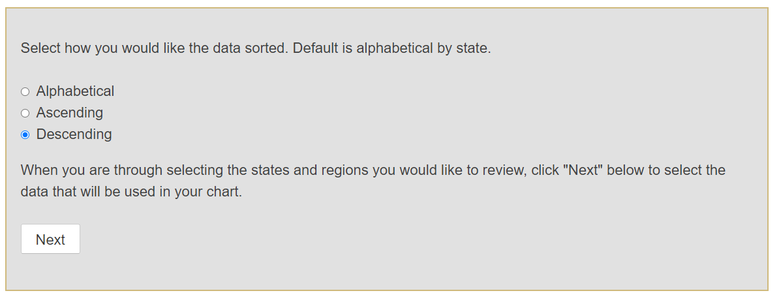
Create-a-Chart continued
Choose order

Slide 15
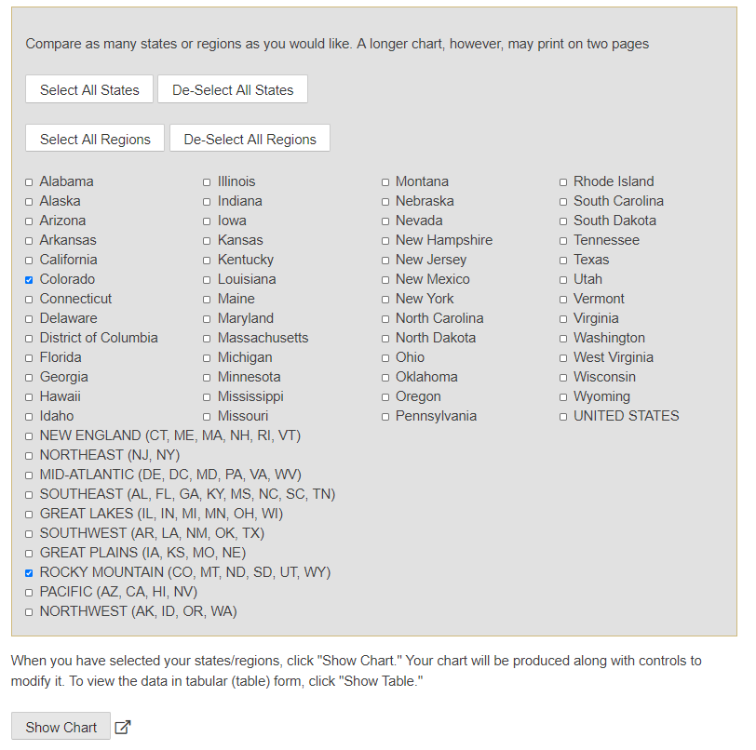
Create-a-Chart continued
Choose state(s)
Choose region(s)

Slide 16
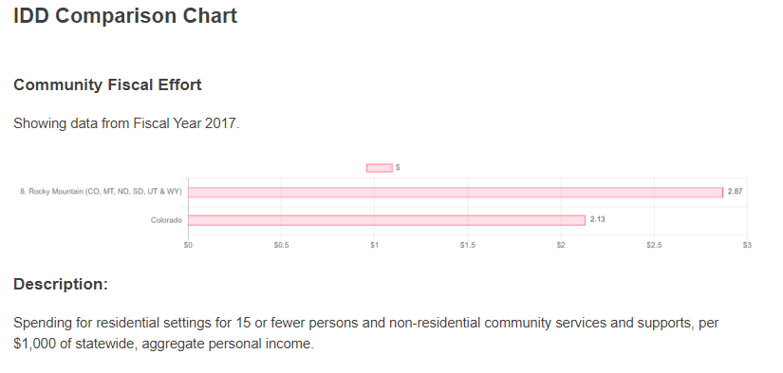
Create-a-chart use

