Slide 1
NACDD Policy Update June 24
Erin Prangley, NACDD, Director, Public Policy
eprangley@nacdd.org

Slide 2
Legislative Update
Appropriations – House markup schedule announced. Labor, Health and Human Services, and Education expected July 7.
HEROES/COVID-4
Senate "dear colleague letter" asking for support of a $30M request for DD Network will go out this week. We will be asking DD Councils to contact their senators to sign the letter.
Senate meetings on dependent adult payments and HCBS funding continue.
DC Statehood (HR51) - Vote in the House expected Friday.
Notes:
FY2021 Appropriations:
Mark-ups in Senate: Likely next week and early June and continue after July 4th recess.
House: Will not proceed until the next COVID-19 relief bill has passed
Covid-19 Response Bills: On Friday, Senate Democrats introduced a COVID-19 response bill that aims to provide affordable coverage to Americans during the pandemic. It includes language that would require coverage of all COVID-19-related treatment, subsidized COBRA and a special enrollment period for healthcare.gov.
Another bipartisan group of Senators introduced the "Paycheck Protection Extension Act", which would extend the deadline to apply to the Paycheck Protection Program (PPP) and the period that borrowers are allowed to use funds, as well as allow funds to be used to purchase PPE. The bill text can be found here, and a summary is here.
When the Senate returns in June, they will have a busy agenda waiting for them. Finance Committee Chairman Chuck Grassley (R-IA) was quoted saying that he expects negotiations on the next coronavirus response to begin in the third or fourth week of June, and wrap up before August recess. (via Roll Call)
House Democrats are expressing more urgency on moving a COVID-19 relief package, and that the PPP fix that could come as soon as next week is not the only urgent need. We are hearing that House Democrats are pushing for negotiations with the pressure points of June 30 for state budgets and July 31 for the need to extend unemployment insurance.

Slide 3
Administrative Update
Nursing Home Commission Members Announced. The 25 member Commission will conduct a comprehensive assessment of the overall response to the COVID-19 pandemic in nursing homes and report out in fall 2020. See list here: https://www.cms.gov/newsroom/press-releases/cms-announces-membership-independent-coronavirus-commission-safety-and-quality-nursing-homes?eType=EmailBlastContent&eId=7a0efbb4-90fe-4e9c-b8ae-2e80ed31ce5a
Department of Education
Judge denies Chicago Teachers Union request for temporary restraining order against federal guidance and district school board requirement to provide accommodations for special education during coronavirus. The teachers' union argued that special education policies during the coronavirus pandemic are “onerous and unmeetable” and that the government’s refusal to waive parts of IDEA during the coronavirus pandemic has swamped special education teachers. In denying the TRO, the judge said the case was unlikely to succeed because Congress required recommendations, not waivers of civil rights. See https://chicago.chalkbeat.org/2020/6/22/21299713/judge-deals-a-setback-to-chicago-teachers-unions-special-education-lawsuit
Notes:
The commission has four primary tasks for immediate and long-term windows, including:
identify best practices for facilities to enable rapid and effective virus identification and mitigate transmission;
recommend best practices for infection control and facility resiliency;
identify best practices for improved care delivery and responsiveness for nursing home residences before, during and after an emergency;
leverage new data sources to improve infection control policies and enable coordination across government and local agencies to mitigate coronavirus and future emergencies.
The commission met for the first time on Tuesday, and Burket said one priority for him is to try to blend the requirement to follow science-driven guidance on the virus with a desire for the public to find a new normal.

Slide 4
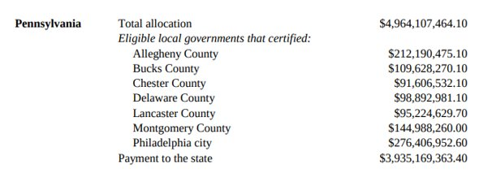
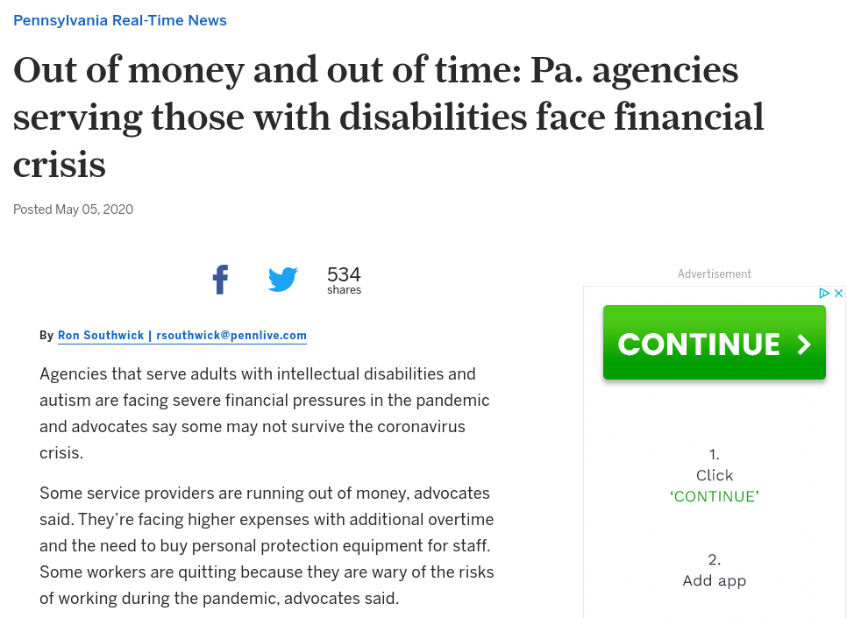
State Spotlight: Pennsylvania
Lisa Tesler, Executive Director, PACDD
Opportunity
Advocacy
Outcome
Payments to States and Eligible Units of Local Government (5/11/2020) https://home.treasury.gov/system/files/136/Payments-to-States-and-Units-of-Local-Government.pdf
https://www.pennlive.com/news/2020/05/out-of-money-and-out-of-time-pa-agencies-serving-those-with-disabilities-face-financial-crisis.html
https://www.governor.pa.gov/newsroom/gov-wolf-announces-260-million-in-funding-to-help-people-with-intellectual-disabilities-and-autism-during-pandemic/
Notes:
The $260 million will be allocated as follows:
$90 million to providers of residential, respite, and shift nursing services;
$80 million to providers of Community Participation Support services for 120 days of retainer payments, covering operations from March through June; and,
$90 million to providers of in-home and community, supported and small group employment, companion, and transportation trip services for 120 days of retainer payments, covering operations from March through June.

Slide 5
Next Steps
Join the State Budget Emergency Task Force!
Contact: Jeremy Paul-Norden at jeremy.norden-paul@ddc.wa.gov
Join "Unwinding" Emergency Waivers Task Force!
Contact: Tamara Jackson tamara.jackson@wisconsin.gov
Follow up with Governor's office to find out more about your state reopening plan and how CARES funding is being spent in your state. You can find more information on CARES funding to states here:
https://home.treasury.gov/system/files/136/Payments-to-States-and-Units-of-Local-Government.pdf

Slide 6
For more information contact Erin Prangley at eprangley@nacdd.org

