Slide 1
POG ACTIVITIES DURING COVID-19 PANDEMIC
Weekly member support call; open to members and self-advocates around the state
POG member lead training on the use of virtual online programs
Voter technical assistance
Created virtual Advocacy 101 presentation
Partnerships to develop virtual self-advocacy groups around the state
First Virtual Quarterly meeting
Notes:
Both

Slide 2
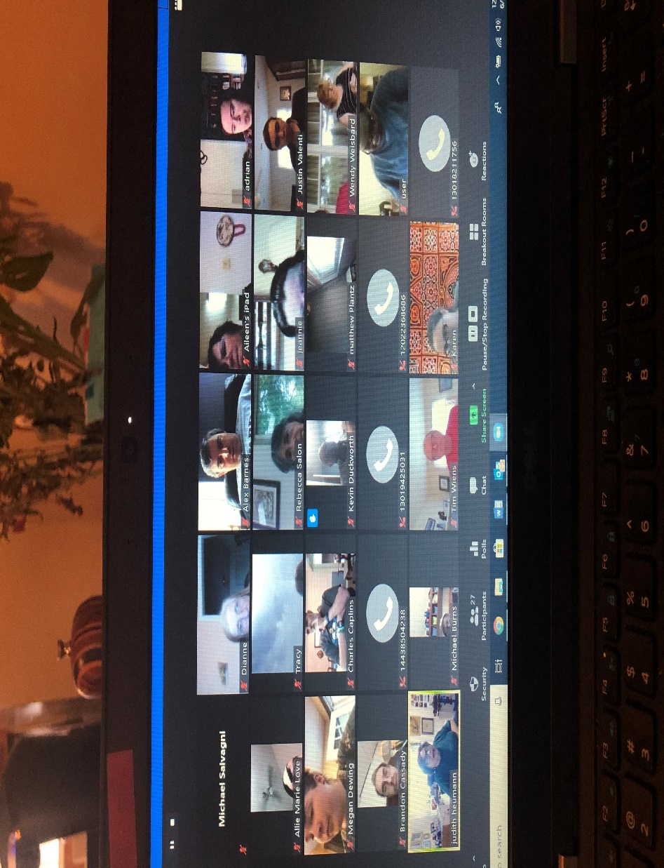
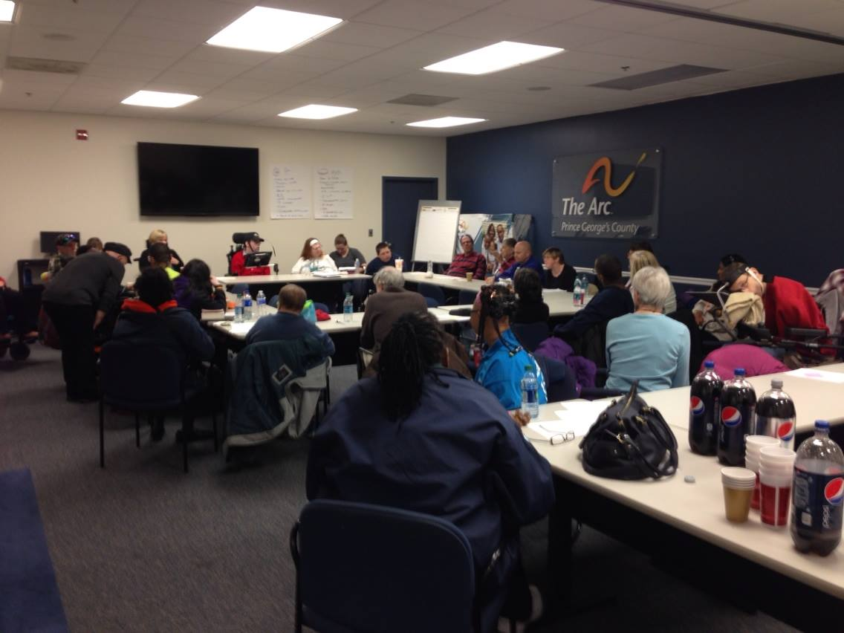
Where does the future lead us
People On the Go of Maryland
Notes:
Ken give us a history lesson

Slide 3
Contact Info: www.peopleonthegomaryland.com 443-923-9593 7000 Tudsbury Road, Baltimore, MD 21224 info@pogmd.org

