Slide 1
NACDD Policy Update June 10
Erin Prangley, NACDD, Director, Public Policy
eprangley@nacdd.org

Slide 2
Legislative Update
Appropriations – Meeting with OMB. Assumption is continuing resolution through March.
HEROES/COVID-4 – Remains stalled. Advocacy meetings continue with Senate staff on two provisions in the HEROES Act: Funding DD Act programs through emergency supplemental appropriations and adult dependent economic impact payments.
Notes:
FY2021 Appropriations:
Mark-ups in Senate: Likely next week and early June and continue after July 4th recess.
House: Will not proceed until the next COVID-19 relief bill has passed
Covid-19 Response Bills: On Friday, Senate Democrats introduced a COVID-19 response bill that aims to provide affordable coverage to Americans during the pandemic. It includes language that would require coverage of all COVID-19-related treatment, subsidized COBRA and a special enrollment period for healthcare.gov.
Another bipartisan group of Senators introduced the "Paycheck Protection Extension Act", which would extend the deadline to apply to the Paycheck Protection Program (PPP) and the period that borrowers are allowed to use funds, as well as allow funds to be used to purchase PPE. The bill text can be found here, and a summary is here.
When the Senate returns in June, they will have a busy agenda waiting for them. Finance Committee Chairman Chuck Grassley (R-IA) was quoted saying that he expects negotiations on the next coronavirus response to begin in the third or fourth week of June, and wrap up before August recess. (via Roll Call)
House Democrats are expressing more urgency on moving a COVID-19 relief package, and that the PPP fix that could come as soon as next week is not the only urgent need. We are hearing that House Democrats are pushing for negotiations with the pressure points of June 30 for state budgets and July 31 for the need to extend unemployment insurance.

Slide 3
Administrative Update
OCR Connecticutt Settlement on Visitor Policy!
The Office for Civil Rights (OCR) at the U.S. Department of Health & Human Services announced a resolution making clear that federal law requires hospitals and the state agencies overseeing them to modify policies to ensure patients with disabilities can safely access the in-person supports needed to benefit from medical care during the COVID-19 pandemic. Resolution Announcement can be found at: https://www.hhs.gov/about/news/2020/06/09/ocr-resolves-complaints-after-state-connecticut-private-hospital-safeguard-rights-persons.html
Notes:
FY2021 Appropriations:
Mark-ups in Senate: Likely next week and early June and continue after July 4th recess.
House: Will not proceed until the next COVID-19 relief bill has passed
Covid-19 Response Bills: On Friday, Senate Democrats introduced a COVID-19 response bill that aims to provide affordable coverage to Americans during the pandemic. It includes language that would require coverage of all COVID-19-related treatment, subsidized COBRA and a special enrollment period for healthcare.gov.
Another bipartisan group of Senators introduced the "Paycheck Protection Extension Act", which would extend the deadline to apply to the Paycheck Protection Program (PPP) and the period that borrowers are allowed to use funds, as well as allow funds to be used to purchase PPE. The bill text can be found here, and a summary is here.
When the Senate returns in June, they will have a busy agenda waiting for them. Finance Committee Chairman Chuck Grassley (R-IA) was quoted saying that he expects negotiations on the next coronavirus response to begin in the third or fourth week of June, and wrap up before August recess. (via Roll Call)
House Democrats are expressing more urgency on moving a COVID-19 relief package, and that the PPP fix that could come as soon as next week is not the only urgent need. We are hearing that House Democrats are pushing for negotiations with the pressure points of June 30 for state budgets and July 31 for the need to extend unemployment insurance.

Slide 4
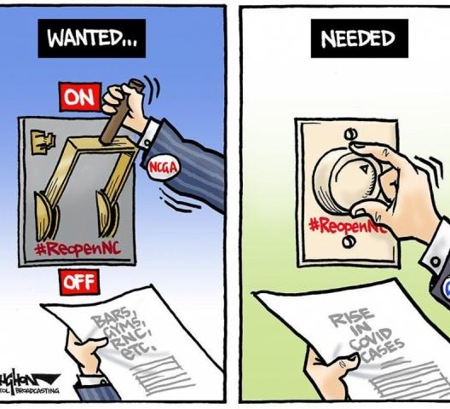
Reopening Issues
Un-winding Emergency Medicaid Waivers. CMS needs state stakeholder input on "un-winding" emergency waivers. There will not be public comment, but NACDD can advocate directly to CMS. We plan to reconviene the Emergency Waiver Task Force to to provide recommendations to CMS. Contact Erin Prangley if you have comments or want to join the task force.
State Education Reopening Plans.
Click here for list of state education reopening plans. Does your state have a plan for students with disabilities?
https://docs.google.com/document/d/1SaIboeKvHkMbgdB9OSUxTr2ic_sS_NVAoVzCuD6m8tU/edit?usp=sharing
Notes:
FY2021 Appropriations:
Mark-ups in Senate: Likely next week and early June and continue after July 4th recess.
House: Will not proceed until the next COVID-19 relief bill has passed
Covid-19 Response Bills: On Friday, Senate Democrats introduced a COVID-19 response bill that aims to provide affordable coverage to Americans during the pandemic. It includes language that would require coverage of all COVID-19-related treatment, subsidized COBRA and a special enrollment period for healthcare.gov.
Another bipartisan group of Senators introduced the "Paycheck Protection Extension Act", which would extend the deadline to apply to the Paycheck Protection Program (PPP) and the period that borrowers are allowed to use funds, as well as allow funds to be used to purchase PPE. The bill text can be found here, and a summary is here.
When the Senate returns in June, they will have a busy agenda waiting for them. Finance Committee Chairman Chuck Grassley (R-IA) was quoted saying that he expects negotiations on the next coronavirus response to begin in the third or fourth week of June, and wrap up before August recess. (via Roll Call)
House Democrats are expressing more urgency on moving a COVID-19 relief package, and that the PPP fix that could come as soon as next week is not the only urgent need. We are hearing that House Democrats are pushing for negotiations with the pressure points of June 30 for state budgets and July 31 for the need to extend unemployment insurance.

Slide 5
Next Steps
Join the State Budget Emergency Task Force!
Goal: Develop unified messaging and model state strategies that can be adopted to meet the needs of states.
Next meeting: Tuesday, June 23, 3pm Eastern
Current members:
Jeremy Paul-Norden, Chair, WA Kriston Britton, MA Adrienne Stuart, WA Daintry Bartoldus, HI Alice McCoy, NM Bill Kallestad, IA Bob Titus, NJ Isadora Rodriguez-Legendre, NH Rachel London, MD Leslie Sutton, OR Tami Jackson, WI
Contact: Jeremy Paul-Norden at jeremy.norden-paul@ddc.wa.gov
Join "Rewinding" Emergency Waivers Task Force!
Goal: Develop recommendations for CMS as they begin work on how to end services provided through Medicaid emergency waivers (1135, "K" waivers), maintain through 2nd wave, or find ways to continue Medicaid waiver services through other authorities.
Contact: Erin Prangley at eprangley@nacdd.org to join task force to make state recommendations to CMS.
Engage in State Education Reopening Plans. ​
Does your state have a plan for students with disabilities? ​Check here. And contact your governor and/or state education administration to get involved.
https://docs.google.com/document/d/1SaIboeKvHkMbgdB9OSUxTr2ic_sS_NVAoVzCuD6m8tU/edit?usp=sharing​

Slide 6
For more information contact Erin Prangley at eprangley@nacdd.org

