Slide 1
NACDD Policy Update May 20
Erin Prangley, Director, Public Policy National Association of Councils on Developmental Disabilities

Slide 2
Legislative Update: HEROES Act (CARES 2)
Top 3 NACDD Priorities Included in HEROES Act
ACL $100M
$85M Older Americans Act / Social Services Block Grant
$10M DD Act Programs
$5M Assistive Technology Act (devices)
FMAP bump to 14% plus additional 10% HCBS program for 1 year
Dependent rebate. Includes adult dependents rebate (includes adults with disabilities, students under 24, relatives (e.g. parents if more than ½ income from taxpayer) and another round of direct payments of up to $1,200 per adult and $1,200 per dependent.

Slide 3
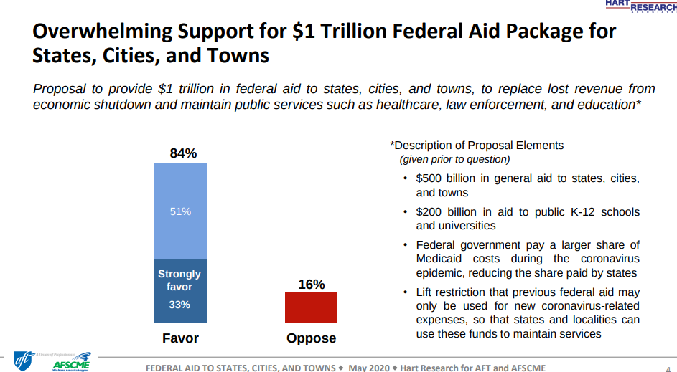
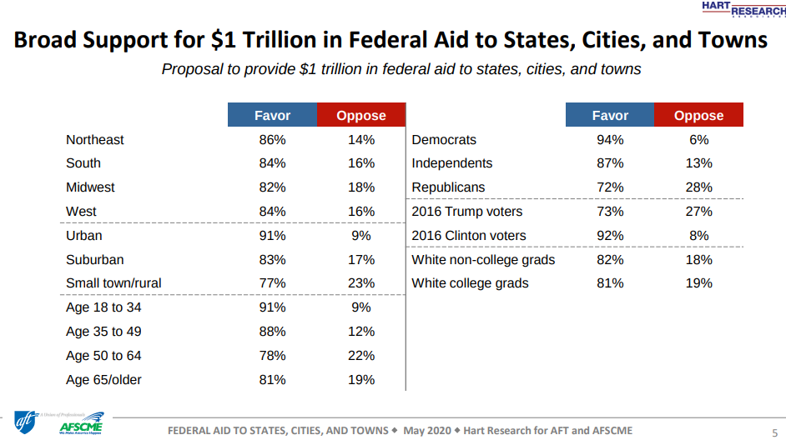
HEROES Act: DOA or ASAP?
Notes:
Settling in for the stalemate — Trump lunched with Republican senators today and GOP leaders met with Vice President Mike Pence and Treasury Secretary Steven Mnuchin — but don’t mistake the meetings movement. There’s still no progress on another bipartisan coronavirus response package, spurring Democrats to ratchet up their attacks on what they see as Republican inaction. The Senate is out for the Memorial Day recess next week and the House is expected to be in for just two days.

Slide 4
Administrative Update: Reopening
President Trump's Guidelines for Opening Up America Again: Three-phased approach to help state and local officials when reopening their economies, getting people back to work, and protect American lives. https://www.whitehouse.gov/openingamerica/
CDC Guidance On Safely Reopening Community: CDC released tools for decision-makers in these settings: schools, workplaces, camps, child care programs, mass transit systems, and bars and restaurants. See more here: https://www.cdc.gov/coronavirus/2019-ncov/community/reopen-guidance.html
CMS Guidance On Safely Reopening Nursing Homes: Steps include rigorous infection prevention and control, adequate testing, and surveillance. Go to https://www.cms.gov/newsroom/press-releases/trump-administration-issues-guidance-ensure-states-have-plan-place-safely-reopen-nursing-homes
Coronavirus Commission on Safety and Quality in Nursing Homes - Call for nominations: CMS will establish an independent commission inform immediate and future responses to COVID-19 in nursing homes. Nominations can be made online at https://sites.mitre.org/nhcovidcomm/app/ by 5 PM EDT on Friday, May 22, 2020.
FEMA Planning Considerations for Organizations in Reconstituting Operations During the COVID-19 Pandemic
https://www.fema.gov/news-release/2020/04/30/planning-considerations-organizations-reconstituting-operations-during-covid
Notes:
The Commission will conduct a comprehensive assessment of the nursing home response to the COVID-19 pandemic which will inform efforts to safeguard the health and quality of life of vulnerable Americans as CMS continues to battle COVID-19, as well as prepare for future threats to resident safety and public health. The Commission will consist of a diverse group of individuals which may include industry experts, clinicians, residents, patient advocates, family members, medical ethicists, administrators, academicians, infection control and prevention professionals, state and local authorities, and other stakeholders whose expertise can contribute to one or more of the areas on which the Commission will focus. The Commission will virtually convene at the beginning of June and may convene 2-3 additional times during the summer. The Commission’s work is expected to be completed by September 1, 2020.
MITRE is convening the Commission, which includes nominating and selecting members, facilitating meetings, and independently producing a final report to CMS regarding the commission’s findings and recommendations. MITRE will submit the final report to CMS on September 1, 2020.

Slide 5
Administrative Update:
SNAP Online Purchasing
NDRN/NACDD/AUCD letter to USDA and Congress (4/22) and CCD letters to USDA. (5/14)
RespectAbility action alert sent to NACDD list. https://www.respectability.org/snap/ (5/8)
Sens. Bob Casey (D-PA) and Susan Collins (R-ME) led a bipartisan letter to USDA. (5/11).
USDA/Food Nutrition Service response: USDA supports expansion of online purchasing in SNAP. New expedited process. States should contact their respective FNS regional office. Adding functionality through the addition of retailers includes inherent risks, such as potential disruption to normal EBT transaction processing if the changes are not thoroughly tested before implementation. (5/19)
Sec. Perdue today announced that households in 13 new states – Connecticut, Georgia, Illinois, Indiana, Maryland, Massachusetts, Michigan, New Jersey, Ohio, Oklahoma, Pennsylvania, Tennessee, and Virginia – are approved bringing total to 36 states and the District of Columbia, home to more than 90% of SNAP participants. Full list of added "flexiblities" can be seen at https://www.fns.usda.gov/disaster/pandemic/covid-19. (5/20)

Slide 6
State Spotlight: Alaska
Notes:
At the last NACDD call, there seemed to be interest in the chat box on Alaska’s messaging around masks and supporters in the community. Our DHSS just made these final so I wanted to share in case you wanted to pass along to other councils. DHSS worked with us on this effort, and in our state, we are getting quite a lot of calls on the mask issue for individuals with DD and other disabilities. Hope this is helpful. I believe the intent is social media messaging and getting the posters directly to stores for increasing awareness. I will be in an all-day meeting with the Alaska Mental Health Trust Authority for this week’s meeting, but will try to have a staff attend. The meetings are so helpful – thanks for all you do.

Slide 7
Next Steps
Join the Rebates and ABLE Campaign!
Advocate for ACL Funding in HEROES Act
We need Congress to know why it is important to keep ACL funding in the HEROES Act. Why not send a message to your Senator ?
For example:
The House passed HEROES Act funding for ACL could help meet the needs of people with disabilities in our state. By providing funding to DD Act programs, this bill would help fill gaps in caregiver supports, bridge the digital divide, provide emergency communication in accessible formats, fight social isolation in the I/DD community and more.
[Insert state specific work you are doing to help people.]
Please contact me or Erin Prangley at eprangley@nacdd.org if you have any questions.
Reopening Concerns
Join the State Budget Task Force!
Watch and share House Briefing on Impact of COVID-19 for Seniors, Individuals with Disabilities at https://www.youtube.com/watch?v=ZrkzlLcpY2s&feature=youtu.be&t=267
Nursing Home Commission Nomination

Slide 8
For more information contact Erin Prangley at eprangley@nacdd.org

