Slide 1
The CARES Act:
A discussion about Stimulus checks
and STABLE Account

Slide 2
Coronavirus Aid, Relief, and Economic Security (CARES) Act
The following criteria are a general guide to broadly describe who may receive a stimulus check
U.S. citizens or permanent residents who filed federal income taxes for 2018 or 2019, if you meet the income thresholds
Recipients of Social Security retirement, Supplemental Security Income (SSI) Social Security Disability Income (SSDI), or survivor benefits
Recipients of Railroad Retirement benefits

Slide 3
CARES Act: SSI and SSDI Recipients
May need to file an additional form with the IRS in order to receive a stimulus payment for dependent, minor children
https://www.irs.gov/coronavirus/non-filers-enter-payment-info-here

Slide 4
Coronavirus Aid, Relief, and Economic Security (CARES) Act
The federal government will:
Deposit funds into a bank account where tax returns were deposited,
Mail a check,
Deposit funds into a Representative Payee account, or
Deposit funds onto Direct Express debit cards (used to receive Social Security Administration payments)

Slide 5
Coronavirus Aid, Relief, and Economic Security (CARES) Act
Stimulus funds can be transferred from the account where the funds are deposited into a STABLE Account at the discretion of the STABLE Account beneficiary or Authorized Legal Representative (ALR)

Slide 6
Coronavirus Aid, Relief, and Economic Security (CARES) Act
Stimulus funds will not count as resources for means-tested benefits for a twelve (12) month period following the receipt of the funds (26 U.S. Code § 6409)
Additionally, stimulus payments will not count as income in the calculation of the individual’s SSI amount for that month (26 U.S. Code § 6409)

Slide 7
Coronavirus Aid, Relief, and Economic Security (CARES) Act
Depositing funds received through the federal stimulus check into a STABLE Account keeps the funds from being co-mingled with other personal funds that count toward your resource limitations for means-tested federal assistance programs

Slide 8
SPENDING YOUR FUNDS
Withdrawals must be used on
“Qualified Disability Expenses”
+
Must relate to the disability
Help maintain or improve health, independence, or quality of life
Stimulus funds deposited into an STABLE Account
can then be spent at a later time
by either the account beneficiary or ALR
managing the account

Slide 9
ABLE Accounts do not affect eligibility for benefits programs
WHAT IS ABLE?
ABLE Act of 2014 created savings and investment
accounts for individuals with disabilities
SSI
Medicaid

Slide 10
WHAT IS STABLE?
STABLE is Ohio’s ABLE Plan
Administered by the Ohio Treasurer’s office
Launched June 1, 2016
First and Largest ABLE Plan in the nation

Slide 11
Hybrid Functionality
+
+
529 College Savings
Checking Account
Special Needs Trust

Slide 12
ELIGIBILITY
To see who qualifies for a Oklahoma STABLE account,
take our eligibility quiz at okstable.org
Oklahoma residents with disabilities that occurred prior to age 26
PLUS ONE OF THE FOLLOWING:
Eligible to receive SSI or SSDI due to disability; or
Condition listed on SSA’s “List of Compassionate Allowances Conditions”; or
Self-certification

Slide 13
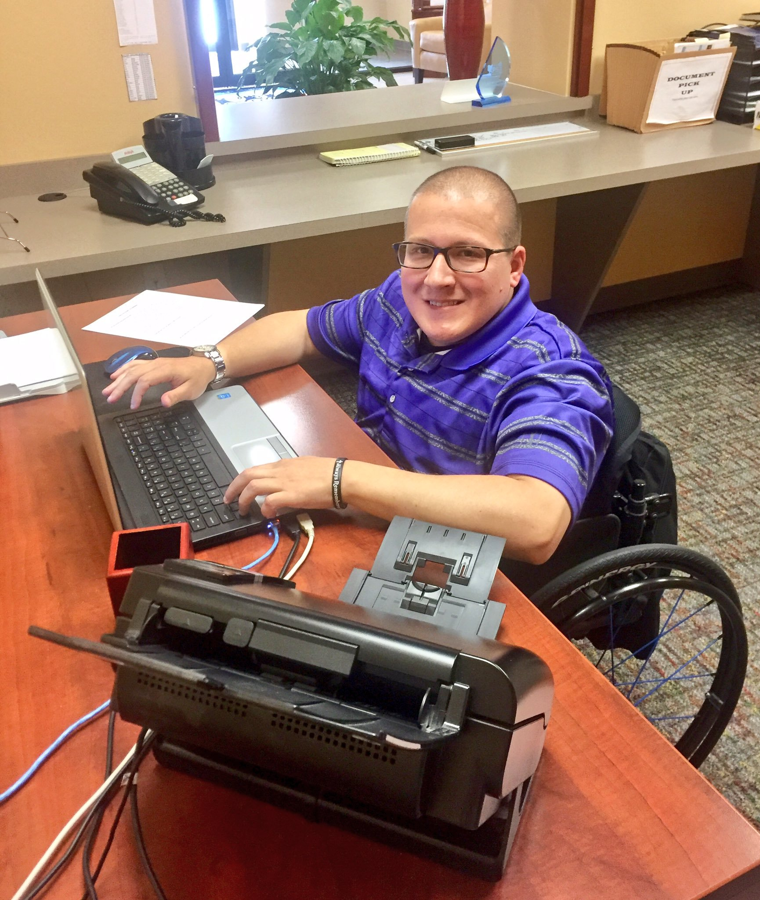
ENROLLMENT
Free online enrollment
Quick & easy – approx. 20 minutes
$50 minimum opening deposit
Can be done by either:
Individual with disability (Beneficiary)
Travis Dresbach
ABLE Account Enrollee
or
Authorized Legal Representative (parent, guardian, power of attorney)

Slide 14
Much more than
an account for
stimulus funds
okstable.org

Slide 15
Saving
SMALL AMOUNTS
of money
over time

Slide 18
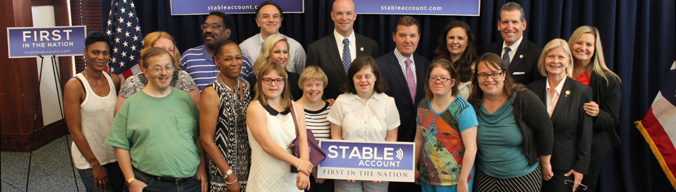
WE’RE HERE TO HELP!
CUSTOMER SERVICE
CUSTOMER SERVICE INFORMATION
1-800-439-1653
team@stableaccount.com
Monday - Friday 9 am - 8 pm EST
stableaccount.com

