Slide 1
NACDD Policy Update April 30
Erin Prangley, Director, Public Policy National Association of Councils on Developmental Disabilities

Slide 2
Legislative Update
Paycheck Protection Program and Health Care Enhancement Act (COVID 3.5) passed.
Provides $483B for assistance to small businesses and health systems. Go to Center for Public Representation website for details on this and other COVID bills by clicking here: https://medicaid.publicrep.org/feature/covid-19-legislation/.
CARES 2.0
Reps. Diana DeGette and Fred Upton released a concept paper for CARES 2.0 including sections on caregivers and "Rare Disease Support Program” to help familes. See https://upton.house.gov/uploadedfiles/cures_2.0_concept_paper_final.pdf
20 Democratic Senators sent support letter for HCBS services to leadership.
Timeline: Expect language by Friday from House Democrats. Senate in session May 5; House May 12.
See disability community priorities go to CCD website here: http://c-c-d.org/rubriques.php?rubpage=58
Notes:
Passed last week: $75B to hospitals and healthcare providers for COVID-19 related expenses and lost revenue;
$25B to expand capacity for COVID-19 tests
$6M for HHS Office of Inspector General for oversight activities.
Requires plan from States, localities, territories, and tribes on how resources will be used for testing and easing COVID-19 community mitigation policies.
Requires strategic plan related to providing assistance to States for increasing testing capacity.
OVID 4
Disability Requests
DD Councils funding
Increases to Medicaid FMAP
Increase HCBS funding
Increases for funding for direct support professionals
Significant increases to SEAs and LEAs for IDEA instructional and support services
Flexibility and increases in funding for nutritional support to people with disabilities from SNAP and Meals on Wheels.
Much more: See CCD Letter http://c-c-d.org/fichiers/FINAL-CCD-Asks-for-COVID-19-Package4.pdf and CAP Letter https://medicaid.publicrep.org/wp-content/uploads/2017/06/Disability-Community-Package-4-COVID-19-Asks.pdf
All Dependent Children Count Act (HR 6420) Uses 26 U.S. Code § 152.Dependent definition for qualifying child, or a qualifying relative. Would extend rebate to people who claim adult dependants who are permanently disablited for the CARES Act rebate. (Also includes students up to age 24, other relatives (parents), and more).
COVID-19 Emergency Supplemental Funding Packages Funding Directed to State, Local, Territorial, and Tribal Governments Money will be flowing to states, as part of recently passed federal emergency relief legislation to support COVID-19 response efforts. Consider the following as opportunities to build relationships with key partners and stakeholders in your state and leverage funds to meet the needs of people with disabilities. Sample messaging below to use and customize when contacting state and local partners.

Slide 3
Administrative Update
CMS: Announced new requirement for nursing homes to give notice to residents and their families when there is a COVID-19 case and report that information to CDC, state and local authorities.https://www.cms.gov/newsroom/press-releases/trump-administration-announces-new-nursing-homes-covid-19-transparency-effort
Treasury Department: Announced deadline May 5 for Social Security beneficiaries who had not filed 2018 or 2019 tax returns and who have dependent children to use the non-filers web tool to inform the IRS of their children or it will be delayed a year.https://thehill.com/policy/finance/494655-irs-announces-deadline-for-social-security-va-recipients-to-get-stimulus
Agriculture: Announced emergency benefit increases for SNAP households. https://www.usda.gov/media/press-releases/2020/04/22/usda-increases-monthly-snap-benefits-40
Education: Announced that it is not requesting waiver authority for any of the core tenets of the IDEA or Section 504 of the Rehabilitation Act of 1973. https://www.disabilityscoop.com/2020/04/28/devos-no-reason-waive-provisions-idea/28244/
Notes:
Passed last week: $75B to hospitals and healthcare providers for COVID-19 related expenses and lost revenue;
$25B to expand capacity for COVID-19 tests
$6M for HHS Office of Inspector General for oversight activities.
Requires plan from States, localities, territories, and tribes on how resources will be used for testing and easing COVID-19 community mitigation policies.
Requires strategic plan related to providing assistance to States for increasing testing capacity.
OVID 4
Disability Requests
DD Councils funding
Increases to Medicaid FMAP
Increase HCBS funding
Increases for funding for direct support professionals
Significant increases to SEAs and LEAs for IDEA instructional and support services
Flexibility and increases in funding for nutritional support to people with disabilities from SNAP and Meals on Wheels.
Much more: See CCD Letter http://c-c-d.org/fichiers/FINAL-CCD-Asks-for-COVID-19-Package4.pdf and CAP Letter https://medicaid.publicrep.org/wp-content/uploads/2017/06/Disability-Community-Package-4-COVID-19-Asks.pdf
All Dependent Children Count Act (HR 6420) Uses 26 U.S. Code § 152.Dependent definition for qualifying child, or a qualifying relative. Would extend rebate to people who claim adult dependants who are permanently disablited for the CARES Act rebate. (Also includes students up to age 24, other relatives (parents), and more).
COVID-19 Emergency Supplemental Funding Packages Funding Directed to State, Local, Territorial, and Tribal Governments Money will be flowing to states, as part of recently passed federal emergency relief legislation to support COVID-19 response efforts. Consider the following as opportunities to build relationships with key partners and stakeholders in your state and leverage funds to meet the needs of people with disabilities. Sample messaging below to use and customize when contacting state and local partners.

Slide 4
COVID 19 Stories Update
Goal: Advocate to ACL and Congress that state DD Councils provide the mechanism to fill gaps in emergency response for people with I/DD and families.
There are two ways councils can participate:
Complete a survey at https://www.surveygizmo.com/s3/5575239/DD-Council-s-COVID-19-Response\
Send an email to eprangley@nacdd.org if you’d prefer to answer these questions over the phone
Kelly Friedlander and Erin Prangley will be following up and drafting report.
We are looking to collect this information by Friday, May 8th.
Notes:
Information we need: Total amount of money awarded through grants Application process Names of grantees
Areas of funding
A compelling story from the grantee – what was impact (pictures, quotes)
How long did it take to get money out the door
·Accountability for these funds

Slide 5
Rebates and ABLE "Program In a Box"
Goal of Project: NACDD/NDRN/NAST ABLE Committee members to create and produce materials for the state DD councils, ABLE plans and other interested parties can use to brand and customize their education and informational outreach to their disability communities.
Timeline:
May 11: NACDD/NDRN/NAST finalize Power point; Sample letters to editor/op eds; Social media messaging; Stimulus/ABLE FAQs.
Week of May 18: Presentation to DD Councils during call and sign up. NAST ABLE Committee outreach on regular call. State programs and state advocacy organizations begin collaborations using the materials
Week of May 25: Target date for state collaborations to begin outreach webinars and social media.
Notes:
Rebate checks are a unique opportunity for people with disabilities receiving Social Security income to spend extra funds to meet immediate needs and help stimulate the economy. But, there is a lot of confusion about the rebate and lack of information about its purpose.
Program will focus on:
Rebates are extra money for people to spend the way they see fit so they can help support the economy.
What is rebate for people with disabilities who receive income from SSA?
What – amounts
Why – to pay for needs created by the emergency and stimulate economy
When – now, website to check status
Exceptions – dependents
How is this different from my regular payments from Social Security?
Rebates are not a benefit. You are in charge of deciding how to spend the money. (Self-directed)
It is not counted as income for benefits, but you must spend it in 12 months or it will count against you as an asset for benefits eligibility.
Who can help me if I have questions or do not receive a payment?
IRS website
Member of Congress district office
DD Councils, P&A?
You can spend rebates any way you want but this is a good opportunity to save.
Self-direction and the importance of supported decision making.
Examples of ways to spend the rebate?
Spend on immediate wants or needs - e.g. devices to connect to telehealth
Save for a rainy day (ABLE)
Invest in future spending on big ticket items (ABLE)
How can families and caregivers support people deciding on how to use their rebate?
Participate in supported decision making for people with I/DD who get the rebate.
Consider investing their own rebates into ABLE accounts for their family members.
What is responsibility of representative payees and group homes to make sure rebates are spent?
Follow good fiduciary practices
Supported decision-making
ABLE to protect spend down issue

Slide 6
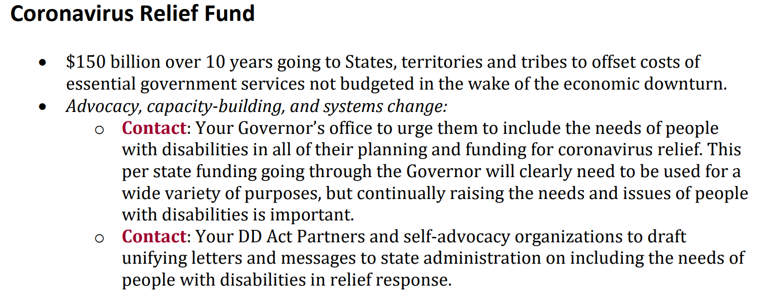
State Advocacy
Example from AUCD COVID-19 Emergency Supplemental Funding Packages
https://www.aucd.org/docs/urc/COVID_Funding.pdf
Notes:
COVID-19 Emergency Supplemental Funding Packages Funding Directed to State, Local, Territorial, and Tribal Governments Money will be flowing to states, as part of recently passed federal emergency relief legislation to support COVID-19 response efforts. Consider the following as opportunities to build relationships with key partners and stakeholders in your state and leverage funds to meet the needs of people with disabilities. Sample messaging below to use and customize when contacting state and local partners.

Slide 7
State Advocacy
Example from AUCD COVID-19 Emergency Supplemental Funding Packages
https://www.aucd.org/docs/urc/COVID_Funding.pdf
Notes:
COVID-19 Emergency Supplemental Funding Packages Funding Directed to State, Local, Territorial, and Tribal Governments Money will be flowing to states, as part of recently passed federal emergency relief legislation to support COVID-19 response efforts. Consider the following as opportunities to build relationships with key partners and stakeholders in your state and leverage funds to meet the needs of people with disabilities. Sample messaging below to use and customize when contacting state and local partners.

Slide 8
State Advocacy
Example from AUCD COVID-19 Emergency Supplemental Funding Packages
https://www.aucd.org/docs/urc/COVID_Funding.pdf
Notes:
COVID-19 Emergency Supplemental Funding Packages Funding Directed to State, Local, Territorial, and Tribal Governments Money will be flowing to states, as part of recently passed federal emergency relief legislation to support COVID-19 response efforts. Consider the following as opportunities to build relationships with key partners and stakeholders in your state and leverage funds to meet the needs of people with disabilities. Sample messaging below to use and customize when contacting state and local partners.

Slide 9
State Advocacy
Public Health and Social Services (COVID 3.5)
$25,000,000,000, to remain available until expended for testing. Within 30 days after the date of enactment of this Act, the Governor or designee of each State, locality, territory, tribe, or tribal organization shall submit to the Secretary its plan for COVID–19.
Advocacy, Capacity Building and Change:
Contact Governor's office to offer recommendations and best practices for equitable testing protocols and distribution that is inclusive of people with disabilities.
Notes:
COVID-19 Emergency Supplemental Funding Packages Funding Directed to State, Local, Territorial, and Tribal Governments Money will be flowing to states, as part of recently passed federal emergency relief legislation to support COVID-19 response efforts. Consider the following as opportunities to build relationships with key partners and stakeholders in your state and leverage funds to meet the needs of people with disabilities. Sample messaging below to use and customize when contacting state and local partners.

Slide 10
For more information contact Erin Prangley at eprangley@nacdd.org

