Slide 1
DD Network 2015 Joint Needs Assessment Survey
Preliminary Results

Slide 2
Responses
2012
2015
418 responses 24 -individuals with DD/ID
496 completed the survey
74 -individuals with DD/ID

Slide 3
2015 Respondent Demographics--Categories
Category | N
Individual with a developmental disability | 74
Family member of an individual with a developmental disability | 164
Service provider | 249
Other (please specify) | 32
Total | 519

Slide 4
2015 Respondent Demographics--Age
Total | 0-17 yrs % | 18-39 yrs % | 40-59 yrs % | 60-79 yrs %
523 | 3 % | 35% | 53% | 9%

Slide 5
2015 Respondent Demographics--Sex
Total | Female* % | Male %
516 | 82% | 18%
*Most of the family members and service providers identified themselves as female

Slide 6
2015 Respondent Demographics--Race
Total | White, non-Hispanic % | African-American % | Other %
531 | 89 % | 8% | 4%

Slide 7
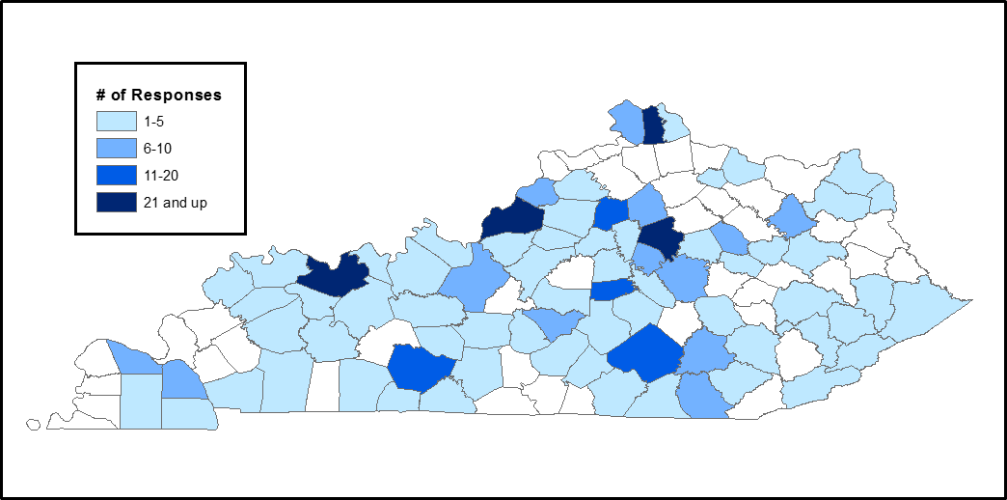
2015 Respondent Demographics--Region

Slide 8
Group Activity
The next slide is going to list the areas of need listed in the survey. Guess the top 3 areas that you think the respondents chose as areas of very high need

Slide 9
Areas of Need
Self Advocacy
Education & Early Intervention
Childcare
Healthcare
Health & Wellness
Employment
Housing
Transportation
Recreation
Community

Slide 10
Top 3 areas in 2012
Employment
Health Care/Wellness
Self-Advocacy

Slide 11
Top 3 areas in 2015
Transportation
Employment
Housing

Slide 12
Areas of Need (n=496) | Very High % | High % | Moderate % | Low & Very Low %
Self-Advocacy | 39% | 36% | 22% | 3%
Education & Early / Intervention | 41% | 35% | 20% | 3%
Childcare | 41% | 34% | 21% | 4%
Healthcare | 38% | 34% | 21% | 7%
Health & Wellness | 32% | 37% | 27% | 4%
Employment | 46% | 33% | 16% | 5%
Housing | 44% | 33% | 18% | 4%
Transportation | 48% | 31% | 15% | 6%
Recreation | 36% | 37% | 23% | 3%
Community Supports | 43% | 36% | 19% | 1%

Slide 13
Respondents with DD/ID rated the areas very similar to other categories. They rated Health care and Health wellness slightly higher than other categories of respondents

Slide 14
Areas of Need (n=496) | Overall Mean | Overall Mean (people with DD/ID)
Self-Advocacy | 4.10 | 4.09
Education & Early / Intervention | 4.14 | 4.13
Childcare | 4.10 | 4.07
Healthcare | 4.02 | 4.16
Health & Wellness | 3.96 | 4.1
Employment | 4.21 | 4.16
Housing | 4.16 | 4.12
Transportation | 4.22 | 4.16
Recreation | 4.05 | 4.03
Community Supports | 4.20 | 4.10

Slide 15
Exploring areas of very high need

Slide 16
Transportation– Both a rural and urban issue

Slide 17
Not enough public transportation that covers the entire Louisville area, therefore they again depend on natural supports to provide transportation, unless they just want to stay at home all day every day. Transportation needs to be built in to more ADTs, etc. as a service to make that opportunity possible to more people.

Slide 18
There are effectively no transportation at all in rural areas (i.e., anywhere NOT Louisville, Lexington, and Northern KY) unless a consumer wants to go to an ADT, and no reimbursement for the people that provide any assistance.

Slide 19
Transportation– Restricted to certain times of the day and therefore limits choices

Slide 20
There is no such thing as 'transportation' for those who reside outside of Hopkinsville. Period. Perhaps my son would like to one day go to a horse race in Louisville? or a baseball game in Nashville, TN? Maybe he would like to hang out with friends at a volleyball game after school? And I hear the plan is to build a skate park, he will miss out on that too! He certainly will not be able to jump in the new waterpark or enjoy working out at YMCA...all in Hopkinsville. See, the trip from Oak Grove, KY is 35-40 minute drive--one way.

Slide 21
Transportation– limited timings

Slide 22
The area in which I live only have a cab service that runs Monday - Friday from 8:00-5:00.
We have had repeated issues with late drop-offs, people getting home hours late. not being picked up. LKLP has proven to cause many issues.

Slide 23
Transportation– Accessibility

Slide 24
Specialized transportation is not reliable and public transportation not accessible
Not enough accessible transportation options across the state.

Slide 25
Employment– Not enough employers are willing to give people with disabilities a chance

Slide 26
If more businesses and employers were more open and receptive to job carving or even job shadowing, this would open up more opportunities for supported employment job sites or on the job training sites for individuals with disabilities. If our communities and businesses could be more open minded or receptive of helping someone that can do one job tasks well then I feel this would open up more opportunities for anyone with a disability.

Slide 27
The advantages to productivity and workplace skills acquisition when employing individuals with disabilities is not in the forefront in employers minds, in the way that it should be, to create environments that are welcoming and informed.

Slide 28
Employment– Inefficient systems

Slide 29
The supportive employment agency is not effective in the areas where participants reside. There are a few who have accessed this and have been put off for long periods. With continued efforts in following up on getting this service, the point of contact usually distances themselves from agencies in that phone calls/emails are not being returned. It is disheartening for the participant who has that drive for employment. It has come to the point where other supportive employment programs outside a participant's area are being looked into.

Slide 30
Lack of Job Placement specialist who is familiar with persons with disabilities and how to work with them.
Not enough good Supported Employment program s available to support individuals. / Individuals are kept in sheltered workshops that can work in the community.

Slide 31
The office of Voc. Rehab is a disaster-- they openly tell you that in the Lexington area there are " no good agencies" to help your adult child find employment. we have tried several agencies-- They were supposed to meet with him and develop a plan-- they had 5 min conversations, mostly on the phone that they turned in on reports that sounded like they spent hours with. They were supposed to take him to observe a variety of work locations- never happened.. They were supposed to find him full time job opportunities-- there was never an interview, application or any activity whatsoever. When we complained -- we were assigned another agency-- same result-- 3 times!!!! We wasted years trying-- My son finally gave up -- he is still underemployed.
The Voc Rehab office needs to be redone-- Agencies should not be paid for just " meeting" with someone. They should only be paid if they actually get the person an appropriate job! These agencies are making money accomplishing absolutely nothing but handing in paperwork!

Slide 32
Employment– Misconception about benefits

Slide 33
There is so much disinformation out there about the impact of wages on benefits that it may not be possible to have the truth accepted. Medicaid has acted completely irresponsibly by failing to address the rate paid for supported employment in the Michelle P waiver. Providers are reluctant to promote employment for people receiving services because it will reduce the amount they can bill for day training.

Slide 34
Housing– Accessibility

Slide 35
Home ownership for people with developmental disabilities, or even renting a an apartment or home, versus living in an agency provided arrangement is still a very foreign concept in Kentucky. Lack of knowledge about resources to assist people with home ownership, as well as lack of vision, are two critical challenges. Educating builders about the need for more housing with universal design would also be helpful as finding accessible housing/rental units continues to be difficult except in segregated housing primarily for senior citizens of low income.

Slide 36
And HUD housing refuses to build a ramp for a regular unit if a person with a disability is living there. They do not want to install grab bars either. Very tight on HUD money for such things.

Slide 37
Modifying housing to ADA specifications is expensive. It is rare to find houses that are already ADA accessible so modifications must be made in order for the individual with DD to be able to maneuver in their own household.

Slide 38
Housing– Unsuitable alternatives

Slide 39
Low cost housing tends to be in high crime areas. Not safe for those at risk for exploitation. .

Slide 40
Low cost housing tends to be in high crime areas. Not safe for those at risk for exploitation.
It is substandard! I am in awe of some of the trailers being rented for up to 800 without proper plumbing, holes in the walls, improper insulation, running water and infested. People with disabilities either don't have an option or are afraid to report them. I have provided early intervention in these homes with snakes, squirrels and opossums frequenting the interior. The other options are low income housing apartments which separate individuals with limited to no transportation from their families.

Slide 41
Housing– Need support for caregivers

Slide 42
I have no idea where to begin to look for housing for my disabled adult children-- we are paying ourselves for housing for our son. / Our daughter who is more severe lives with us. I don't know what will happen when we die. The group homes I have observed are not places I would want her to live.
When I become too old to take care of my autistic son, I have no idea where to find a suitable group home. What you see in the news looks horrible
My son he is twelve at this point he is home with me but being an aware parent I wonder what my son will go through as he is older and I'm no longer around. My area which is more rural doesn't offer housing for disabled people like the city areas do and those are even scarce.

Slide 43
Housing– Long waiting list

Slide 44
Long waiting lists to housing specific for disabled individuals. Limited access to lower level apartments
I am being encouraged to be on a waiting list for housing for my son who is just now 12 years old. A 6+ year waiting list is much too long. Parents dedicate every waking hour to their children with disability, the support for these parents is nearly non-existent.

Slide 45
Healthcare– Lack of Appropriate Care

Slide 46
When my niece was at the Home of the Innocents, she was monitored closely and the staff took positive steps in preventative medical care. She was bathed daily too. Now that she's in a regular geriatric nursing home... at the age of 21, she gets bathed every 3 days, and they do not get her scalp clean or rinsed completely. The staff are 'learning' how to take care of her, because she is not their 'typical' geriatric patient. She has had belly and respiratory issues due to the staff not understanding her needs

Slide 47
Healthcare– Accessibility

Slide 48
dr exam rooms & bathrooms aren't accessible. If you do not bring a family member with you they will not transfer you onto an exam table. They need adaptable equipment i.e. exam tables that raise/lower, foot stirrups, and need to know how to do modify exams to the person with a disability.

Slide 49
Healthcare– Few providers & specialists

Slide 50
From our experience there is little available in care coordination. Most individuals have to travel over an hour or more for specialized care.
Need more providers who provide dental care
Limited access to adequate mental health assistance (services and therapy). Limited access to rehab services PT, ST and OT).
There are not many facilities that can provide skilled nursing care for individuals who are 21, and older that have sub acute conditions. We need more Lee's Specialty Clinics for young adults so they can receive proper medical treatment & therapies & intervention crisis services counseling.

Slide 51
Health & Wellness– Not sufficiently emphasized

Slide 52
I think that some specific issues that are the folks with disabilities face in health and wellness is that there aren't enough doctors and or medical professionals who are well verse in understanding the different types of intellectual disabilities, so I think the health and wellness of the folks we serve gets put by the wayside

Slide 53
Health & Wellness– Need more awareness, training

Slide 54
Accessibility to education of importance of health and wellness; accessibility to education and training on ways the individual can improve his/her health and overall well-being which includes the individual's direct support staff; coordinated care that looks at the underlying causes of behavior of individuals with I/DD which may be attributed to health and wellness issues before developing behavioral support plans as a reactive measure
Lack of knowledge about nutrition. Also there is a tendency for people to attempt to minimize the types and quantity of exercise that a person with disabilities can and should perform.

Slide 55
Health & Wellness– Needed to handle stress

Slide 56
Stress effects those with disabilities just as it does all persons; access to meal planning - nutrition; access to activities that promote wellness (scholarships for gym memberships, counseling, meditation, massage, etc.).

Slide 57
Overall Thoughts and Reflections
Do these results and themes match your own experiences?

