Slide 1
Program Support Center
Guide for completing the federal financial report (sF-425)
PSC/FMP

Slide 2
PURPOSE
The purpose of this guide is to assist recipients who receive grant awards from the Department of Health and Human Services/Administration for Community Living (ACL) with the reporting and accounting of their financial expenditures. The guide provides essential information for facilitating the completion and submission of the mandatory annual Federal Financial Report (FFR) on Standard Form 425 (SF-425).
In today’s demo we will discuss the following:
What is Federal Financial Report (FFR)?
Where and When to submit the FFR reports
User Roles and Responsibilities
Functionalities available in PMS
Navigate to the FFR Module
Search for the FFR
Complete and submit the FFR
How to request access or update permission
Notes:
Negotiated contracts: Negotiated contracts are generally more complex awards greater than $150,000 for supplies and services. These contracts usually require discussions (negotiations) between the government and the vendor before an award can be made.
Simplified acquisitions: Simplified acquisitions are typically reserved for small businesses greater than $3,500 but less than $150,000 although they may include commercial items (products/services) sold in substantial quantities to the general public up to $7.0 million.
Assisted acquisitions: In an assisted acquisition, the servicing and requesting agency enter into an interagency agreement pursuant to which the servicing contracting office (other than the requesting organization’s assigned contracting office) contracts on behalf of the requesting organization.
Help desk services:
Tier one support:
Password resets
Navigation
User-account issues
Tier two support:
Document troubleshooting
Liaison with HCAS O&M, UFMS O&M, DCIS, Finance
Submit change requests (CR), etc.
PRISM support services: Includes both ad hoc and pre-defined access to workload status/milestone.

Slide 3
What is Federal Financial Reporting (FFR)?
A Federal Financial Report (FFR) is a statement of expenditures associated with a grant. Recipients of federal funds are required to report the status of funds for grants or assistance agreements to the awarding agency of the grant using the Federal Financial Report expenditure data. The Office of Management and Budget (OMB) merged previous financial reporting methods (Financial Status Report (FSR, or SF-269/SF-269A) and the Federal Cash Transactions Report (FCTR, or SF-272) into one comprehensive financial reporting form (Federal Financial Report (FFR, or SF-425) to give recipients of grants and cooperative agreements a standard format for reporting the financial status of their awards.
Recipients of federal funds are required to submit annual Federal Financial Reports (SF-425). The SF-425 is a standard form that grantees must use to report cumulative expenses (calculated by adding all expenses from the beginning of the grant to date) incurred under each grant number. These expenses can be categorized as cash disbursed or as incurred but not yet paid (accounts payable).
Notes:
Negotiated contracts: Negotiated contracts are generally more complex awards greater than $150,000 for supplies and services. These contracts usually require discussions (negotiations) between the government and the vendor before an award can be made.
Simplified acquisitions: Simplified acquisitions are typically reserved for small businesses greater than $3,500 but less than $150,000 although they may include commercial items (products/services) sold in substantial quantities to the general public up to $7.0 million.
Assisted acquisitions: In an assisted acquisition, the servicing and requesting agency enter into an interagency agreement pursuant to which the servicing contracting office (other than the requesting organization’s assigned contracting office) contracts on behalf of the requesting organization.
Help desk services:
Tier one support:
Password resets
Navigation
User-account issues
Tier two support:
Document troubleshooting
Liaison with HCAS O&M, UFMS O&M, DCIS, Finance
Submit change requests (CR), etc.
PRISM support services: Includes both ad hoc and pre-defined access to workload status/milestone.

Slide 4
When and Where to Submit the SF-425
A grantee is required to submit a final SF-425 no later than 90 days after the expiration date of the award. Grantees are also required to draw down funds for allowable costs incurred within 90 days after the grant period end date and prior to the submission of the final federal financial report. If remaining funds are not drawn down within 90 days after the grant period end date, the grantee forfeits the remaining eligible balance and are still required to report those funds on the final SF-425.
Grantees should submit the final SF-425 in the Payment Management System. Effective 10/1/2019, ACL grantees will submit the FFR’s in PMS for new awards issued in FY20 and forward. For awards issued prior to FY20, grantees should continue to submit their FFR’s via email to GrantSolutions. PMS allows grantees to electronically submit a statement of expenditures associated with their grant to the awarding agency of the grant the electronically based on a set frequency basis. For example, if the reporting period end date is September 30, 2019, a grantee could submit the final report as early as October 1, 2019. In cases, where recipients have requested an extension of the period of performance, the reports are due 90 days after the end of the period of performance including extension period.
A grantee should ensure that the expenditures reported on the SF-425 reconciles with the drawdown and reported disbursements in the Payment Management System. In cases, where drawdown and disbursements do not reconcile with the SF-425, the grantee will have to revise their reported disbursements in PMS to ensure that the PMS account reconciles with the reported expenditures on SF-425.

Slide 5
Payment Management System
Federal Financial Report (FFR) Module

Slide 6
PMS FFR User Roles and Responsibilities
Grantees
Request access to FFR report.
View, Prepare, Revise and/or certify FFR report on behalf of their organization.
Combining Authorities on the same account.
Based on the workflow process of the organization, the Signing Official (SO) or Business Official/Administrative Official (BO/AO) may share same responsibilities; therefore two authorities maybe combined on the same account.
View Submission History.
Upload supporting documentation
Agency users
Provide information for FFR’s to be created in PMS.
Review (Approve or Reject) FFR report.
Run Compliance Reports.
PMS staff
Grant access to grantee and agency users based on the access request.
Create FFR’s based on information provided by awarding agencies.
Provide operational support in filling and reviewing the report.
Notes:
Negotiated contracts: Negotiated contracts are generally more complex awards greater than $150,000 for supplies and services. These contracts usually require discussions (negotiations) between the government and the vendor before an award can be made.
Simplified acquisitions: Simplified acquisitions are typically reserved for small businesses greater than $3,500 but less than $150,000 although they may include commercial items (products/services) sold in substantial quantities to the general public up to $7.0 million.
Assisted acquisitions: In an assisted acquisition, the servicing and requesting agency enter into an interagency agreement pursuant to which the servicing contracting office (other than the requesting organization’s assigned contracting office) contracts on behalf of the requesting organization.
Help desk services:
Tier one support:
Password resets
Navigation
User-account issues
Tier two support:
Document troubleshooting
Liaison with HCAS O&M, UFMS O&M, DCIS, Finance
Submit change requests (CR), etc.
PRISM support services: Includes both ad hoc and pre-defined access to workload status/milestone.

Slide 7
PMS Functionality for Users
Provides availability to search FFR’s based on different criteria's Ex. Payee Account, Grant Document number etc.
Ability to upload supporting documentation
Group Functionality
Grantee can certify multiple FFRs at the same time.
Grantee user can print or download multiple reports at the same time.
Depending on agency requirements we can have any fields under section 10 as editable, non-editable, pre-populated, auto-calculated, or validating matching percent
Grantee Reports
FFR Agency Status Report - Provides status of FFR’s that are pending agency review at regional and/or central office.

Slide 8
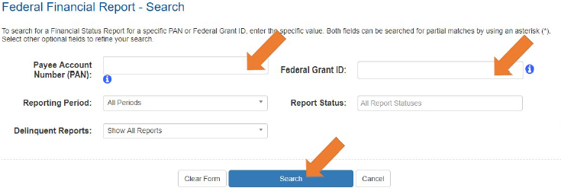
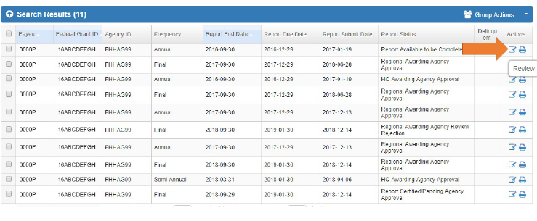
Federal Financial Reports Search
FFR’s can be searched based on different criteria's Ex. Payee Account, Grant Document number etc.
From the Search Result, Under Actions, Select Review to display the FFR

Slide 9
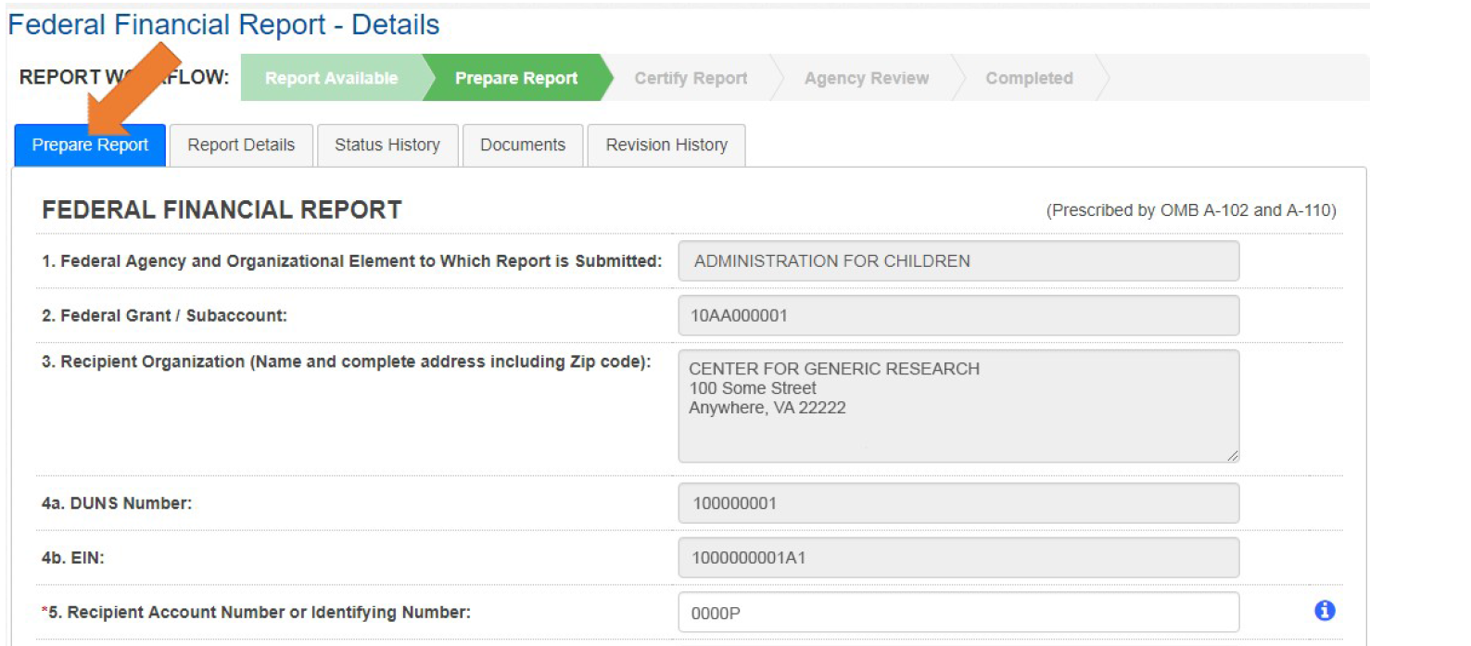
FFR Information
Block 1: Federal agency: This read-only field will prepopulate to read “Assistant Secretary for Preparedness and Response.”
Block 2: Federal grant number: This field will prepopulate the alpha-numeric grant number cited on your award document. Verify this grant number is correct. Grantees will complete one SF-425 for each grant number.
Block 3: Recipient organization: This field will prepopulate the grantee organization’s legal name and address and should match the name and address on the award document.
Block 4a. DUNS number: This field will be an editable field for the grantee to enter the organization’s Data Universal Numbering System (DUNS) number or central contract registration extended DUNS number.
Block 4b. EIN: This field will prepopulate the grantee organization’s employer identification number (EIN).
Block 5. Recipient account number: This field should be populated by the grantee noting their recipient account number or organization’s identifier number.

Slide 10
FFR Information Cont’d
Block 6: Report Type: This field is prepopulated based on the requirements received from the awarding agency. The final SF-425 is due 90 days after the grantee has reported all federal expenses for all awards issued under the same grant number or after the grant period end date of the award. A grantee must draw all funds prior to the submission of the final FFR. Grantee is no longer eligible to draw down funds 90 days after the end of the period of performance and the grantee forfeits the remaining eligible balance. Note: If a grantee is using accrual/cash basis of accounting and submits a final SF-425, “Block 10f. Federal share of unliquidated obligations” should always be reported “$0.00” because unliquidated obligations are not acceptable on final reports.
Block 7: Basis of accounting: Mark the appropriate box to specify whether a cash or accrual basis was used for recording financial transactions related to the award.
Cash basis of accounting refers to the accounting method in which expenses are recorded when they are paid.
Accrual basis of accounting refers to the accounting method in which expenses are recorded when they are incurred.
Block 8. Project/grant period (from/to): This field will prepopulate with the time period covered by the grant number. Verify this information is correct.
Block 9: Reporting period end date: This field is prepopulated based on the requirements provided by the awarding agency. For final FFRs, the reporting period end dates shall be the end date of the project or grant period.

Slide 11
FFR Information Cont’d
Block 10: Transactions: Enter cumulative amounts from the date of the award’s inception through the end date of the reporting period specified in “Block 9. Reporting period end date.” The cumulative amount is calculated by adding all expenses incurred to date, including all previously reported expenses. Use “Block 12. Remarks” to provide further details or explanations necessary about information listed in this section.
Federal cash
Block 10a. Cash receipts: This field is prepopulated based on the current drawdown in Payment Management System.
Block 10b. Cash disbursements: This field is prepopulated based on the last reported disbursements by the grantee.
Block 10c. Cash on hand: This field is auto-calculated based on the formula Cash receipts (10A) - Cash disbursements (10B)

Slide 12
FFR Information Cont’d
Federal expenditures and unobligated balance
Block 10d: Total federal funds authorized: This field will prepopulated with the appropriate amount of federal funds authorized as of the reporting period end date. This information can also be found on the award documentation.
Block 10e: Federal share of expenditures: Enter the cumulative amount of federal fund expenditures. The cumulative amount is calculated by adding all expenses incurred to date. The cumulative amount includes all federal share of expenditures for the life of the grant.
Block 10f: Federal share of unliquidated obligations: If a grantee is using accrual/cash basis of accounting and submits a final SF-425, “Block 10f. Federal share of unliquidated obligations” should always be reported “$0.00” because unliquidated obligations are not acceptable on final reports.
Block 10g: Total federal share: This field will prepopulate with the calculated sum of “Blocks 10e. Federal share of expenditures” and “10f. Federal share of unliquidated obligations.”
Block 10h: Unobligated balance of federal funds: This field will prepopulate with the calculated difference of “Block 10d. Total federal funds authorized” and “Block 10g. Total federal share” based on prior period submissions. Upon reporting the current information, this block will recalculate to include the updated information.

Slide 13
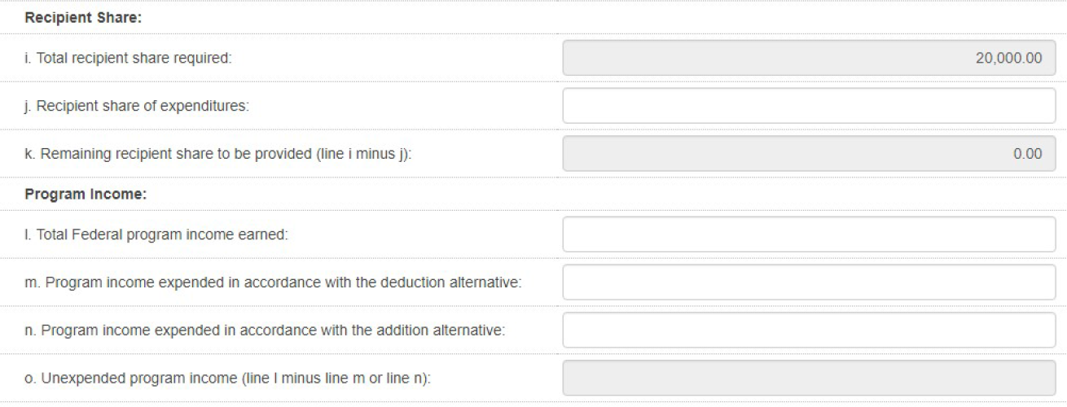
FFR Information Cont’d
Recipient Share
Block 10i: Total recipient share required: This field will prepopulated with the appropriate amount of federal funds authorized as of the reporting period end date. This information has been provided to PMS by the awarding agency and it can also be found on the award documentation.
Block 10j: Recipient share of expenditures: Enter the cumulative amount of federal fund expenditures. The cumulative amount is calculated by adding all expenses incurred to date. The cumulative amount includes all federal share of expenditures for the life of the grant.
Block 10k: Remaining recipient share to be provided: This field will prepopulate with the calculated difference of “Block 10i. Total recipient share required” and “Block 10j. Recipient share of expenditures”. Upon reporting the current information, this block will recalculate to include the updated information. Note: if the recipient share of expenditures are greater than recipient share required, then “$0” will be reflected. Additionally, the grantee must ensure that they meet their matching requirements per the terms and condition of the grant.
Program Income:
Block 10l: Total Federal Program Income Earned: Enter the amount of Federal program income earned. Do not report any program income here that is being allocated as part of the recipient's cost sharing amount included in Line10j.
Block 10m: Program Income Expended in Accordance With the Deduction Alternative: Enter the amount of program income that was used to reduce the Federal share of the total project costs.
Block 10n: Program Income Expended in Accordance With the Addition Alternative: Enter the amount of program income that was added to funds committed to the total project costs and expended to further eligible project or program activities.
Block 10o: Unexpended Program income (Line 10l Minus Line 10m or Line 10n): This field will prepopulate with the calculated difference of “Line 10l minus Line 10m or Line 10n”. This amount equals the program income that has been earned but not extended, as of the reporting period end date.

Slide 14
FFR Information Cont’d
Indirect expense: Enter cumulative amounts from the date of the inception of the award through the end date of the reporting period specified in “Block 9. Reporting period end date.” The cumulative amount is calculated by adding all expenses incurred to date. Use the multiple rows to indicate separate types and rates. Use “Block 12. Remarks” to provide further details and explanations necessary about information listed in this section.
Block 11a: Type If applicable: The grantee should state whether the indirect cost rate(s) is (are) provisional, predetermined, final, or fixed.
Block 11b: Rate If applicable: Enter the indirect cost rate(s) in effect during the reporting period.
Block 11c: Period from; period to; If applicable: Enter the beginning and ending effective dates for the rate(s).
Block 11d: Base If applicable: Enter the amount of the base against which the rate(s) was (were) applied.
Block 11e: Amount charged If applicable: This field will prepopulate a calculation indicating the amount of indirect costs charged during the time period specified (11b x 11d). Verify this information is correct.
Block 11f: Federal share If applicable: Enter the federal share of the amount listed in “Block 11e. Amount charged.”
Block 11g: If applicable Totals If applicable: This field will pre-populate a calculation indicating the summed amounts of “Block 11d. Base,” “Block 11e. Amount charged,” and “Block 11f. Federal share.”

Slide 15
FFR Information Cont’d
Block 12: Remarks If applicable: Use “Block 12. Remarks” to provide further details and explanations necessary about information listed in this report, specifically “Block 10. Transactions.” Use “Block 12. Remarks” to provide an explanation why the grantee is delinquent in submitting the SF-425.
Block 13: Certification Mandatory: The certifying official is the individual who has the knowledge and authority to certify that the figures reported on the SF-425 are accurate and complete.
Block 13a: Name and title of authorized certifying official: This line item will be pre-populated with the certifying official’s name and title.
Block 13b: Signature of authorized certifying official: The authorized certifying official must sign here; therefore from the dropdown box, please select the authorized certifier.
Block 13c: Telephone: This line item is pre-populated with the telephone number (including area code and extension) for the individual listed in “Block 13a. Name and title of authorized certifying official.”
Block 13d: E-mail address: This line item is pre-populated with the e-mail address of the individual listed in “Block 13a. Name and title of authorized certifying official.”
Block 13e: Date report prepared/submitted: This line item is pre-populated based on when the grantee certifies the report in Payment Management System.
Block 14: Agency use only Not applicable : This section reserved for federal agency use only.

Slide 16
How to Update Permissions or Request Access
Grantees who do not have access to PMS should submit a new user access request to PMS. Copy or Click on the link below and follow the instructions to request access: https://pms.psc.gov/grant-recipients/access-newuser.html
Grantees who currently have access to PMS and are submitting/certifying the FFR’s on behalf of their organization, should login to PMS and update their permissions to request access to the FFR Module. Copy or click on the link below and follow the instructions on how to update user permission: https://pms.psc.gov/grant-recipients/access-changes.html
Note: It can take up to 4 days to process the User Access Request.

Slide 17
PMS Information
Internet Access
Payment Management Services
Home Page
pms.psc.gov
Hours of Operation
Monday through Friday:
5:00 a.m. until 11:00 p.m. ET*
Saturday and Sunday:
9:00 a.m. until 9:00 p.m. ET*
*Requests for payment submitted after 5:00 p.m. ET will be processed as if received on the next business day.
Help Desk Number
Telephone #: 877-614-5533
E-Mail: PMSSupport@psc.hhs.gov
PMS FFR Support
Email: PMSFFRSupport@psc.hhs.gov
PMS Federal Holidays Payment Management Services is considered an Essential Government Office due to the nature of its business activities. This means as a general rule, PMS remains open for business year round except Federal Holidays and bank holidays.
Payment Management Services is closed on the following Federal holidays
New Year's Day
Martin Luther King, Jr. Day
President's Day
Memorial Day
Fourth of July
Labor Day
Columbus Day
Veteran's Day
Thanksgiving Day
Christmas Day
Notes:
Negotiated contracts: Negotiated contracts are generally more complex awards greater than $150,000 for supplies and services. These contracts usually require discussions (negotiations) between the government and the vendor before an award can be made.
Simplified acquisitions: Simplified acquisitions are typically reserved for small businesses greater than $3,500 but less than $150,000 although they may include commercial items (products/services) sold in substantial quantities to the general public up to $7.0 million.
Assisted acquisitions: In an assisted acquisition, the servicing and requesting agency enter into an interagency agreement pursuant to which the servicing contracting office (other than the requesting organization’s assigned contracting office) contracts on behalf of the requesting organization.
Help desk services:
Tier one support:
Password resets
Navigation
User-account issues
Tier two support:
Document troubleshooting
Liaison with HCAS O&M, UFMS O&M, DCIS, Finance
Submit change requests (CR), etc.
PRISM support services: Includes both ad hoc and pre-defined access to workload status/milestone.

Slide 18
Questions?

Slide 19
Thank You
Contact Information:
Dan Long
Director, PMS
Office: 385-285-7390
Email: Daniel.long@psc.hhs.gov
Mausami Kothari
Supervisory Financial Management Specialist, PMS
Office: 301-492-5505
Mobile: 202-868-7701
Email: Mausami.Kothari@psc.hhs.gov

